Slide 1
LAO PDR
Research and evidence on climate change and Nutrition: Health impacts from climate change
Environmental health
WHO Country Office

Slide 2
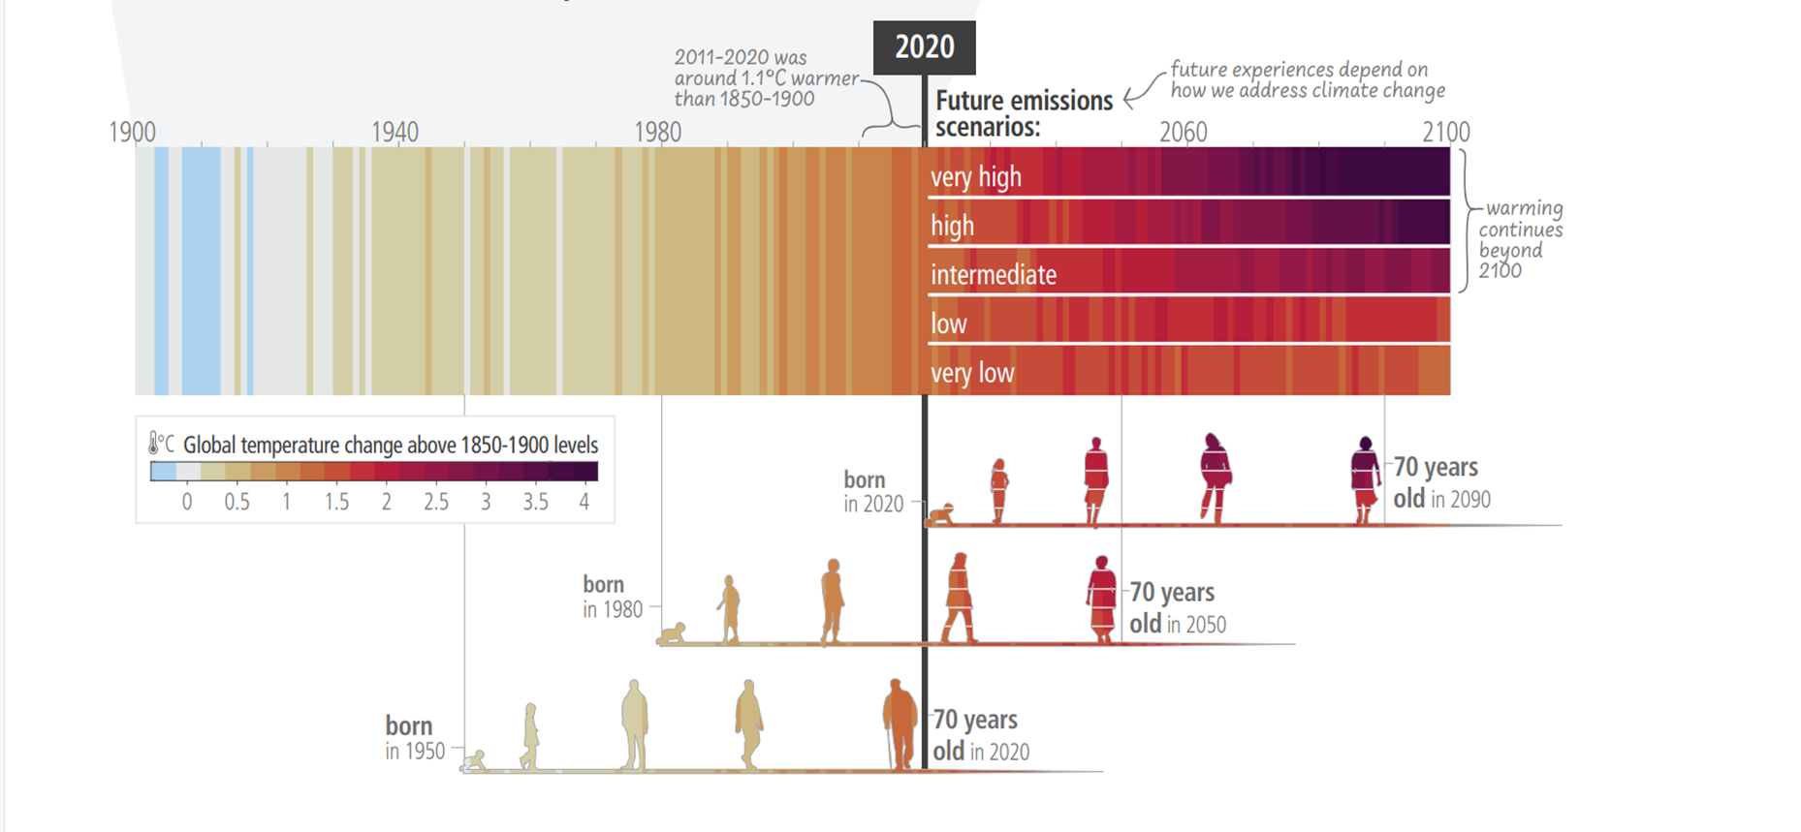
Background:
Climate change is a threat to human well-being and planetary health
Global warming: continue
intensify
Source: Synthesis report, Sixth Intergovernmental Panel on Climate Change, 2022
Adverse impacts caused by climate change will continue intensify
Notes:
Climate change is one of global – biggest public health threats. The model projections below present climate hazards under a high emissions scenario, Representative Concentration Pathway 8.5 [RCP8.5] (in orange), and a low emissions scenario, [RCP2.6] (in green). The text boxes describe the projected changes averaged across about 20 models (thick line). The figures also show each model individually and the 90% model range (shaded) as a measure of uncertainty and, where available, the annual and smoothed observed record (in blue).
Under a high emissions scenario, compared to 1990, in 2100, mean annual temperature is projected to rise by about 4.5°C, the number of days of warm spell is projected to increase from less than 10 days to about 170 days in 2100, the number of days with very heavy precipitation is projected to increase by about 7 days with increasing the risk of floods, and the longest dry spell is indicated to increase by about 10 days, with continuing large year-to-year variability.
Latest report of Intergovernmental panel on climate change warned that global warming continue intensity and adverse health effects of the climate change continue intensify. Our younger generation our children and grand children will be living in this situation
Globally, healthcare sector is confronted with challenges from climate change and environmental threats.
Increases in the severity and frequency of extreme weather events such as flooding, droughts, and heatwaves, as well as changing rainfall patterns and higher temperatures are already being experienced in Lao PDR.
As with many countries in the region, Lao PDR is expecting more extreme weather, an increase of up to 30% of monsoonal rainfall and temperature rises of 2–3 °C by 2050, which will have a severe impact on health and on the health system.

Slide 3
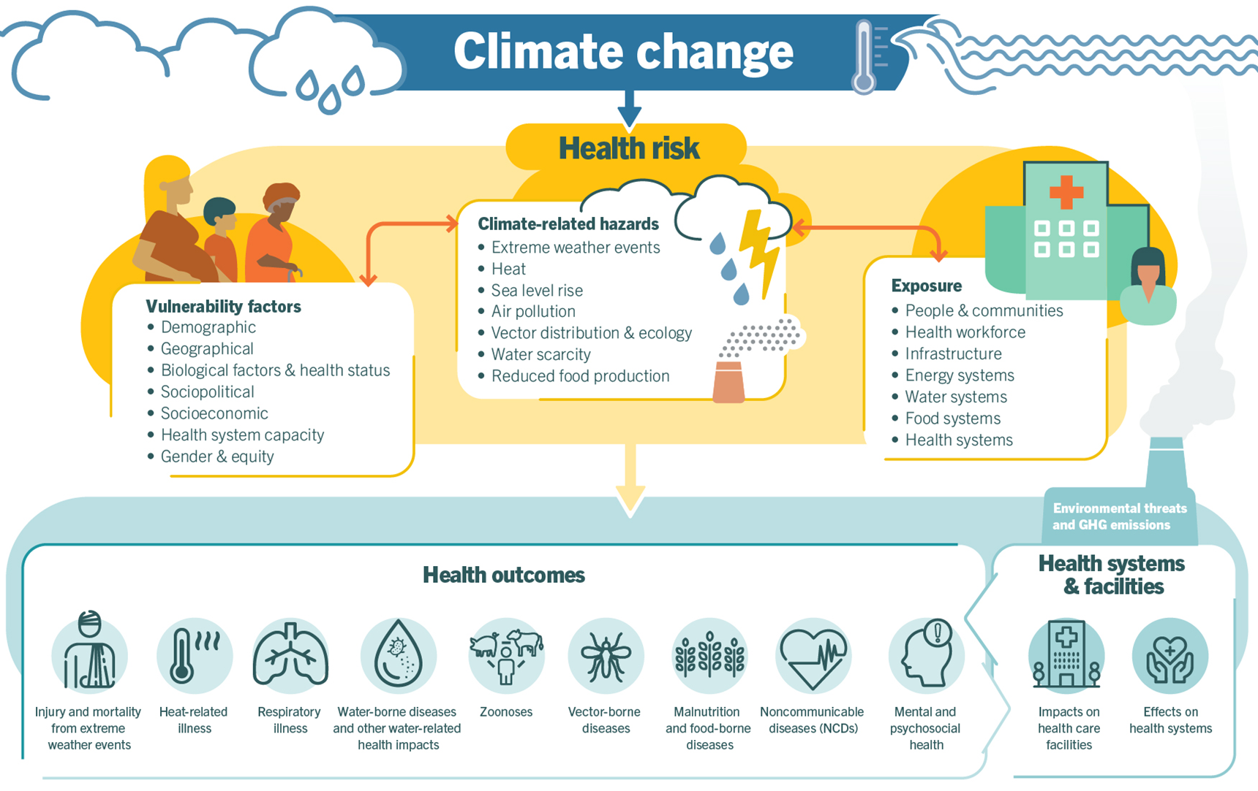
Part 1: CC effects on our health in direct and indirect ways
  Mortality is projected to increase, with mid-range emissions scenarios projecting up to 250 000 additional deaths per year by 2050.
  Demand for healthcare services will increase as the health effects of climate change
Protecting food, water and air as fundamental determinants of health is important for climate-resilient development
Notes:
Climate change is a determinant of health and influences a wide range of other social and environmental determinants of health.
Climate change impacts health in direct and indirect ways
Direct effect includes death and injury caused by frequent extreme weather events, such as heatwaves, storms and floods;
Furthermore, climate change is undermining many of the social determinants of good health, such as livelihoods, equality and access to health care and social support structures. The indirect effects of climate change result from, for example, food, nutrition and water insecurity; increasing transmission of vector- and water-borne diseases; the disruption of health care systems and water and sanitation supplies; increased health inequalities; and
climate-induced displacement and migration of communities
Climate change has contributed to malnutrition in all its forms in many regions, including undernutrition, overnutrition and obesity, and to disease susceptibility,*** especially for women, pregnant women, children, low-income households,
Indigenous Peoples, minority groups and small-scale producers – IPCC WG II (8).***

Slide 4
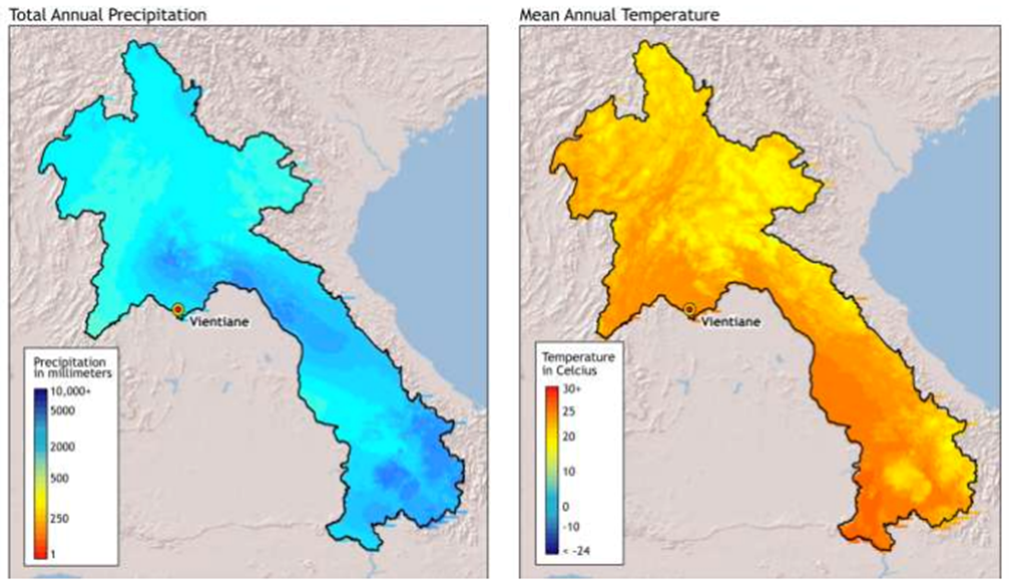
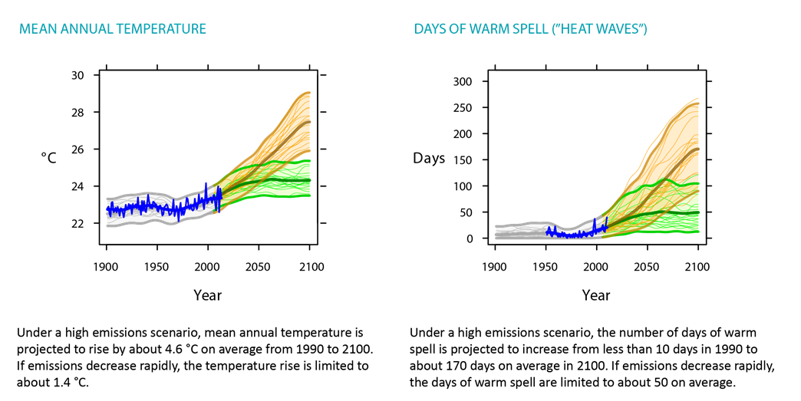
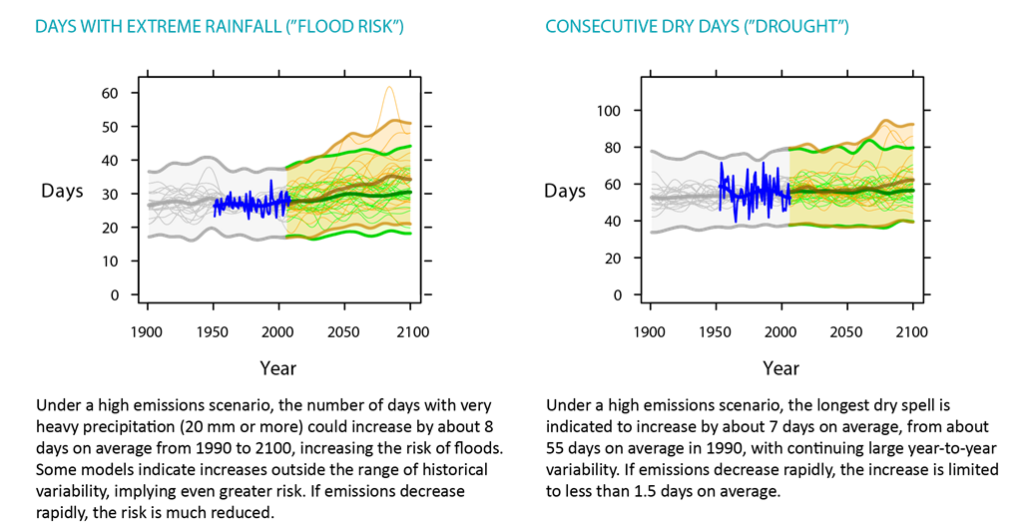
National health vulnerability assessment results in the Lao PDR
South: mean annual rainfall (10–30%)
North: flash floods
Flood: rainy seasons shorter/more intense.
Droughts: dry seasons are getting longer, hot spell
Notes:
Climate change is expected to cause an increase in mean annual rainfall across eastern and southern areas of the country by up to 10–30% during the wet season, including an increase in the intensity and frequency of extreme events such as flooding (Figure 3). Mountainous areas across all provinces are expected to face increased vulnerability to flash floods.3
Projected changes in temperature in the Lao People’s Democratic Republic averaged across about 20 models (thick line). The figures show each model individually and the 90% model range (shaded) as a measure of uncertainty and, where available, the annual and smoothed observed records (in blue). A “warm spell” day is a day when the day’s maximum temperature, and that of at least the six consecutive previous days, exceeds the 90th percentile threshold for the time of year. Source: Climate change and health in the Western Pacific region. Geneva: World Health Organization; 2015.
Dry seasons are getting longer, while rainy seasons tend to be shorter and more intense.

Slide 5
VA: current and further climate change risks to health in the country
Injury or death: Increases in extreme weather events, resulting in increased risk of injury or death due to heat waves, flooding and drought.
The direct impacts of floodwater: damage to housing, Water sanitation in health care facility
Heat-related deaths among elderly people expected to increase to 72 per 100 000 by 2080 (3 per 100 000 worldwide in 1961–1990).
Waterborne Diseases: increases in dry season and account for 11% of deaths among children under 5.
Dengue: Increase vector borne diseases, especially dengue
Undernutrition: Agricultural losses due to changing weather patterns will affect food security and put rural populations at risk of under nutrition.
Notes:
Climate change may increase the risk and severity of droughts and floods in the Lao People’s Democratic Republic.
The direct impacts of floodwater include drowning, physical trauma, and damage to housing and health-care facilities.
Indirect impacts of flooding include an increase in waterborne diseases due to the spread of faecal pathogens in areas with unsafe or insecure water and sanitation systems.
Periods of extreme heat threaten health due to heat-related illness and exacerbations of chronic medical problems. In the Lao People’s Democratic Republic under a high emissions scenario, heat-related deaths among elderly people are expected to increase to approximately 72 per 100 000 by 2080, compared with 3 per 100 000 worldwide during the baseline period 1961–1990
Extreme weather events and climate are major drivers of waterborne disease. In the Lao People’s Democratic Republic, diarrhoeal diseases account for 11% of deaths among children aged under 5 years
Climate change-related increases in temperature and precipitation in an area could substantially increase the transmission of dengue. An increase of 1 °C in the average mean temperature may lead to an increase in the number of dengue cases worldwide.

Slide 6
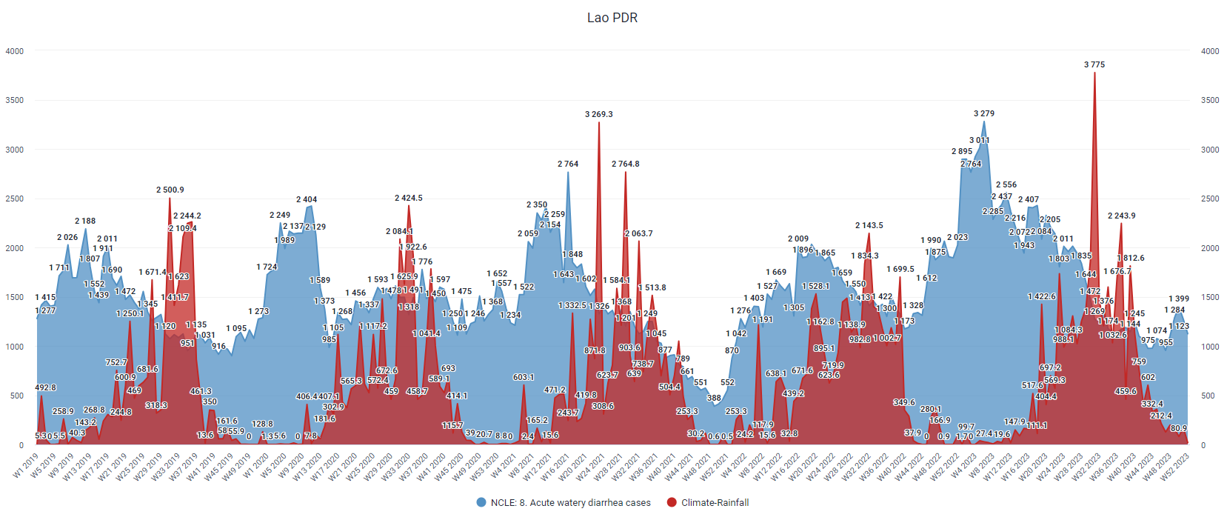
Current health impact:
Rainfall and Diarrhea Cases in Lao PDR 2019-2023
Notes:
The relationship between rainfall patterns and diarrhoeal disease was assessed based on climate and weather data collected from the Department of Meteorology and Hydrology and diarrhoeal cases taken from the inpatient disease database (DHIS2) for 2016–2019. The results, as shown in Figure 4, presented a clear correlation between increased rainfall and cases of hospitalized diarrhoeal diseases. 0.0 10.0 20.0 30.0 40.0 50.0 60.0 70.0 80.0
Diarrhoea cases per 1000 population
Provinces

Slide 7
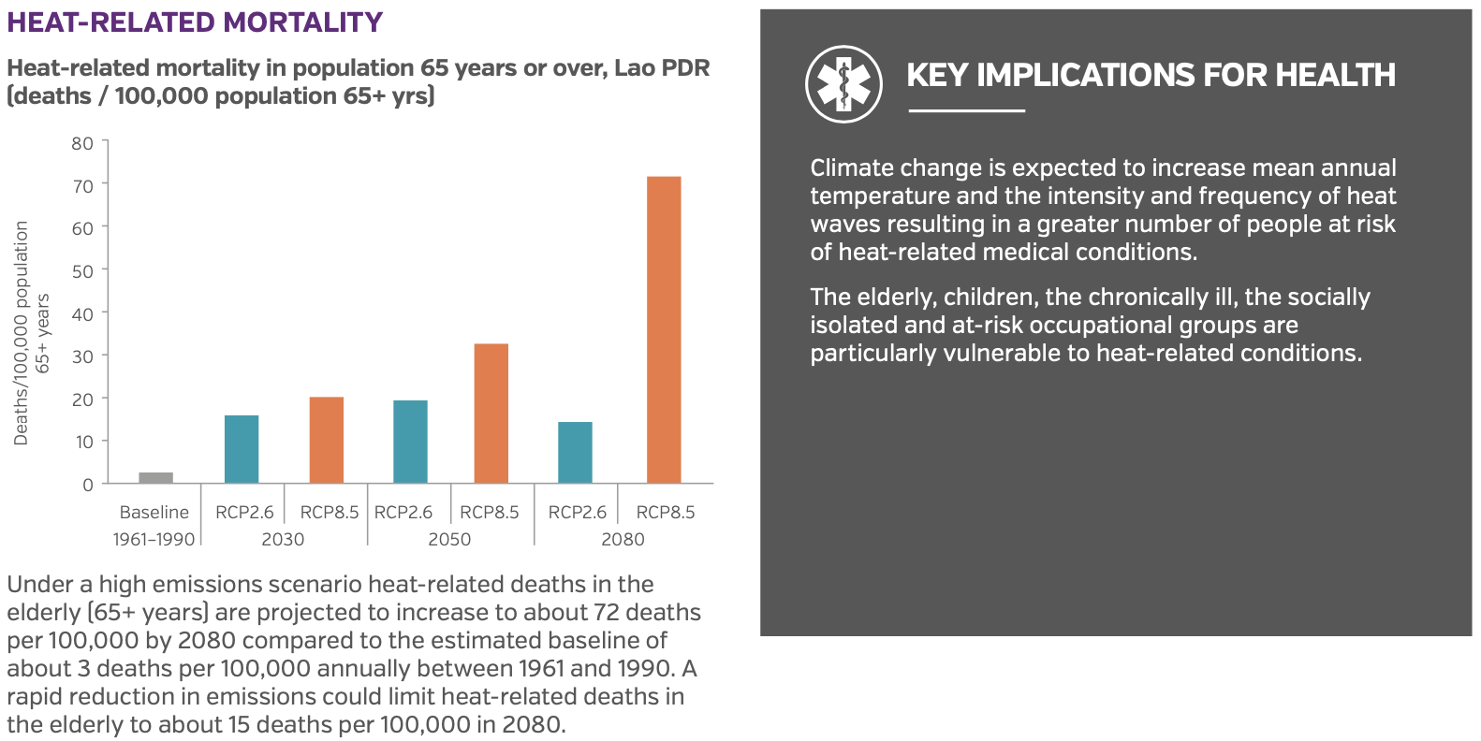
Further health impacts of CC in the country
WHO, 2015

Slide 8
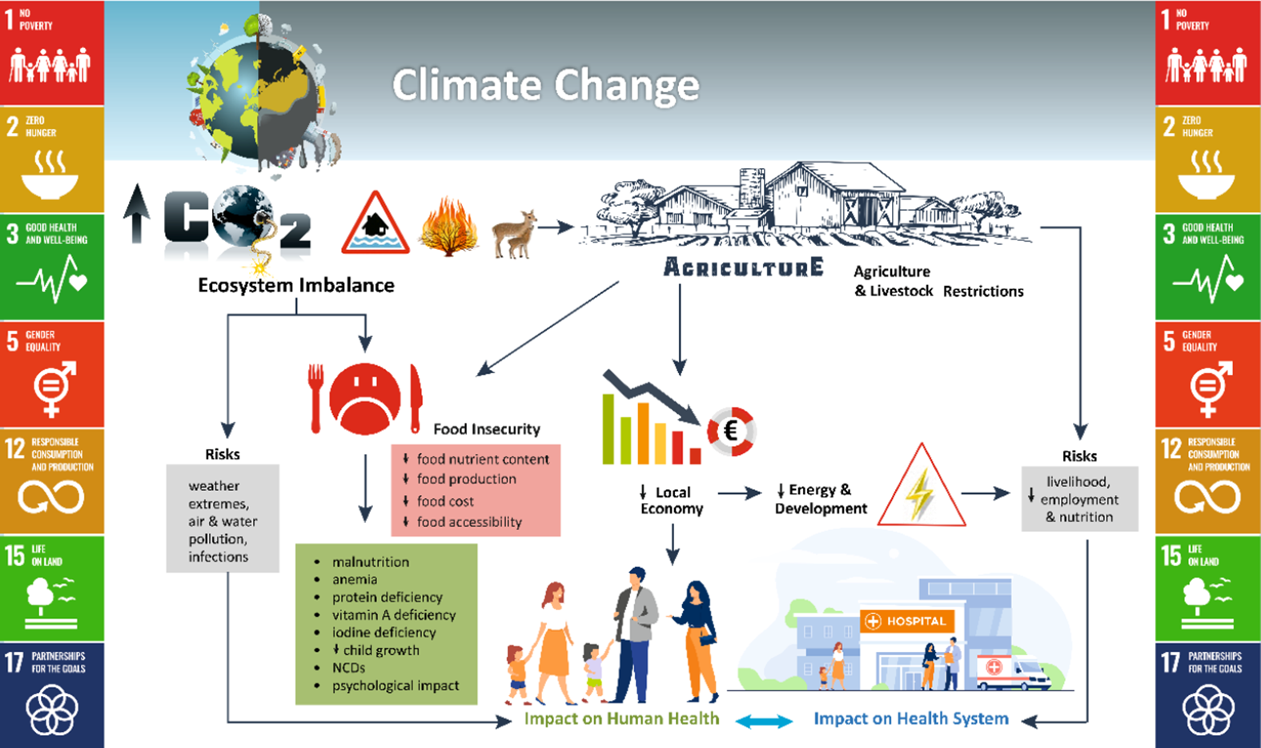
Part 2: CC impacting food, diet and health
CC is impacting food, diet, health, WASH that are fundamentals for good nutrition
  High global prevalence of all forms of malnutrition (IPCC report)
  Food security, food production and food price
Globally undernutrition (wasting and stunting) declines slowly
Drivers are food, agriculture, transportation, urban design and land use
  Crop failures, Reduced food production, Extreme weather events, droughts and flooding
  Increased food-borne and other infectious diseases (WBDs
Notes:
IPCC working group reported that the “impacts of climate change on food systems affect everyone” (16).
Over 800 million people are undernourished
Over 30 percent of global population face various deficiencies of micronutrient,
while over 600 millions are obese. CC is impacting food, diet, health, WASH that are fundamentals for good nutrition
Reduced Agricultural Productivity: Changes in temperature and precipitation patterns can lead to decreased crop yields, affecting the availability and stability of food supplies.
Extreme weather events: droughts and floods, can damage crops and disrupt planting and harvesting cycles.
Water Scarcity: Climate change can alter the availability and distribution of water resources, impacting irrigation systems and reducing the water supply needed for agriculture. This can lead to reduced crop production and increased competition for water between agricultural and non-agricultural uses.
Food Distribution Disruptions: Extreme weather events, such as hurricanes, storms, and heavy rainfall, can damage infrastructure critical for food storage and transportation. This can lead to supply chain disruptions, increased food spoilage, and higher food prices, making food less accessible to vulnerable populations.

Slide 9
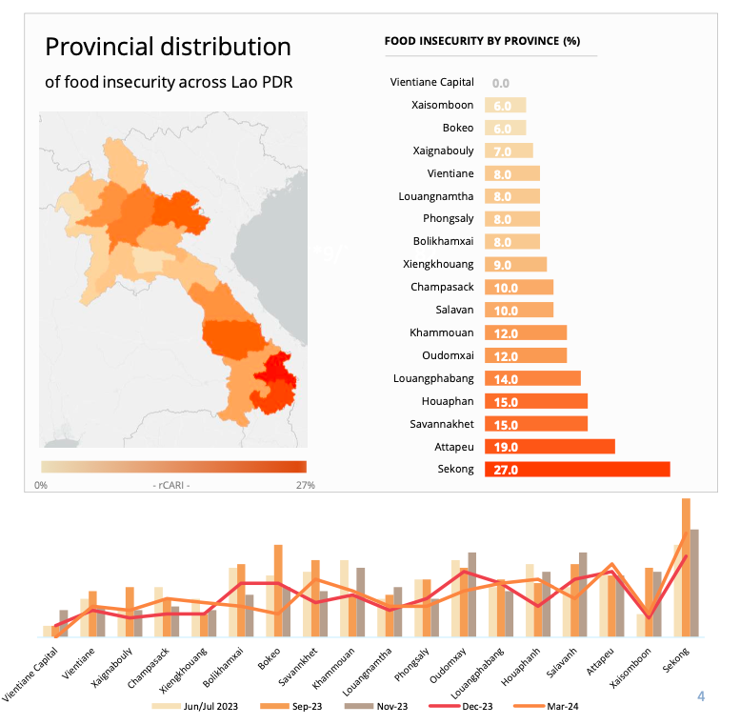
Food Insecurity in Laos
The prevalence of food insecurity remains a concern in Lao PDR
Impact of climate change on food security
Reduced Agricultural Productivity: Changes in temperature and precipitation patterns can lead to decreased crop yields
Extreme weather events: droughts and floods, can damage crops and disrupt planting and harvesting cycles.
Water Scarcity: Climate change can alter the availability and distribution of water resources, impacting irrigation systems and reducing the water supply needed for agriculture.
Food Distribution Disruptions: Extreme weather events, such as hurricanes, storms, and heavy rainfall, can damage infrastructure critical for food storage and transportation.
WFP is monitoring Food security in Lao PDR
Source: Lao PDR Food Security Monitoring March 2024, WFP
Notes:
By addressing these two priorities in an integrated way we can accelerate progress in both CC and NUT (SDG13 and SDG3)
Benefits to health, WASH, NUT and sustainable development
Triple win approach (health co-benefit, society and environment)

Slide 10
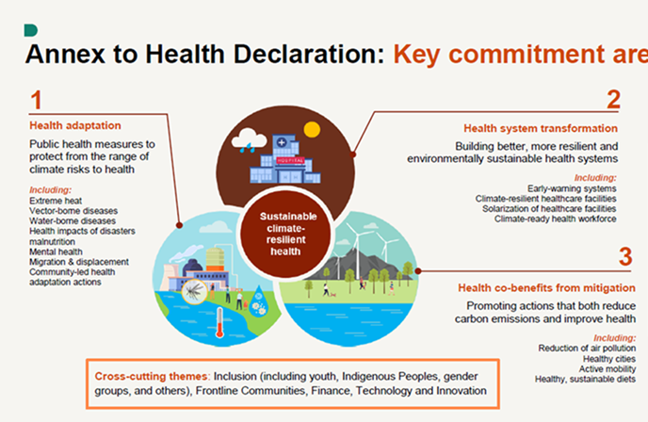
Part 3: Climate actions to address the health risks of climate change global and regional levels
Addressing the complex, compound and cascading risks1 resulting from climate change
requires transformation across society and systems and multisectoral collaborations.
A climate-resilient development approach recognizes necessary integration of mitigation and adaptation planning
  to advance sustainable development, and determine synergies

Slide 11
I-CAN Global Initiative
Goal: Foster collaboration to accelerate transformative action to address the critical nexus of CC and NUT
Launched during COP 27 in Egypt. Co-led by MOFA Egypt and WHO CO in Egypt
Contributing to achieve SDGs 2, 3 and SGD 13
Sustainable, climate resilient diet: win-win approach: health, social protection and WASH systems
4 outcome indicators:
  # of MSs include NUT in the NDC
  # of MS s with National NUT Plans that includes CC
  # MSs with the National food-borne disease guideline
Notes:
I-CAN Launched in Egypt during COP 27 by Egyptian government in partnership with GAIN WHO FAO, and other DPs.
Ending hunger and all forms of malnutrition depends on not only food system but also depends on health, WASH and social protection. Therefore, Climate action positively impacting health, WASH systems, also gives benefit to NUT and sustainable development, for win-win solutions.
By addressing these two priorities in an integrated way we can accelerate progress in both CC and NUT. (SDG13 and SDG3)

Slide 12
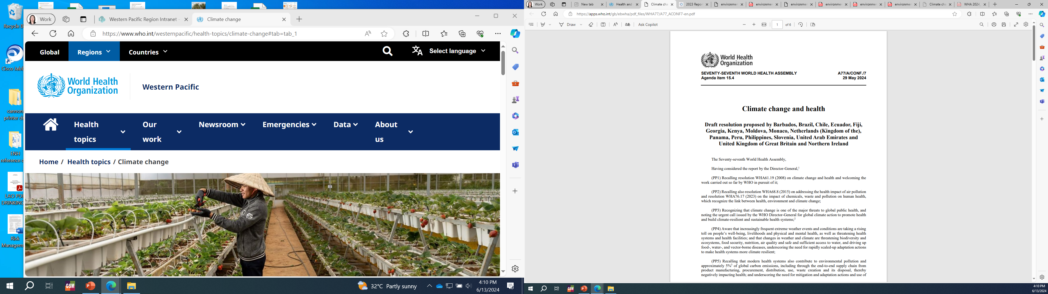
WHA 2024 Resolution A/77
WHA77 set new ambitions
Resolution on climate change and health,
to build climate resilient sustainable low carbon health for all for sustainable development
Sustainable NUT and WASH systems
I-CAN included
WHO’s Fourteenth General Programme of work for the period 2025-2028 (GPW14)
CCH is one of its six key strategic objectives
  HNAP is for building CR low carbon sustainable health system
Notes:
he Seventy-seventh World Health Assembly (WHA77) was held in Geneva, Switzerland, on 27 May – 1 June 2024. The theme of this year’s Health Assembly was: All for Health, Health for All.
WHA77 set new ambitions for the Member States and the WHO in the area of climate and health by the adoption of a dedicated Resolution on climate change and health, as well as the WHO’s Fourteenth General Programme of work for the period 2025-2028 (GPW14) with the response to climate change being selected as one of its six key strategic objectives.

Slide 13
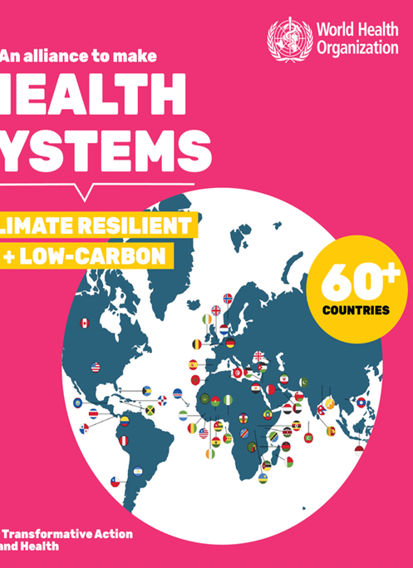
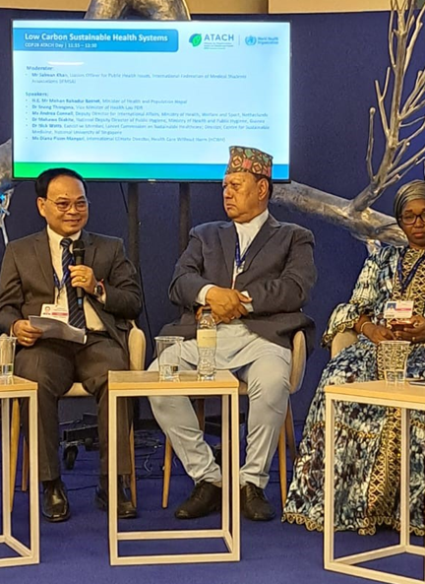
Part 4: Global climate actions translated into local actions
Leadership role of Lao MOH in enhancing climate and health NEXUS
Lao MOH representatives in COP 27, 28
Lao MoH is chair of working group Global Alliance
LAO MOH signed on Global CCH Decleration
ATACH (The Alliance for Transformative Action on Climate and Health established as a mechanism for collaboration and coordination that:
    provides a platform for knowledge, best practice
    monitors global progress
    facilitates and coordinates technical assistance provision.
    generates collective action to address global challenges such as access to finance for developing countries
Over 86 countries have committed to these initiatives
Lao PDR joined the ATACH in 202.
    To develop and implement the HNAP is
    to assess carbon emission
    to expand the safe-clean-green-climate resilient health care facility initiative
Notes:
86 Countries and DPs joined
HNAP is key to implement the commitment to build a climate-resilient and low-carbon sustainable health system as part of the 26th UN Climate Change Conference of the Parties Health Programme.
UK co-led the successful COP26 Health Programme, where over 60 countries have now signed up to build climate resilient and/or sustainable, low carbon health systems.
To maintain momentum, the Alliance for Transformative Action on Climate and Health (ATACH) was established as a mechanism for collaboration and coordination that:
provides a platform for knowledge, best practice and expertise sharing.
monitors global progress and promotes accountability for the commitments.
facilitates and coordinates technical assistance provision.
generates collective action to address global challenges such as access to finance for developing countries, and greening supply chains.

Slide 14
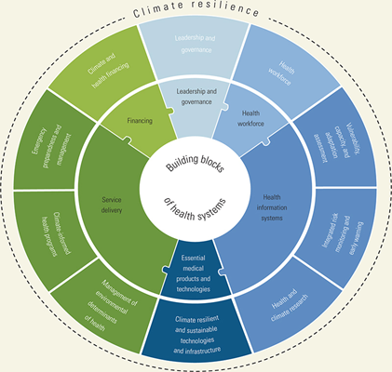
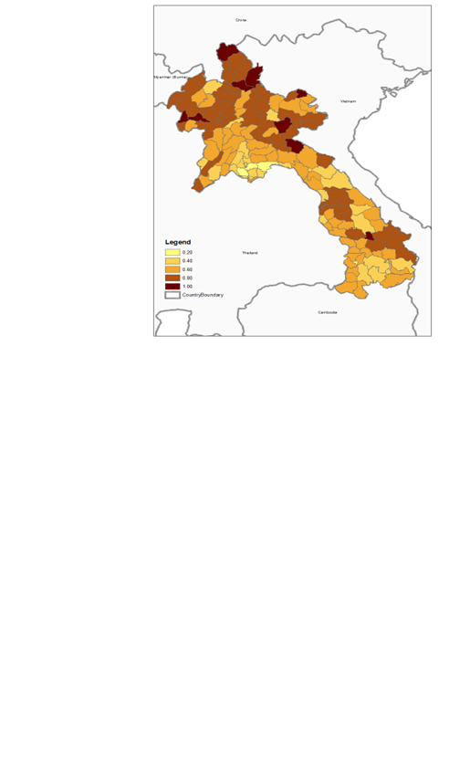
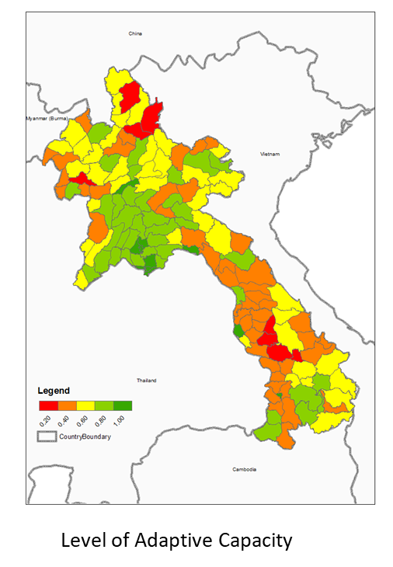
Building climate resilient health system
(H-NAP) in the country
Menu options
Strategic actions
160 adaptation options developed, based on health system building blocks.
References: World Health Organization’s Operational Framework for Building Climate Resilient Health Systems, 2016, Lao PDR MOH Health Adaptation Plan, 2023.
Target communities:
National, sub-national
Vulnerable community
Vulnerable health facility level actions
Note: Most vulnerable areas to climate change (brown color, Map 1)
Low level of Adaptation
(red and orange color, Map 2)
Notes:
Main goal is to reduce vulnerability to current and future health effects of climate change and increase health adaptation capacity by mainstreaming of climate change adaptation measures into health sector development planning (9th HSDP), MoH, PHDs and climate sensitive disease, WASH programmes
High level commitment Vice Minister leadership support (COP 26, ATACH co-chair of WG)
Enhanced Health and environment sector collaboration and coordination (COP 26, COP 27, COP28)
HNAP finalized and approved by high –level official consultation meeting in Sept 03
National CCH training (9 modules) trained over 70 national health care workers/managers of PH programmes, July 17-19, 2023
HNAP planning and prioritization workshops and training for 17 provincial health departments, Sept 2-4, Oct 6-8 2023

Slide 15
V&A for designing health and NUT adaption actions
Approximately 70% of the Lao PDR population relies on subsistence agriculture, making them acutely vulnerable to extreme weather events and other natural disasters.
  Impacts are likely to include food insecurity and access to other services
  One-fifth of the country’s population consumes less than the minimum dietary energy requirements
Mainstream CC in existing NUT NAP: The 2010 health vulnerability assessment concluded that the country already has poor overall indicators on nutritional status, especially in rural areas where malnutrition is often chronic.
V&A: CC effects on NUT (rates of undernutrition and anaemia and long-term adverse health) and food productivity outcomes (production and prices),
  example, in 2018 flooding damaged crops and limited access to roads, resulting in malnutrition and then an acute outbreak of 343 cases of beriberi in Khammuane province.
  Revise adaptation actions under 8: Climate informed program
More evidence/data needed
Notes:
For

Slide 16
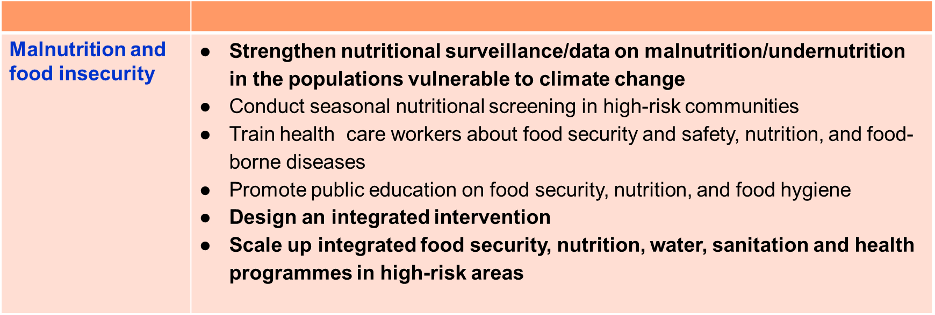
PART 5: Components 8: Climate informed health programmes of the Lao MOH HNAP
Component 8. Climate informed programmes

Slide 17
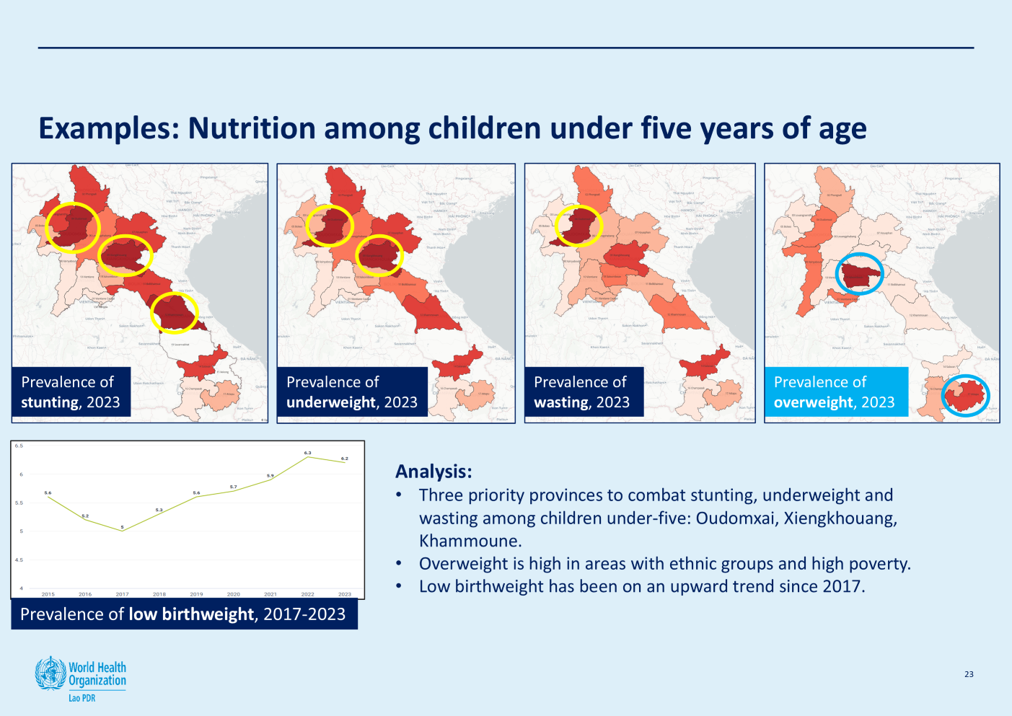
Strengthening Nutrition Surveillance
Old Manual Forms | Revised Forms Digitalize | Tracking Individuals
MCH data capturing form version 2.0 Cannot estimate the nutrition indicators because of counting number of visits instead of number of children | MCH data capturing form version2.1 Able to calculate nutrition indicators Collect more data (anaemia, overweight, etc) SOP for nutrition monitoring → Introducing 20 national nutrition indicators Data quality assurance guidelines Routine mapping of infrastructure for data reporting | Individual mother and child tracking system Able to calculate more indicators Capturing granular data Capturing quality of care data Routine collaborative action plan development procedure throughout 4 levels of governance Dictionary of data and indicators

Slide 18
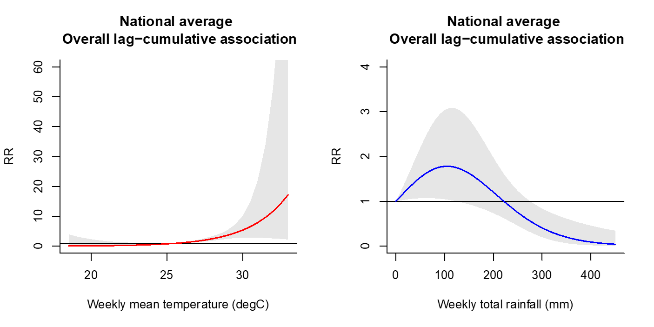
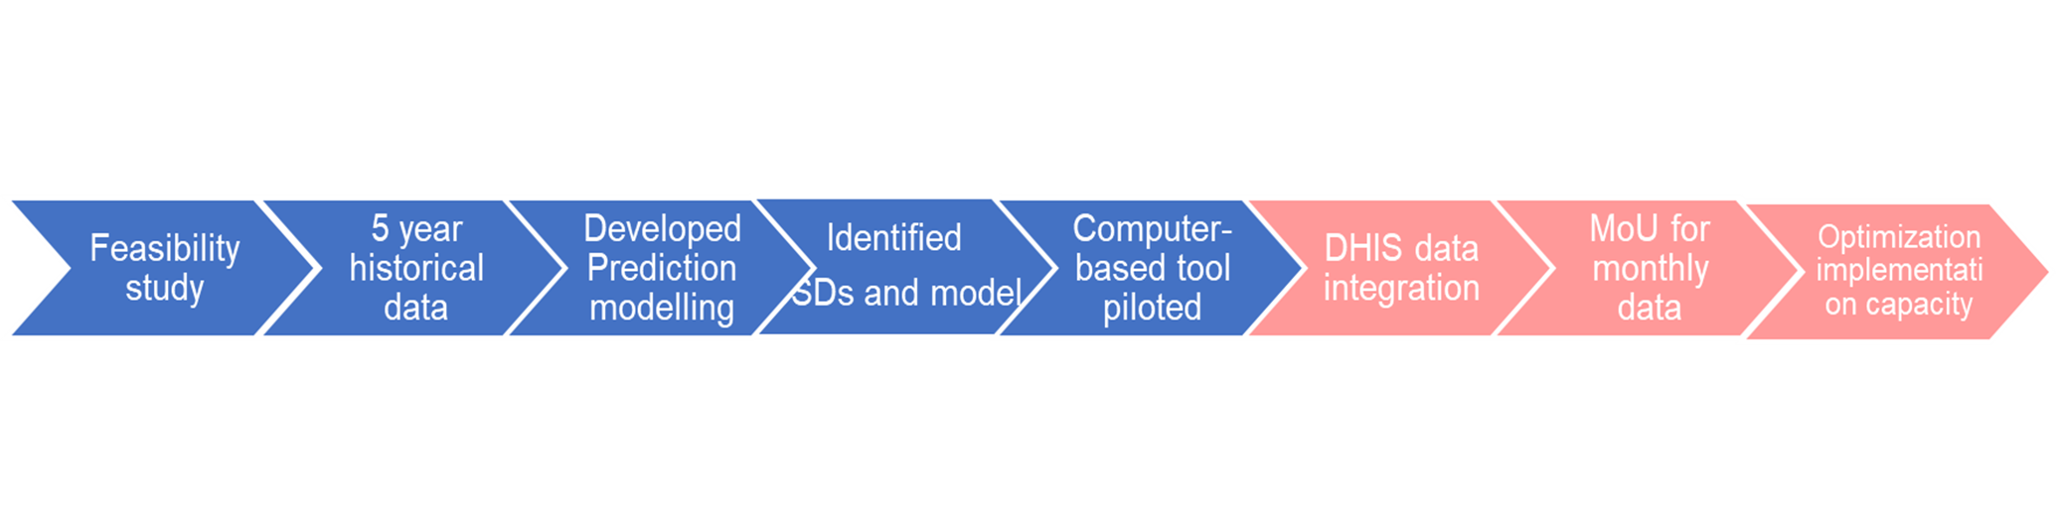
Establishing the Health Early Warning and Response system in the country
The national average associations between
dengue& temperature
Dengue and rainfall
Data 2018-2022
Reference: WHO Consultants report 2022

Slide 19
Further directions could be to assess triple burden and take triple win-win-win actions
Obesity
Undernutrition
Climate change
Triple burden challenges
  Interacted each others at biological, physiological societal levels
  Share common underlying societal drivers
  Recommendations:
  Double or triple duty work
  Triple wins
  Joining up the silos of thinking and similtaneousely actions to address common systemic drivers
  SDG 3 and SDG 13
Source: The Global Syndemic of Obesity, Undernutrition and climate Change: the Lancet Commission report
Notes:
The Lao MOH – CCH Adaptation strategy and HNAP will contribute to the implementation of the 2030 Agenda for Sustainable development by contributing to address specific targets of climate change, WASH and health related SDGs.
In turn, implementation of the SDGs will contribute to reducing CC and environmental risks to health in the country.
The Lao MOH – CCH Adaptation strategy and HNAP will contribute to the implementation of the 2030 Agenda for Sustainable development by contributing to address specific targets of climate change, WASH and health related SDGs. The Lao MOH – CCH Adaptation strategy and HNAP will contribute to the implementation of the 2030 Agenda for Sustainable development by contributing to address specific targets of climate change, WASH and health related SDGs.
In turn, implementation of the SDGs will contribute to reducing CC and environmental risks to health in the country.
In turn, implementation of the SDGs will contribute to reducing CC and environmental risks to health in the country.

Slide 20
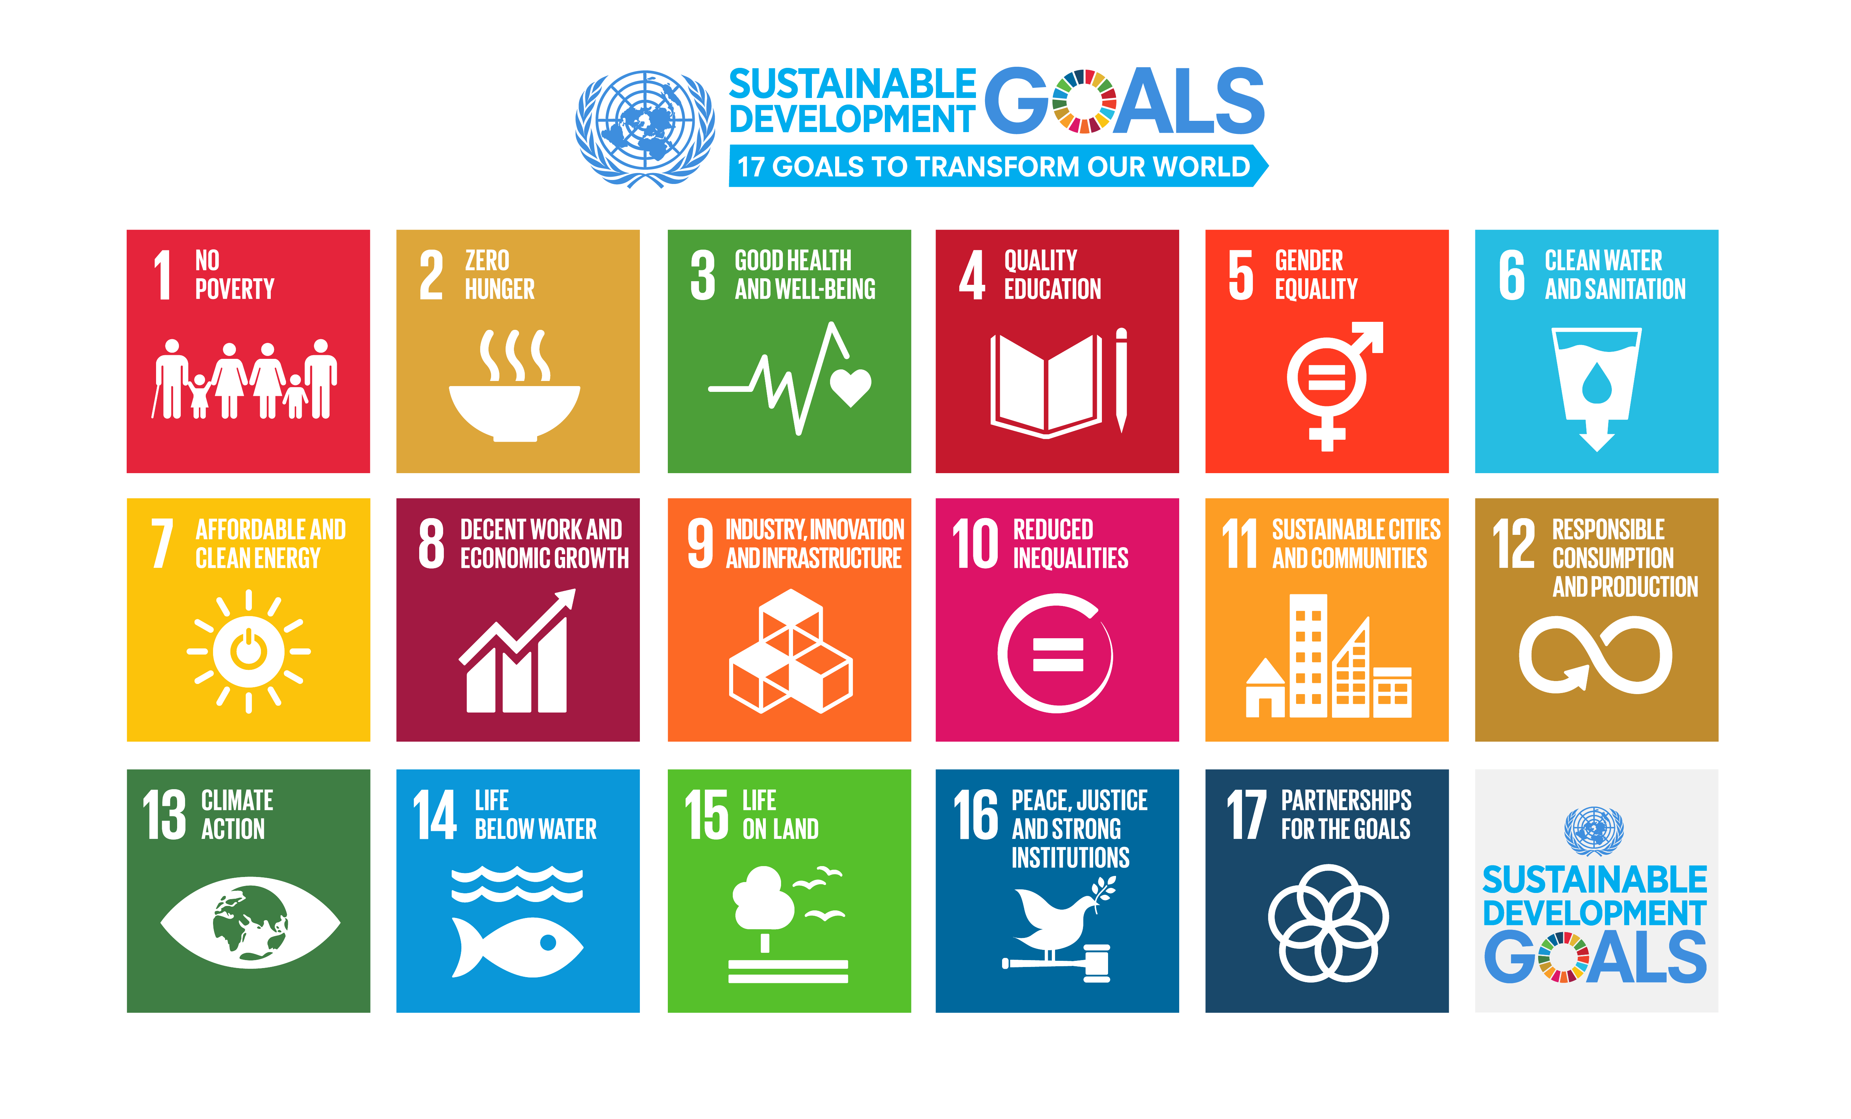
Summary: CC – Health –Food – Sustainable Development
CC is impacting health and food insecurity
HNAP key for assessing and designing CR Health, Food, Nut systems
Multisectoral actions for Sustainable development (SDG, NDC, CCH Strategy HNAP): By addressing these two priorities in an integrated way we can accelerate progress in both CC and NUT (SDG13 and SDG3)
Benefits to health, WASH, NUT and sustainable development
Triple win approach (health co-benefit, society and environment)
triple win-win-win approach
Notes:
-

