Slide 1

SUN CSA Laos
Advocacy Working Group
28 AUGUST 2024

Slide 2
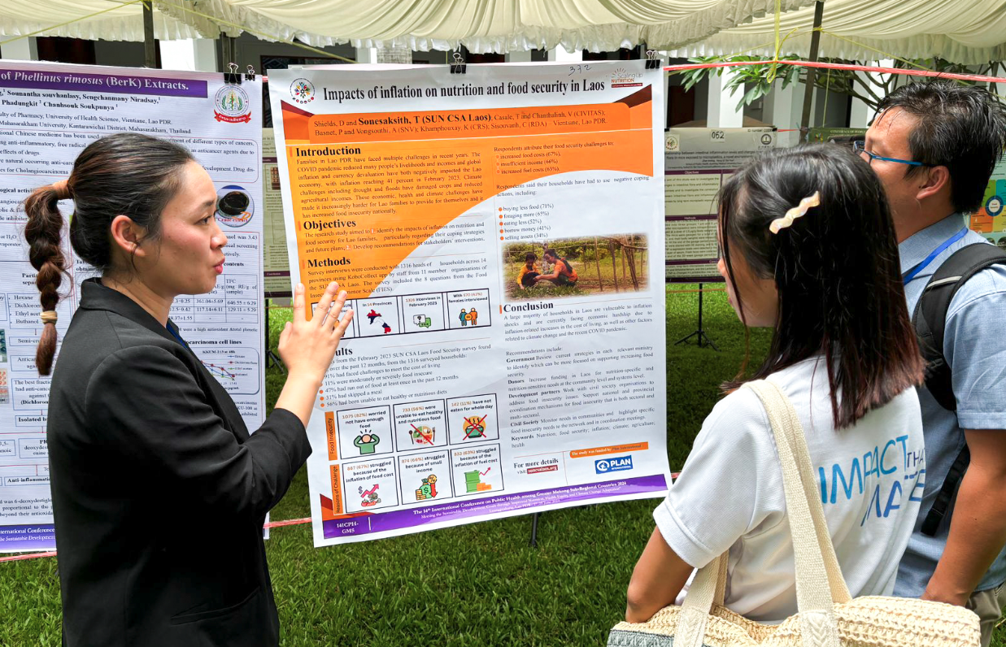
Advocacy Working Group Agenda
AWG Agenda:
Review advocacy priorities and recent activities
Share member recent advocacy activities
Discuss and agree on priorities for 6-12 months
Open discussion
Summary and closing

Slide 3
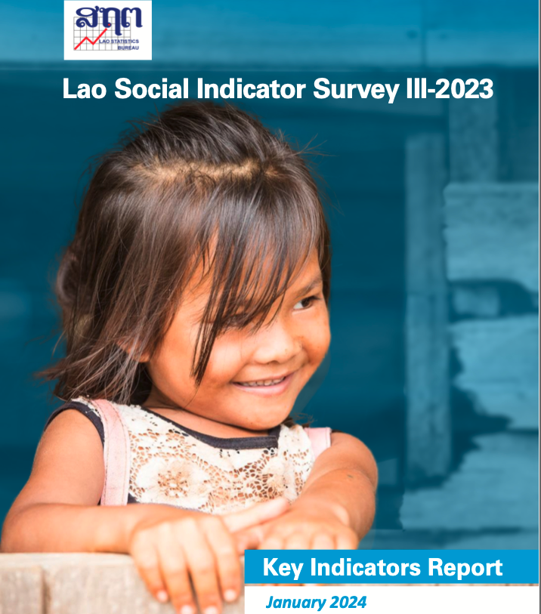
Advocacy Working Group Task List
TASKS: (February 2024)
Review member advocacy actions based on projects and share with Secretariat by 15 March (all orgs)
Share NIPN online link to members if possible. (Secretariat)
Contact Gender WG and HR WG to introduce the Workplace BF Awards campaign and discuss how to work together. (David)
Add breastfeeding to NNF comments (David)
Create Workplace BF Award promotion posts on Facebook. Develop activity plan for coming 12 months. (Secretariat)
Maybe SUN CSA can create a new campaign to highlight “Climate Change Innovation for Nutrition Food Security in Laos” (MC)
Ask CRS (Kelley) for research priorities and compare to advocacy actions. (Secretariat)

Slide 4
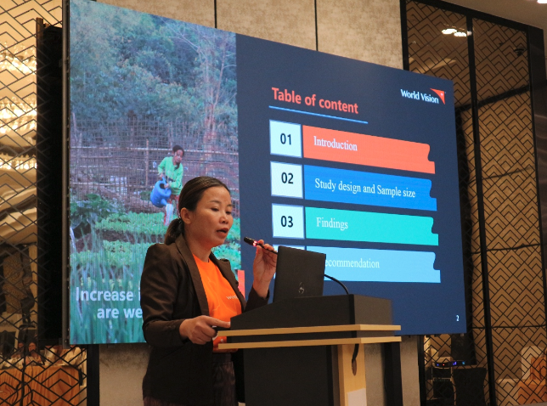
SUN CSA Advocacy Priorities
Advocacy Priorities:
1000 Days
Breastfeeding
Food Security – Climate Change
BMS Code
LSIS III results
ODF – Open Defecation Free

Slide 5
ADVOCACY ACTIVITIES FROM PAST 6 MONTHS
ກິດຈະກໍາສະໜັບສະໜູນໃນໄລຍະ 6 ເດືອນຜ່ານມາ
18 ກິດຈະກຳສະໜັບສະໜູນຮ່ວມ
ກິດຈະກຳທີ່ສຳຄັນໄດ້ແກ່:
ການຄົ້ນຄວ້າ ແລະ ການລົນນະລົງກ່ຽວກັບການຄໍ້າປະກັນດ້ານສະບຽງອາຫານ
ກິດຈະກຳການລົນນະລົງໃນໄລຍະສັບປະດາສາກົນການລ້ຽງລູກດ້ວຍນໍ້ານົມແມ່
1. ລາງວັນກ່ຽວກັບການລ້ຽງລູກດ້ວຍນໍ້ານົມແມ່ຢູ່ບ່ອນເຮັດວຽກ
2. ວີດີໂອການສະໜັບສະໜູນການລ້ຽງລູກດ້ວຍນໍ້ານົມແມ່
ກອງປະຊຸມວຽກງານສະໜັບສະໜູນ SUN CSA
NNF & NIPN
ກອງປະຊຸມ SUN CSA ລາວ: ການປ່ຽນແປງສະພາບດິນຟ້າອາກາດ ແລະ ໂພຊະນາການ
ແລະ ອື່ນໆ
18 Joint Advocacy Activities
Key actions include:
Food Security Research & Campaign
World Breastfeeding Week Campaigns
  Workplace BF Awards
  Breastfeeding Videos
SUN CSA Advocacy Working Group
NNF & NIPN
SUN CSA Conference: Climate Change and Nutrition in Laos
ETC…

Slide 6
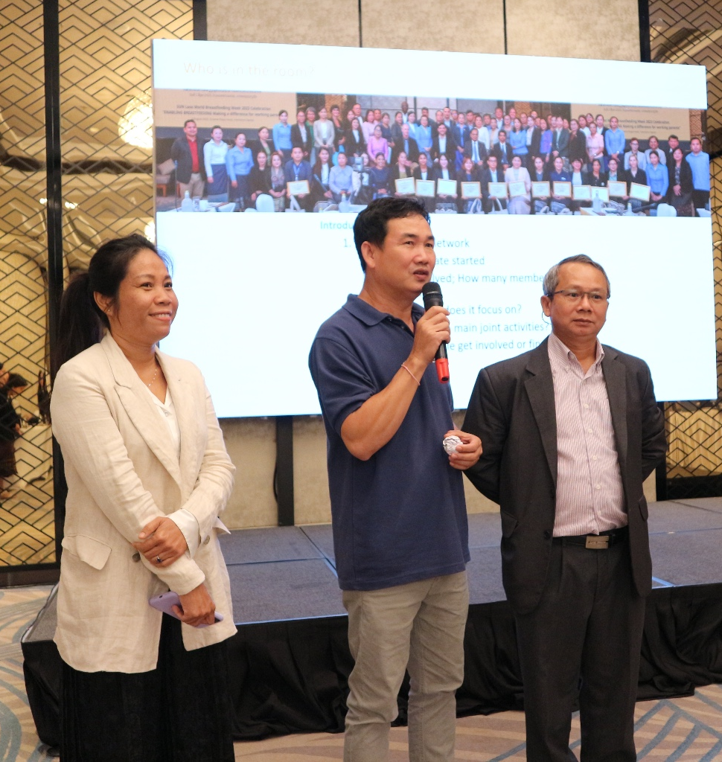
Food Security & Climate Change
Conducted joint Food Security Research & Campaign
9 videos of member’s food security work
Add our joint Food Security Research to NNF comments
Combined our food security research with UNICEF and WFP to develop a joint presentation for donors and the Prime Minister of Laos
SUN CSA Conference: Climate Change and Nutrition in Laos - enhance our understanding of how climate change impacts nutrition in Lao PDR and how targeted development interventions can effectively mitigate these challenges at various levels
Notes:
Our 64 nationwide membership

Slide 7
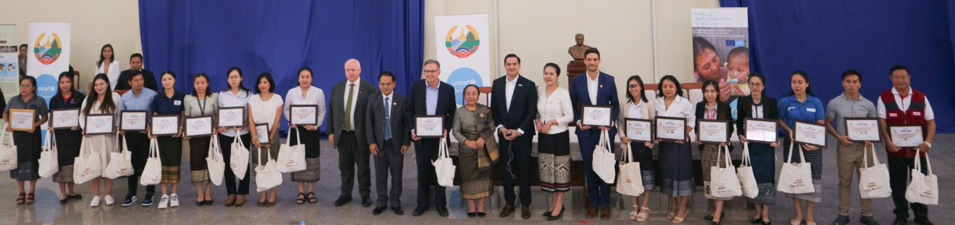
Breastfeeding
Add breastfeeding to NNF comments
Workplace Breastfeeding Awards 2024 – 35 organisations participated.
3 We love breastfeeding in Laos videos
Online Competition – “I support breastfeeding”
Breastfeeding social media toolkit- Key massage through SUN CSA FB Page
Notes:
Our 64 nationwide membership

Slide 8
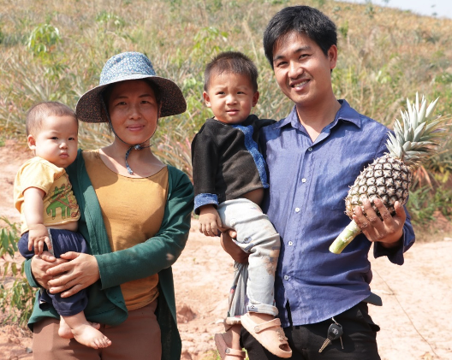
Updates from members on advocacy actions
Advocacy Priorities:
1000 Days
Breastfeeding
Food Security – Climate Change
BMS Code
LSIS III results
ODF – Open Defecation Free

Slide 9
Priority actions for next 6-12 months
Advocacy Priorities: | Advocacy Actions | Who Involved?
1000 Days
Breastfeeding | Model Hospital promotion Workplace Breastfeeding FB posts – encourage more businesses to participate | Secretariat, others?
Food Security – Climate Change | Promote CSO-INGO work via social media ENOUGH campaign? Nutrition Dialogues? (N4G Summit – March 2024) | Secretariat; all WVI
BMS Code | Public promotion of code?
LSIS III | Share key data – FB posts and graphics; summary sheets in Lao CSO-INGO projects responding to LSIS data – posts and videos? | Secretariat All; Secretariat
ODF Open Defecation Free

Slide 10
Priority actions for next 6-12 months
Advocacy Priorities: | Advocacy Actions | Who Involved?
N4G | Update results for BMS; gender etc. | Sec
Global Gathering | Nov 2024 – Rwanda – (CRS, ARMI, Secretariat - TBC) Promote key outcomes – Awards; …. | CRS, ARMI, Sec
ENOUGH |  | WVI

Slide 11
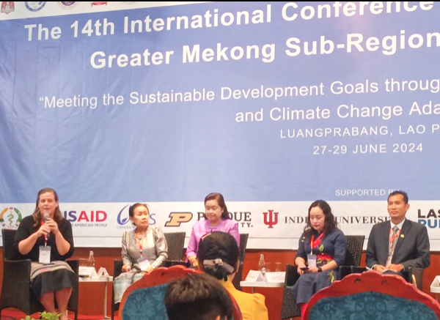
Using research in advocacy actions
What research can we use in these priorities?
Advocacy Priorities:
1000 Days
Breastfeeding
Food Security – Climate Change
BMS Code
LSIS III results
ODF – Open Defecation Free

Slide 12
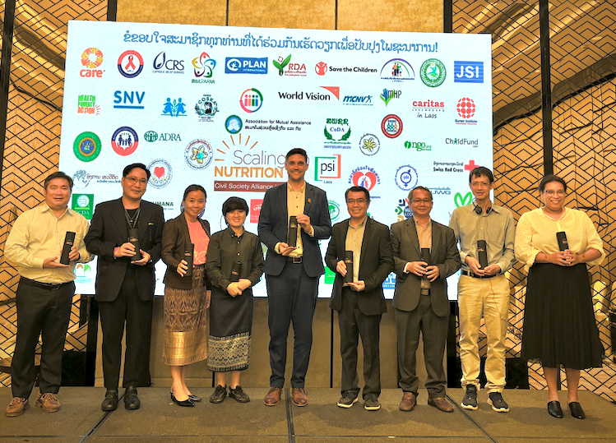
Next Steps
Tasks-events:
Global Gathering – Nov 2024
N4G Summit – March 2025
National Nutrition Conference – March 2025?
Next AWG meeting – February 2025

Slide 13































































Thanks to all members for Scaling Up Nutrition together!

