Slide 1

Developing a National Nutrition Research Agenda (NNRA) for Lao PDR 2023-2026
(ການພັດທະນາ ວາລະການຄົ້ນຄວ້າແຫ່ງຊາດ ທາງດ້ານໂພຊະນາການ ໃນ ສປປ ລາວ 2023-2026)
Advisors:
1. Dr Latsamy Siengsounthone (Lao TPHI, Lao PDR)
2. Prof. Gerald Shively (Purdue University, USA)
Present by:
Dr. Somphone Soukhavong (Lao TPHI)
August 2024

Slide 2
Problem and Rationale
Malnutrition is a primary contributor to high rates of mortality among children under the age of 5 years in Lao PDR (WHO, 2015).
Inequities in access to health and nutrition services are also a persistent problem.
At present, the knowledge base necessary for addressing these challenges is incomplete.
Multisectoral research on nutrition is needed to fill gaps in knowledge and improve the evidence base for policies and implementation.

Slide 3
Response
In response to the challenges identified above, this activity aims to develop a National Nutrition Research Agenda for Lao PDR.
The process of developing a research agenda, and priority setting, can help to better direct effort and guide the allocation of scarce resources among competing programs and activities.
In 2017, Lao TPHI developed an Adolescent research agenda one of these focused on adolescent nutrition
In 2018, Lao TPHI developed a National Health Research Agenda, which included 11 priority topics and 42 sub-topics. Only one of these focused on maternal and child health. This NNRA adds to that prior work.

Slide 4

The objectives of the NNRA:
To identify knowledge gaps, relevant research questions and the need for targeted nutrition research in Lao PDR.
To prioritize these identified needs and communicate them to stakeholder groups.

Slide 5
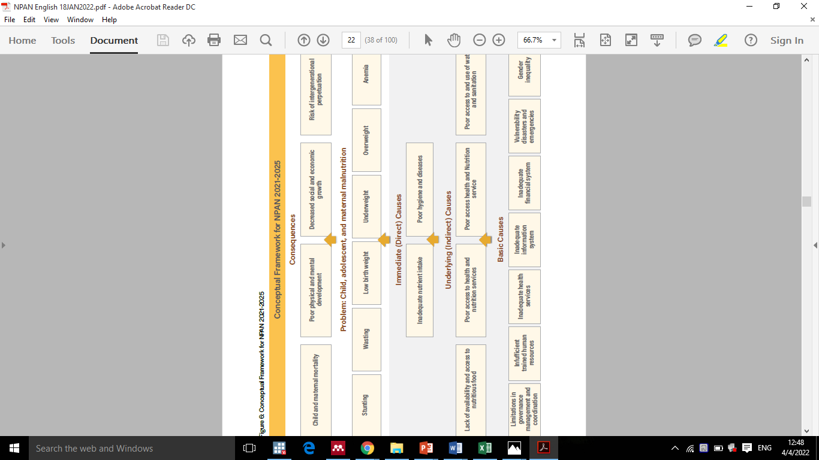
Conceptual Framework for NPAN 2021-2025

Slide 6
Research Methodology
A descriptive, cross-sectional study consisting of three phases:
Phase 1: Identifying nutrition themes, topics, and subtopics (March 2022 to May 2023)
    Data collection: Multisectoral interviews with 30 policymakers including nutrition and health researchers and practitioners in Vientiane Capital, MOH, MAF, MOES, MPI, SUCSA, and GOs (WFP, UNICEF).
    Literature review related to nutrition topics.
    Feedback: Presented results from interviews with 30 experts from multiple sectors. (October and December 2022).
    Result: 8 primary themes for inclusion questions within each theme. (February to May 2023).
Phase 2: Developing Research Topic Priorities and Rank, (June to July 2023)
    Data collection: Distributed forms to a range of stakeholders, including district Health Offices, Provincial Health Offices, and Provincial Hospitals, Ministry of Health (National Nutrition Committee).
    Result: prioritization and ranking of research subthemes (from 160 participants).
Phase 3: Finalize, and endorse the NNRA (August and September 2023)
    Multi-criteria analysis with insights from 30 experts (Wednesday, August 30th, 2023).
    NNRA advocacy final result meeting (Friday, September 22nd, 2023).

Slide 7
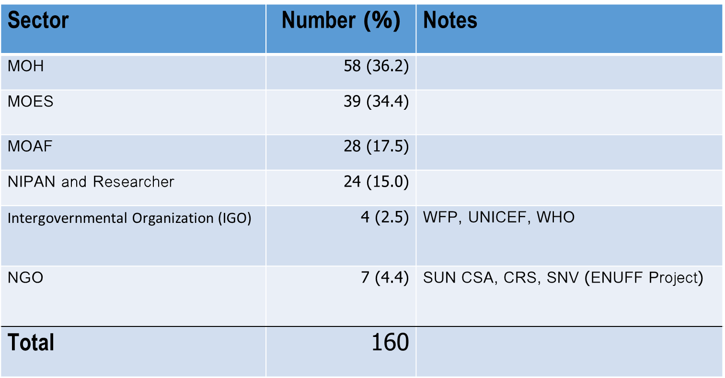
Phase 1: STAKEHOLDERS interviewed
Phase 2: Stakeholders responded to the questionnaire
Type of interviewee | Number
National level policymaker (MoH) | 3
National Nutrition Committee representative (MOES, MAF, MPI) | 6
Mother and child center staff | 2
Vertical program manager | 4
Technical staff member | 4
Medical practitioner | 4
University researcher (UHS) | 2
Researcher at LAOTPHI | 3
Researcher at PHO | 2
Total | 30

Slide 8
Main themes of NNRA before ranking | Main themes of NNRA after ranking
I. Dietary intake (food consumption) in Lao PDR | 1. Dietary intake (food consumption) in Lao PDR (I)
II. Food security (access to and affordability of food) | 2. Food security (access to and affordability of food) (II)
III. Food systems (production, safety, climate change, value chains) | 3. Maternal, child and adolescent nutrition (V)
IV. Nutrition governance | 4. Food systems (production, safety,climate change,value chains) (III)
V. Maternal, child and adolescent nutrition | 5. Nutrition governance (IV)
VI. Nutrition and health behaviors and behavior change | 6. Impact of nutrition on public health and diseases (communicable and non-communicable diseases) (VI)
VII. Impact of nutrition on public health and diseases (communicable and non-communicable diseases) | 7. Nutrition behavior change (VII)
VIII. Nutrition therapy | 8. Nutrition therapy (VIII)
The main themes of NNRA Phase 2

Slide 9
Table 1 Dietary intake (food consumption) in Lao PDR
Theme 1 | Research topics/sub-themes | Theme 1 Research Questions
Dietary intake (food consumption) in Lao PDR | Nutrition in pregnancy and lactation | What are the overall patterns of food consumption among the Lao population? How do current food consumption patterns relate to nutrition adequacy? What factors influence current food preferences? What Knowledge, Attitudes and Practices (KAP) relate to diets and nutrition in various communities? What are current nutrient and micronutrient intakes/deficiencies and what can be done to address these? What current practices address nutrition supplementation among women?
 | Food preferences and nutrition culture
 | Effect of balanced diets and micronutrient intake on nutritional status
 | Dietary habits of females affect their overall nutrition
 | Exploration of the role for affordable nutritional supplements for poor people
 | Investigation and analysis of food and nutrition intake
 | Psychological issues related to food consumption
 | Updating the Lao food composition table and dietary guidelines
Note: More research questions for each of the topics/sub-themes could be made by researchers

Slide 10
Table 2 Food security (access to and affordability of food)
Theme 2 | Research topics/sub-themes | Theme 2 Research Questions
Food security (access to and affordability of food) | Household food and nutrition security survey in Lao PDR | What are dietary intakes (energy and nutrient intakes) and acceptance of nutritionally-balanced school lunches/meals compared to regular school meals among primary school pupils? What are the individual and community factors associated with food security in Lao PDR? What is the cost and how affordable is a nutritionally adequate diet in Lao PDR? How do communities contribute to family food security? How do current food trade patterns and policies impact food and nutrition security? What can be done to do to make agriculture more nutrition-sensitive? How cost-effective are interventions?
 | Community contribution to food security
 | Food security and reducing poverty in rural area
 | The role of government in food security
 | Food insecurity, hunger, and malnutrition
 | Exploration of affordability to access a basic food basket (food poverty)
 | Food rich in nutrients available in the remote community
 | Food trade impacts food and nutrition security
 | Patterns of food insecurity
 | Dimension thematic link to food security
Note: More research questions for each of the topics/sub-themes could be made by researchers

Slide 11
Table 3 Maternal, Child and Adolescent Nutrition
Theme 3 | Research topics/sub-themes | Theme 3 Research Questions
Maternal, Child and Adolescent Nutrition | Nutrition in schools and school lunches | What actions can increase the quality of Infant Young Child Feeding (IYCF) practices? What behaviors affect maternal, child, and adolescent nutrition? What forms of nutrition monitoring are currently needed and for which groups? What actions can address the challenges of providing nutrition services to young children and adolescents? How do gender inequities and traditional/social norms affect the nutrition of women and their children? How can development tools for community engagement be used to improve mothers’ and children’s nutrition? What are the current rates and patterns of anemia and micronutrient deficiencies in pregnant and women of childbearing age?
 | Establishing nutrition/growth monitoring and health education at the services delivery level for the first 1000 days
 | Assessment of quality of routine monitoring systems, skills and abilities of nutrition staff
 | Assessment of accessibility of services and information on nutrition
 | Assessing gender inequities and traditional/social norms that affect the health and nutrition of women of reproductive age and their children
 | Cost-effectiveness of breastfeeding and IYCF
 | Identifying prevalence and factors associated with anemia
Note: More research questions for each of the topics/sub-themes could be made by researchers

Slide 12
Table 4 Food system (production, safety, climate change, value chains)
Theme 4 | Research topics/sub-themes | Theme 4 Research Questions
Food system (production, safety, climate change, value chains) | Impact of Climate Change on Food Security, Food Safety, food consumption and nutrition | What are the likely impacts of climate change on food security in Lao PDR? What are traditional/indigenous foods that help to increase dietary diversity and nutrition security? What are farmers' and food system workers' health and nutrition status and needs? What is the role and importance of forests in contributing to diets and food security? What forms of local food processing would be useful to support livelihoods and enhance food safety and access? What data are needed to assess equity in food access? What is the appropriate role of public and private storage in addressing seasonal and regional food shortages? How we better address food security during natural disasters?
 | The transition towards more diversified, sustainable, and inclusive agriculture and nutrition
 | Food processing for nutrition
 | Techniques and innovative technology to rural smallholder farmers to help them build resilience to socioeconomic and climate changes
 | Explorations on traditional foods and re-evaluation of national food needs
 | Making agriculture more nutrition-sensitive
 | Production levels and lack of purchasing power, a large section of the rural population’s daily diets
 | Food safety risk assessment
 | Managing value chains for improved nutrition
 | Cost-effectiveness and sensitivity analysis for interventions
Note: More research questions for each of the topics/sub-themes could be made by researchers

Slide 13
Table 5 Nutrition governance
Theme 5 | Research topics/sub-themes | Theme 5 Research Questions
Nutrition governance | Assessment of the human resource capabilities in relation to nutrition (multisectoral) | What are the training needs to support through multisectoral in relation to nutrition research? How to integrate the nutrition data into the National Health Information System (DHIS2)? Why is Local Community Limited involved in project/policy and strategy? What gaps exist in human and institutional capacity related to nutrition research? What do we need to integrate the convergence approach in nutrition projects? How can community engagement with projects, policy and strategy be improved? How can multisectoral approaches and coordination of roles and responsibilities be improved? What are the institutional and individual responsibilities for in enforcing food safety standards and improving food quality controls and inspections?
 | Nutrition regulations/policy/strategies process to control high salt and sugar consumption
 | Impact assessment on multisectoral approaches (coordination mechanisms, roles, and responsibilities)
 | Assessment of adequate nutrition financing and costing
 | Assessment of adequate nutrition data information system
 | Impact assessment on institutional and individual involvement in enforcing food safety standards and improving food quality controls and inspections
 | Mapping on the Nutrition Investments Stakeholders
 | Understanding the regulations related to contract farming and land concessions to protect the communities and workers as well as the environment, health and nutrition
 | Promoting corporate sustainable responsibilities of large-scale, commercial agriculture companies
 | Use of Nutrition Data in decision making for nutrition leaders and stakeholders
 | Cost-effectiveness for investment in nutrition
 | Identify requiring accountability, responsiveness, and transparency
 | Nutrition and health claims on consumer use and evolving regulation
Note: More research questions for each of the topics/sub-themes could be made by researchers

Slide 14
Table 6 Nutrition-related public health and diseases (communicable diseases and non-communicable diseases)
Theme 6 | Research topics/sub-themes | Theme 6 Research Questions
Nutrition-related public health and diseases (communicable diseases and non-communicable diseases) | Nutrition surveillance system | What nutrition surveillance systems are available and appropriate in a limited-resource setting, such as Lao PDR? What are the health implications of current nutritional patterns? What is the prevalence of obesity in adulthood? What is the evidence regarding double and triple burdens in Laos? What are the most significant impacts of food consumption patterns and nutritional status on NCDs in the Lao population? What surveillance and monitoring systems for malnutrition in children under 5 years of age in hospitals and monitoring NCDs, and how it affect health and the economy? What nutrition and food approaches can help to address diet-related public health issues? What is the food consumption of people related to non-communicable diseases? To what extent do nutrition interventions impact public health? What are the existing nutrition and food approaches to address diet-related public health issues?
 | Nutrition-related health effects
 | Situation analysis of double and triple burden on nutrition
 | Prevalence of communicable diseases related to nutrition and health
 | Nutritional status and effectiveness on non-communicable diseases (NCDs)
 | Nutrition interventions on public health
 | Nutrition and food approaches to address diet-related public health issues
Note: More research questions for each of the topics/sub-themes could be made by researchers

Slide 15
Table 7 Nutrition behavior change
Theme 7 | Research topics/sub-themes | Theme 7 Research Questions
Nutrition behavior change | Empowerment and capacity building for community-based nutrition programs | What forms of nutrition communication and education are most effective and for which groups? What is the satisfaction among communities in implementing the program to address nutrition issues? Can peer nutrition education effectively influence dietary behaviors and health outcomes? What approaches are most effective in promoting food safety awareness and practices among various actors involved in the food value chain? What is the best way to implement a multi-sectoral convergence approach in addressing malnutrition works at the central, provincial, district, and community levels? What are the challenges or barriers to nutritional and health behavior change in the community? What are the priorities and behavior changes related to food and nutrition among various groups? How can community engagement contribute to nutrition activities?
 | Food safety awareness and education among consumers and all actors involved in the food value chain
 | Impact of Audio-visual communication campaigns tailored for local dialects and levels of literacy, particularly in rural and remote areas toward nutrition behavior change
 | Nutrition education, awareness, and information to improve food consumption behaviors
 | Improving utilization of communication and nutrition education
 | Assessment of communities’ satisfaction with the program nutrition implementation to address nutrition issues
 | Community engagement on nutrition improvement
 | Impact of peer nutrition education on nutrition outcomes
Note: More research questions for each of the topics/sub-themes could be made by researchers

Slide 16
Table 8 Nutrition Therapy
Theme 8 | Research topics/sub-themes | Theme 8 Research Questions
Nutrition Therapy | Assessment of nutrition service in Health facility | What is the status of the current nutrition services at health facilities in Lao PDR? What can be done to improve nutrition services in health facilities? What is the most effective way to provide nutrition care? Can online services be effective for counseling on nutrition and health? What is the nutrition impact of dietician knowledge? What are the most effective approaches to providing diet therapy guidelines?
 | Online service center for counseling on nutrition
 | Situation analysis related to the nutrition therapy guideline
 | Understanding food eating habits and cultural patterns of existing therapies
 | Assessment the current state on mental health in relation to Nutrition therapy
Note: More research questions for each of the topics/sub-themes could be made by researchers

Slide 17

Conclusions
A National Nutrition Research Agenda 2023-2026 has been developed based on input from multiple policy and stakeholder audiences.
The agenda identifies 8 main research themes, 66 sub-themes/topics, and provides 60 research questions across the themes.
The top three themes, as prioritized by stakeholder rankings are dietary intake; food security (access to and affordability of food); and maternal, child and adolescent nutrition.
The NNRA can provide guidance for researchers, donors and policymakers to help focus attention on priority areas for investigation.

Slide 18

Recommendations
To policymakers/donors:
  The NNRA highlights gaps in evidence and knowledge and provides an action plan for targeted nutrition research in Lao PDR.
  The NNRA should be shared with researchers, stakeholders and decision-makers.
  Sub-prioritized themes may be needed for special sectors such as MOH, MOES, MOAF, and MPI to understand better and identify the particular need for each sector.
  The agenda should be updated after 2026.
To researchers/students:
  Future research should focus on the topics identified in the NNRA in order to provide evidence to support decision-makers.

Slide 19


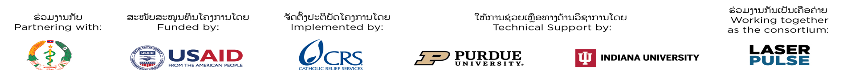
Thank you
(Khop Chai)

