Slide 1
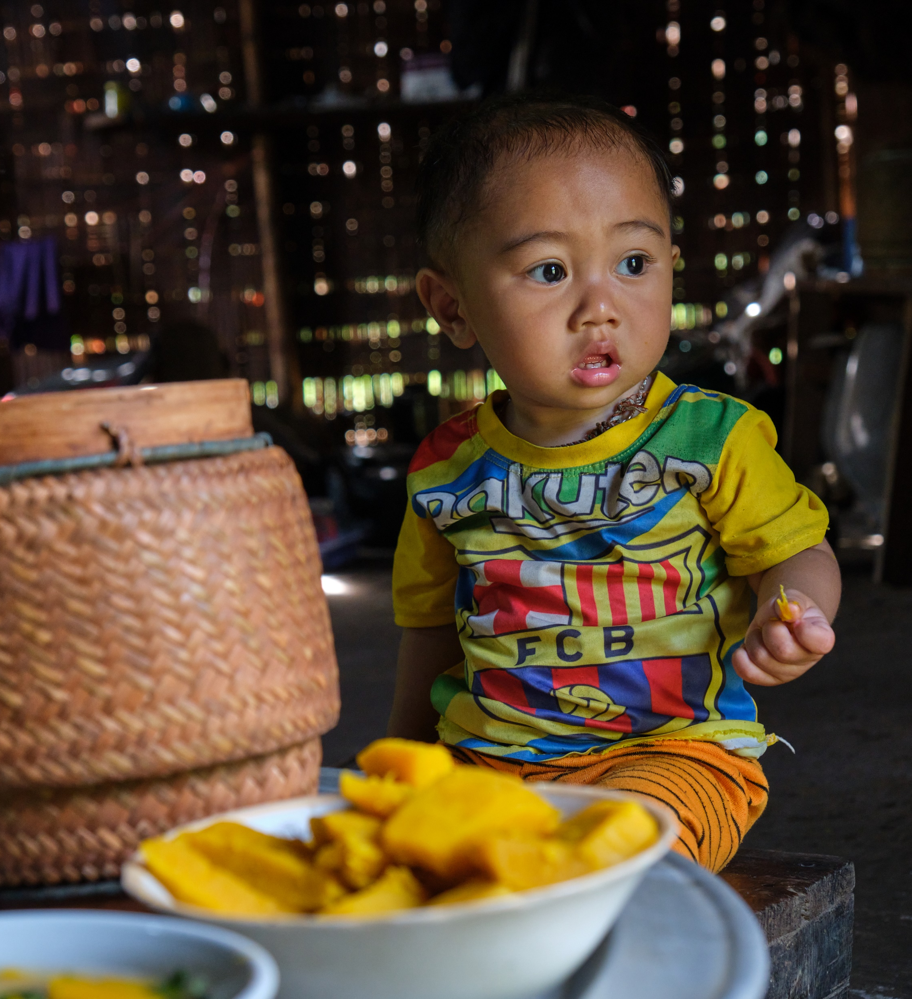

Consumption of Unhealthy Snack Foods and Beverages amongst children under 2 years in Oudomxay and Houaphan, Lao PDR
Presented by: MS. PANTAVANH KEOBOLITH

Slide 2
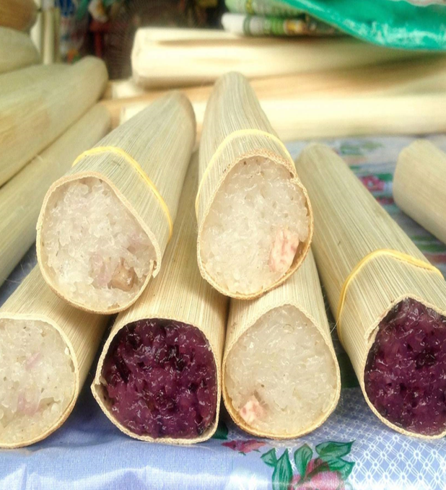
DATA COLLECTION
305 quantitative surveys in 16 villages
1 Focus Group Discussions
9 health / nutrition staff interviewed
14 shop-owners interviewed

Slide 3

Unhealthy Snack Foods and Beverages
“Food products that are often energy-dense, nutrient-poor and high in salt, sugar, saturated and/or trans fatty acids.” – WHO.
Unhealthy Snacks
Unhealthy Beverages
Frozen treats such as ice cream or similar confections
Candies, chocolate, and other sugar confections
Chips, crisps, cheese puffs, French fries, fried dough, instant noodles, and similar items
Cakes, pastries, sweet biscuits, and other baked or fried confections
Commercially produced and packaged, sweetened beverages (soda pop, fruit-flavoured drinks, sports drinks, chocolate and other flavoured milk drinks, malt drinks)
Sweet beverages including 100% fruit juice as well as fruit-flavoured drinks, whether made at home, by informal vendors or packaged in cans, bottles, boxes, sachets
Sweet beverages include home-made drinks of any kind to with sweeteners (sugar, honey, syrup, flavoured powders).

Slide 4
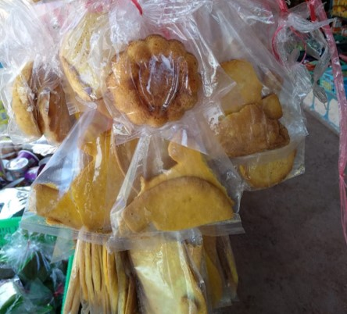
KEY
FINDINGS

Slide 5

Prevalence of Consumption
More than 70% of children between 6 and 23 months had consumed unhealthy snacks and unhealthy drinks in the previous 7 days.

Slide 6
Prevalence of Consumption
The children who were exclusively breastfed received mostly infant formula water, and in some cases, thin porridge. They were not given unhealthy snacks.

Slide 7
Commercially Packaged Snack Consumption
Consumption of unhealthy snacks increases with age.

Slide 8
Consumption of Packaged Beverages
Consumption of unhealthy beverages also increases with age.

Slide 9
Frequency
More than 20% of children are consuming unhealthy snacks and beverages everyday.
 | Every day |  | At least 4 days a week |  | Between 1 and 3 days a week |  | Never
Sweet biscuit, cookies, crackers
Savoury snacks (chips, puffs, krupuk)
Sweetened Milk

Slide 10
Expenditures
50% of caregivers spend between 10,000-50,000 kip per week on unhealthy snacks
Sweet and savoury snacks
Sweet Beverage
 | No expense
 | < 10,000 LAK
 | 10,000> x <49,999 LAK
 | 50,000> x <100,000 LAK
 | > 100,000 LAK

Slide 11
Perception
Child’s happiness and convenience are the main reasons for offering unhealthy snack and beverages

Slide 12
Recommendations
National Level
  Integrate discouragement strategies targeting unhealthy snack foods and beverages in the national SBCC strategy
  Provide incentives to local enterprises with broader distribution capacities to produce healthier options
  Tax unhealthy foods and beverages
  Implement food labeling and marketing policies
Development partners
Utilize existing village structures to promote healthy snacking (i.e. village volunteers, outreach programs)
Introduce easy recipes for healthy snacking in cooking demonstration activities using available ingredients
Work with local vendors (formal and informal) to supply convenient, healthy snacks year-round
Build the capacity of Micro, Small and Medium Enterprises (MSME) to produce and market healthy snacks and beverages
Invest in nutrition-sensitive value chain projects with a focus on local food environments

Slide 13
THANK YOU

