Slide 1
Generative AI Basics:
SUN CSA network
March 28, 2024
©2021 Catholic Relief Services. All Rights Reserved.
Notes:
Recommended for 1-hour meeting. 20 minutes for slides 2-9 which includes a demo. 30 minutes for the activity. 10 minutes for remaining questions.
If working with less time, slides 2-8 can be sent as pre-reading for the meeting.

Slide 2
STAND UP if you:
…Have used AI tools in the past
…Feel excited about exploring AI
…are curious but unsure about AI
…Worry about job security due to AI
…Think AI can enhance our work
…Have attended training on AI
…Believe AI can improve efficiency

Slide 3

AI and Storytelling…once upon a time…

Slide 4
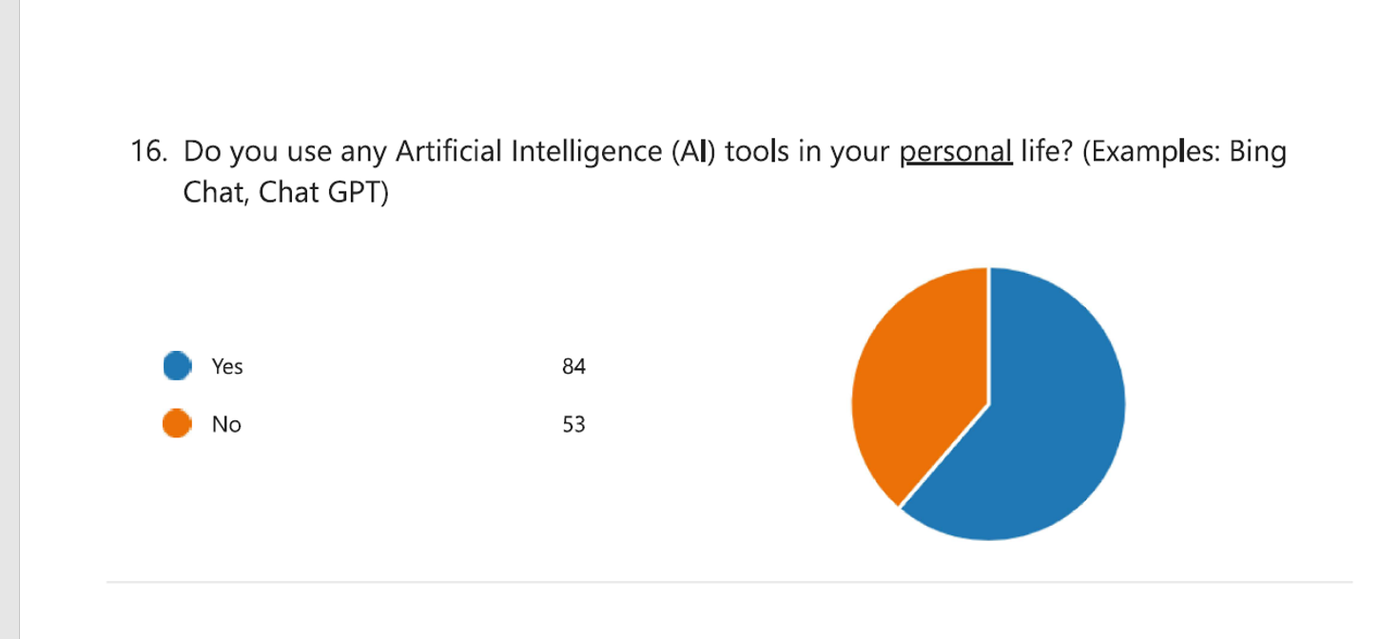

Slide 5
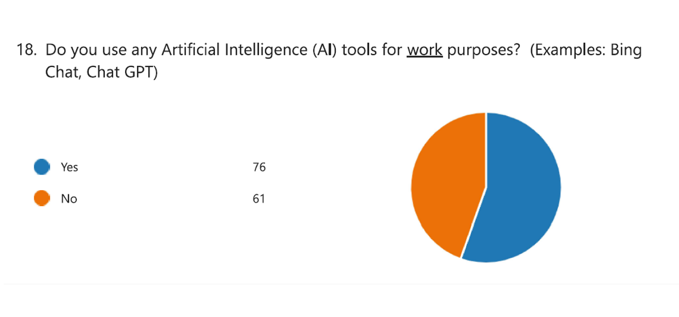

Slide 6
What is generative AI?
Generative AI refers to a subset of artificial intelligence that focuses on creating new, original content rather than analyzing existing data.
These AI models can generate text, images, video, audio, and more opening a range of possibilities for organizations.
Examples: ChatGPT, DALL-E2, AIVA, StyleGAN, Midjourney, Jasper.ai, Google’s Bard and Bing Chat Enterprise

Slide 7
AI, or Artificial Intelligence, is like a smart helper that can learn and do tasks without being explicitly programmed for each one. It's like having a really clever assistant. On the other hand, Generative AI is a specific type of AI that's even more creative. It can generate new things, like art, music, or text, by learning from patterns it finds in data. So, while AI is smart and can solve problems, Generative AI is like the imaginative sidekick that can create new and unique things on its own. It's a bit like having a creative companion to help think up cool and original stuff!

Slide 8
What can we use generative AI for?
Summarizing
Brainstorming
Synthesizing
Writing
Coding
Extracting
Reformatting
Notes:
Artificial Creativity

Slide 9

OK, but how can I use AI in my work to be more efficient and effective?
Human Resources
Trainings and staff support
Safeguarding / role play
Communicating CRS Strategies and Policies: CRS Guiding Principles, 8 REDI Competencies, CRS strategy
PMP and Development Plans – what is a SMART goal?
Performance reviews, coaching sessions
PIP creation support
REDI trainings and awareness
Local Labor Law analysis
New GPT HR chat bot?

Slide 10

Safety and Security
  Dataminr - CRS works closely with DataMinr and First Alert to harness AI for improvements in how we keep staff safe. More specifically, First Alert is focused on events and scans tens of thousands of news sources and outlets, social media, blog posts, dark web and even local radio (using Generative AI and NLP). It then sorts according to my settings and preferences and provides updates by email or straight to mobile app.
  Support in creation of security matrices (Myanmar context)
  Staff messaging

Slide 11

Communications and MEAL
Creation of content for Social Media – facebook
Canva
Quotes and content
Proofreading and structure
Video editing and creation
Increased options for selection of best fit for context
Image creation
MEAL – PowerBI
How can AI improve our MEAL?
Community Capacity Assessment language and text (example)
Fleet analysis – VMS replacement
Example from CRS LEAPS III project (CCA)

Slide 12
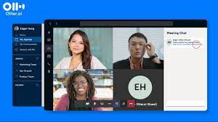

Meeting notes and summaries – Otter, Bing voice activation, Microsoft Word Dictate
Connect Otter to your Google or Microsoft calendar and it can automatically join and record your meetings on Zoom, Microsoft Teams, and Google Meet. Follow along live on the web or in the iOS or Android app.
AI for BD – fundraising and donor prioritization, BD strategy, analysis of donors, budget notes, desk review summaries, data set analysis, structuring and proofreading proposal sections
  The DEC is the largest online resource for USAID-funded technical and project materials. Searching for specific information within the DEC with AI is fast and efficient.

Slide 13

Generative AI Creates Many Kinds of Risks
Intended
Designated use
New, smaller competitors, enabled by
GenAI, entering and disrupting industries
Misuse
Mass production of misinformation and deepfakes
Accidents from use
AI hallucinations leading to
incorrect decision making
GenAI
Structural effects
on society
Mass unemployment of
creators of content and code
Misaligned, power-seeking AIs
Power-seeking AI model with
goals not aligned with humanity
Unintended
Source: Gartner
Notes:
GenAI risk is not just one single risk that should be added to an organization’s risk register like cyber risk or data privacy risk.
Since GenAI amplifies the human type of intelligence that underlies every human activity, providing superhuman capabilities in a range of activities, it also creates brand new risks and it amplifies many existing risks. And this is only complicated further by the output of GenAI often being unpredictable and unexplainable.
Organizations should therefore create their own risk taxonomy specifically for GenAI.
Since GenAI risk will be so all-encompassing, it is key that organizations set risk tolerance levels for the various types of GenAI risk. Some risks will be very hard for organizations to meaningfully mitigate.
This slide suggests one high-level GenAI risk taxonomy, with five categories. For each one, an example risk is provided.
This is not meant to be a comprehensive list, but it can be used as a starting point for an organization looking to think through all the ways in which GenAI will impact its ability to execute its strategies.
The first category is use of GenAI along intended, designated lines. Even if GenAI is “only” used as intended, it will disrupt multiple industries. For instance, the educational services industry is suffering because of students turning to ChatGPT. And Hollywood writers have been on strike, fearing that Generative AI will take their jobs. Generative AI fuels new types of competition with smaller companies getting superpowers and being able to take on bigger competitors. It will also lead to increased ease of entry for new disruptive startups in many industries.
Second, there will naturally be great misuse. People will use GenAI to mass produce highly tailored and personalized misinformation, including deepfakes. This will lead to an increase in fraud and extortion scams. Powerful technology that is easy to use will most certainly be used this way. Another example in this category is creation of code for malware, leading to an increase in cyberattacks.
Third, since GenAI leads to such productivity improvements, it will be adopted widely — soon perhaps in every Microsoft office product. However, since at least the current generations of GenAI tend to “hallucinate,” make up incorrect information and present it in a convincing way, there is great risk of inaccurate, incorrect AI-informed decision making.
A fourth category could be structural effects on society. Some suggest that many jobs could be replaced by GenAI, and we may see large effects on unemployment. This is a risk where there is less that each individual organization can do to manage and mitigate, but it is essential that these scenarios are included in an organization’s scenario planning.
Finally, there is a fifth category, which has the most speculative risks. There has, for example, been speculation over the past decade that AIs that operate as agents, like the recent AutoGPT, if given goals that are misaligned with humanity, can end up causing massive harm to humanity. This is a set of risks that the individual organization cannot do much about, but it is an important set of risks to include in the discussion.
For more information, contact Malcolm Murray.

Slide 14
What are the dos and do not’s of using generative AI?
DO
DON’T
Proceed with experimentation, but exercise caution.
For now, limit your audience to internal stakeholders*.
Continuously learn and adapt.
Disclose where generative AI is used.
Do not enter proprietary or personal information of the agency, partners, participants, or donors.
Do not copy-and-paste agency content, such as emails, reports, or chat logs into generative AI tool prompts.
Do not trust the content produced. Always have a human review for bias and errors.
Do not generate manipulated or counterfeit photographs of participants or partners.
*When using Bing Chat Enterprise, agency data is not stored or shared unless abuse is detected, therefore staff can experiment with broader audiences and topics but should avoid sharing confidential information.

Slide 15
Why use Bing Chat Enterprise?
Bing Chat Enterprise is designed to protect agency data more securely than other generative AI services like ChatGPT and Bard.
Chats are not saved or reviewed by Microsoft (except where abuse/misuse is detected), so your data will not be available outside of CRS or used to train underlying AI models.
Because of this, Bing Chat Enterprise is the preferred generative AI tool for CRS.
To use Bing Chat Enterprise, visit bing.com/chat in Chrome or Edge and sign in using your M365 credentials.
Notes:
If helpful you can post these instructions in the chat so users can log in while following the presentation.
To access Bing Chat Enterprise, follow these steps:
Open a window in Microsoft Edge or Chrome. Other browsers are not currently supported.
Go to bing.com/chat
Select "Sign in" in the upper right-hand corner and select "Sign in with a work or school account" from the dropdown that appears.
Login using your M365 credentials.

Slide 16
What is a prompt?
A prompt in the context of generative AI is a piece of text that is given to a generative AI model to guide its output.
Prompts can be used to generate a variety of creative text formats, including poems, code, scripts, bullet lists, email, letters, etc.
Effective prompts are clear, specific, and informative. They should provide the model with enough information to generate the desired output, but they should also be concise and avoid ambiguity.

Slide 17
Prompt Design
Writing well-structured prompts is an essential part of ensuring accurate, high-quality responses from generative AI tools.
When crafting prompts, you should consider:
Audience: Who is the target audience? What are their interests and needs?
Purpose: What is the purpose of the content? Is it to inform, persuade or entertain?
Tone: What tone should the content have? Formal, informal, inspirational, serious?
Keywords: What words should we use to ensure the content is relevant to our audience?
Length: How long should the content be?
Accuracy: What sources should be used to ensure that the content is accurate?
Bias: How can bias be avoided in the content?

Slide 18
Important Considerations
Read your responses before using them: It is essential to provide a human eye to any content generated using generative AI tools
Get feedback from others: Once you have generated some content, get feedback from others to see if it is inaccurate, biased, or not optimized to CRS’ mission and values
Keep learning and evolving: The field of generative AI is constantly evolving
Disclose the use of AI: In most content you create using AI, it is recommended that you disclose the fact that you used AI to create that content

Slide 19
AI Outperforms People in Some Tasks, but Not All
Example Tasks
2023
2033
Weather prediction
AI Outperforms Human counterpart
Competing in video games
AI + Human Coexistence
Breadth of translation
Human outperforms AI counterpart
Voice/Facial recognition
Driving a car
Medical scan diagnosis
Software programming
Creating financial analysis
Creating music
Writing best-selling books
Moral and ethical reasoning
Build new scientific theories
Personal care & therapy
Notes:
Weather prediction: Weather prediction involves complex models, workflows, and real-time interpretation. These are tasks that AI tools already master.
Competing in video games: AI systems will continuously increase their usage of player behavioral prediction, adversarial strategy and spatial awareness to outperform human players.
Language translation: AI is already much better at translation in certain dimensions like speed and consistency. However, humans can bring unique cultural awareness for more complex or creative translation. The combination, with AI supporting human translators is currently the best option. However, this might quickly change with the rapid improvement of large language models, which can translate large documents in sophisticated ways, even for rare languages. For more information, see Maverick* Research: Machine Translation Can Save the World’s Languages From Extinction (G00773251).
Voice/facial recognition: AI already assists in recognizing human voice and facial features, but humans are still much better at these tasks. This will change as facial- and voice-recognition models improve.
Driving a car: Drivers will be increasingly assisted by AI in control of the vehicle, navigation and avoidance of collisions. We are expecting full autonomy to be allowed by the end of the 2020s. For more information, see Emerging Tech: The Future of Autonomous Vehicles (G00759769).
Medical diagnosis: AI can uncover complex patterns in patient data and clinical images that humans cannot. However, medical diagnosis requires causal reasoning, which current AI struggles with, making human and AI teams the best current option. Rapid advances in causal AI could tip the balance toward AI taking over as the more accurate option.
Software programming: Software programming is a creative endeavor. Humans can be greatly assisted by GenAI proposing solutions to problems and generating the associated code, but it will not replace humans because it lacks context, judgment and contextual knowledge. For more information, see The Ai Weekly article, Will ChatGPT Replace Developers?
Creating financial analysis: AI and machine learning is helping humans automate and run large and complex financial models, but it is unlikely to outperform people in identifying investment opportunities and making new recommendations.
Creating music: AI can help generate ideas, helping humans to create music. It can combine preexisting musical works, but it lacks the creativity needed to generate original art.
Writing best-selling book: AI can help humans gain additional context on a new topic, but writing new stories and creating engaging and compelling plots are aspects not present in current AI. Machine learning algorithms can help in analyzing vast amount of text to create plot structures, but they may not be novel.
Moral and ethical reasoning: Ethical reasoning requires subjective judgments based on the unique human life experience. AI, even very advanced AI, is unlikely to properly consider the complexities and contradictions of human values and preferences. AI can still be useful in implementing ethical principles, but ethical reflection and deliberation will remain a uniquely human activity for the next 10 years.
Building new scientific theories: AI already greatly contributes to science. However, creating fundamentally new scientific theories requires not only domain knowledge, but an ability to reason abstractly and creatively, connecting ideas from different domains. AI is currently incapable of doing any of these things.
Personal care and therapy: Although ChatGPT scored better on “empathy” than doctors (for more information, see the Axios article, ChatGPT Might Show More Empathy Than Docs, Study Finds), there is a physical aspect to care and therapy as well. These are not capabilities and traits that AI systems have or will have in the next 10 years. For more information, see The Washington Post article, AI Isn’t Yet Going to Take Your Job — But You May Have to Work With It.
For more information, contact Gunjan Gupta.

Slide 20
How ChatGPT summarizes the work of SUN CSA
The SUN CSA (Scaling Up Nutrition Civil Society Alliance) network is a global movement comprising civil society organizations, NGOs, and community groups working to address malnutrition and improve nutrition outcomes worldwide.
Their primary focus is on advocating for policy changes, raising awareness, and mobilizing resources to support nutrition interventions at local, national, and international levels. The network collaborates with governments, international agencies, and other stakeholders to promote evidence-based approaches to nutrition, with an emphasis on community engagement, sustainability, and equity.
Overall, the SUN CSA network plays a crucial role in driving collective action and fostering partnerships to accelerate progress towards achieving global nutrition goals and reducing malnutrition in all its forms.

Slide 21
Activity: Exploring AI tools
Time: 30 minutes total (15 for activity, 15 for discussion)
Prerequisites: Access to ChatGPT, Google Bard, Microsoft Edge (Bing Chat Enterprise).
Instructions:
Split the group into pairs or small teams of 3-5 people.
Each group will be assigned 1-2 prompts to test with the tool. Samples provided.
Each team should start with their sample prompts and continue engaging AI to improve upon the generated result. Groups can ask AI for changes in tone, language, format, audience, sources, and more.
After 15 minutes, the teams will quickly share their results with the wider group.
Discuss the accuracy and bias of the generated content.

Slide 22
Sample Prompts (from CRS strategy session)
Generate a social media campaign about a CRS project effort.
Write a blog post about the latest innovations from faith-based organizations in climate change adaptation in Africa.
Create a script for a video about the work CRS has done with the Global Fund.
Generate a summary of the 2022 Catholic Relief Services annual report in bullet points.
Generate a report that evaluates CRS’ performance and impact on Sustainable Development Goal 5: Gender Equality.
Write a speech for a CRS executive about the importance of international cooperation to address global challenges with malaria.
Generate a quiz that tests staff knowledge and awareness of CRS’ Compass Project Management Standards.
Create a curriculum that trains CRS’ partners on disaster risk reduction and preparedness.
Generate a brochure that explains the CRS approach and methodology to justice and peacebuilding in Colombia.

Slide 23
Sample Prompts for SUN CSA network
Ask AI for nutrition tips or healthy recipe ideas.
Discuss the importance of breastfeeding with AI and explore ways to promote it in communities.
Engage AI in a conversation about the role of micronutrients in child development.
Ask AI to generate a short story or scenario illustrating a successful nutrition intervention in a rural village.
Pose a question to AI about common misconceptions related to nutrition and see how it responds.
Challenge AI to generate a list of innovative solutions to address food insecurity in urban areas.
Discuss the potential impact of climate change on food production and nutrition outcomes with AI.
Ask AI to provide insights on how technology can be leveraged to improve nutrition education and awareness.

Slide 24
Sample Reflection Questions – Group Sharing
How did you assess the accuracy of the generative AI responses?
What types or indicators of bias did you look for in the AI’s language, tone, or content?
How did the accuracy and/or bias of the generative AI responses affect your perception, trust, or satisfaction with the AI?
How did you compare and contrast the generative AI responses with your own or other human responses? What similarities or differences did you notice in terms of quality, style, or perspective?
What additional instructions did you give the AI to improve the clarity, accuracy, and tone of your content?

Slide 25
Possible Future AI Considerations for your Agency
Multi-hour training to Asia Staff on the use of Generative AI.
Introduction to Community of Practice and resources.
Webinars on useful resources around new developments.

Slide 26


Democratization of Work and Redistribution of Workload
The most common impact for the next decade will not be the replacement of workers. It will be the augmentation of jobs with AI.
Source: Gartner
Notes:
Most jobs will be recalibrated by the augmentation of the overall evaluation process. Like manual labor was optimized in the days of “scientific management,” every knowledge job will be reviewed under an intense spotlight. Each job will be separated into individual activities and tasks, and these will be scrutinized. Choices must be made as to whether tasks should be executed by an AI, a human being, or a combination of both. ​
Initially the most common impact for the next decade will not be to replace people, but to augment jobs.
Augmentation will occur in two forms:
Expanding or complementing existing jobs: People will be supported by AI. They will use AI applications to increase speed, boost quality and lower error rates.
Creating new jobs: People will augment AI, leading to a democratization of jobs, making them accessible to a group larger than only specialists. In healthcare, caretakers will coach people through AI-driven examinations and procedures. The legal profession will create new jobs to allow people to interpret the output of legal AI (including contracts or even preliminary rulings) and explain next steps..
For more information, contact Fran Karamouzis.

Slide 27


Balancing AI Energy and Emissions Impacts
By 2030, AI has the potential to reduce
global CO₂e emissions by 5% to 15%.
Positive Impacts
Negative Impacts
By 2030, AI may consume up to
3.5% of the world’s electricity.
CO₂e = carbon dioxide equivalent
Source: Gartner
Notes:
AI’s contribution to society, communities and economies will come under increasing scrutiny. Executive leaders must be prepared to explain how AI will both positively and negatively impact sustainability performance. Benefits created through AI use cases must outweigh the impacts from training and development.
Through the lens of greenhouse gas emissions. AI can be seen as part of the solution. Gartner estimates that AI can contribute to a 5% to 15% reduction of carbon dioxide equivalent (Co2e) emissions. But AI also consumes a significant amount of energy, not only through use, but also the embodied energy in IT assets. Increased energy consumption may become a license to operate issue, with investment in new energy generation taking time to deploy, while AI energy needs grow rapidly through iterative development and increased uptake.
Executive leaders must have a sense of AI’s break-even points, where positive impacts exceed negative. Governance processes should be put in place to surface unintended consequences from decision making.
For more information, contact Sarah Watt.

Slide 28

Courses and additional learning on LinkedIn:
What is Generative AI?
How to research and write using generative AI Tools?
Introduction to Prompt Engineering for Generative AI.
Generative AI for Business Leaders
In addition, you can also check out the Microsoft AI Business School.

Slide 29
Relevant Resources
Generative AI MyCRS Page - This page is home to the latest guidance and best practice on generative AI at CRS.
Using Generative AI at CRS – This guidance outlines caveats, risks, and potential use cases of Generative AI in the CRS context
Generative AI Prompt Design at CRS - This guidance provides content creators at CRS with info on how to craft effective prompts, avoid bias and inaccuracies and actively promote CRS values.
All guidance and slide content developed in collaboration with members of the AI CoP and representatives from GKIM, OverOps KML, MarCom, M2, PIQA, and beyond.

Slide 30
RESOURCES:
The art of the prompt: How to get the best out of generative AI: news.microsoft.com/source/features/ai/the-art-of-the-prompt-how-to-get-the-best-out-of-generative-ai/
Introduction to prompt design: cloud.google.com/vertex-ai/docs/generative-ai/learn/introduction-prompt-design
Generative AI prompt samples: cloud.google.com/vertex-ai/docs/generative-ai/learn/prompt-samples
Generative AI for Content Creators: contentstack.com/blog/all-about-headless/how-to-transform-your-content-creation-with-generative-ai/
The Generative AI Starter Guide for Communicators and Content Creators: missionnorth.com/dispatches/the-generative-ai-starter-guide-for-communicators-and-content-creators
Guidelines for Responsible Content Creation with Generative AI: contently.com/2023/01/03/guidelines-for-responsible-content-creation-with-generative-ai/
OECD.AI Guidelines for Responsible Content Creation with Generative AI: oecd.ai/en/catalogue/tools/guidelines-for-responsible-content-creation-with-generative-ai
AI Influence Level (AIL) v1.0: danielmiessler.com/p/ai-influence-level-ail
Why Using a Polite Tone with AI Matters: microsoft.com/en-us/worklab/why-using-a-polite-tone-with-ai-matters

Slide 31

Once upon a time, in a small village suffering from famine, a traveler arrived with nothing but a large cooking pot. The villagers, initially wary of the stranger, refused to share their food with him. Undeterred, the traveler set up a fire in the village square and filled his pot with water.
Intrigued by his actions, the villagers gathered around to watch. The traveler announced that he was going to make "stone soup" and pulled a smooth stone from his pocket, placing it into the pot of boiling water. As the water simmered, the traveler tasted it and exclaimed how delicious it was, despite the lack of ingredients.

Slide 32

Curiosity piqued, the villagers began to contribute small amounts of food to the pot: a handful of carrots, a few potatoes, some herbs and spices. Before long, a hearty soup was simmering, filling the air with a tantalizing aroma.
As the soup cooked, the villagers realized that by each contributing what little they had, they could create a nourishing meal for everyone to share. They came together, shared stories, and enjoyed a feast made possible through cooperation and community spirit.
In the end, the traveler thanked the villagers for their generosity and revealed that the "stone soup" was simply a catalyst for bringing them together and demonstrating the power of sharing and cooperation, even in the face of scarcity.

Slide 33
Thank you! Questions?

