Slide 1



Developing Lao
School Lunch
Nutrition Guidelines
Kelley Khamphouxay
CRS Laos
27 March 2024

Slide 2
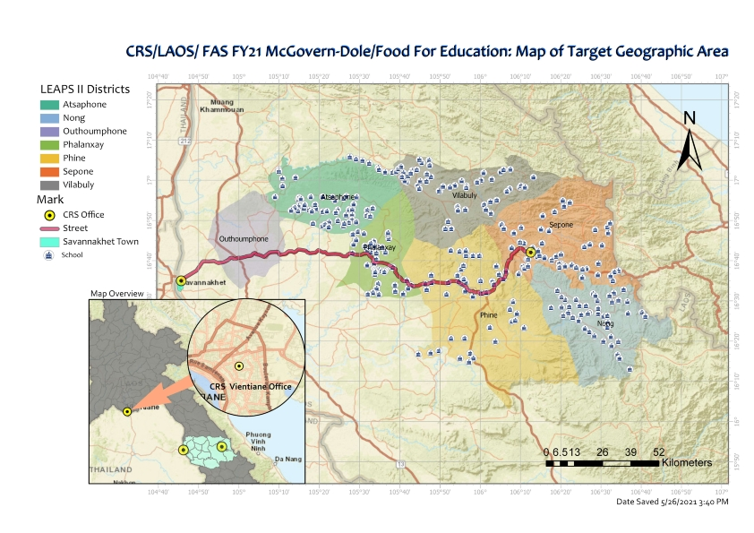
Background of LEAPS III
Funded by USDA
5 years
Budget in MOU worth USD16.764.567
6 districts, 302 schools
Benefiting 30,000+ students
Phasedown handover
Main partner: MOES
Others: WFP, SCI, and supporting sectors
ATP
VIL
ATP
XPN
PIN
NON

Slide 3
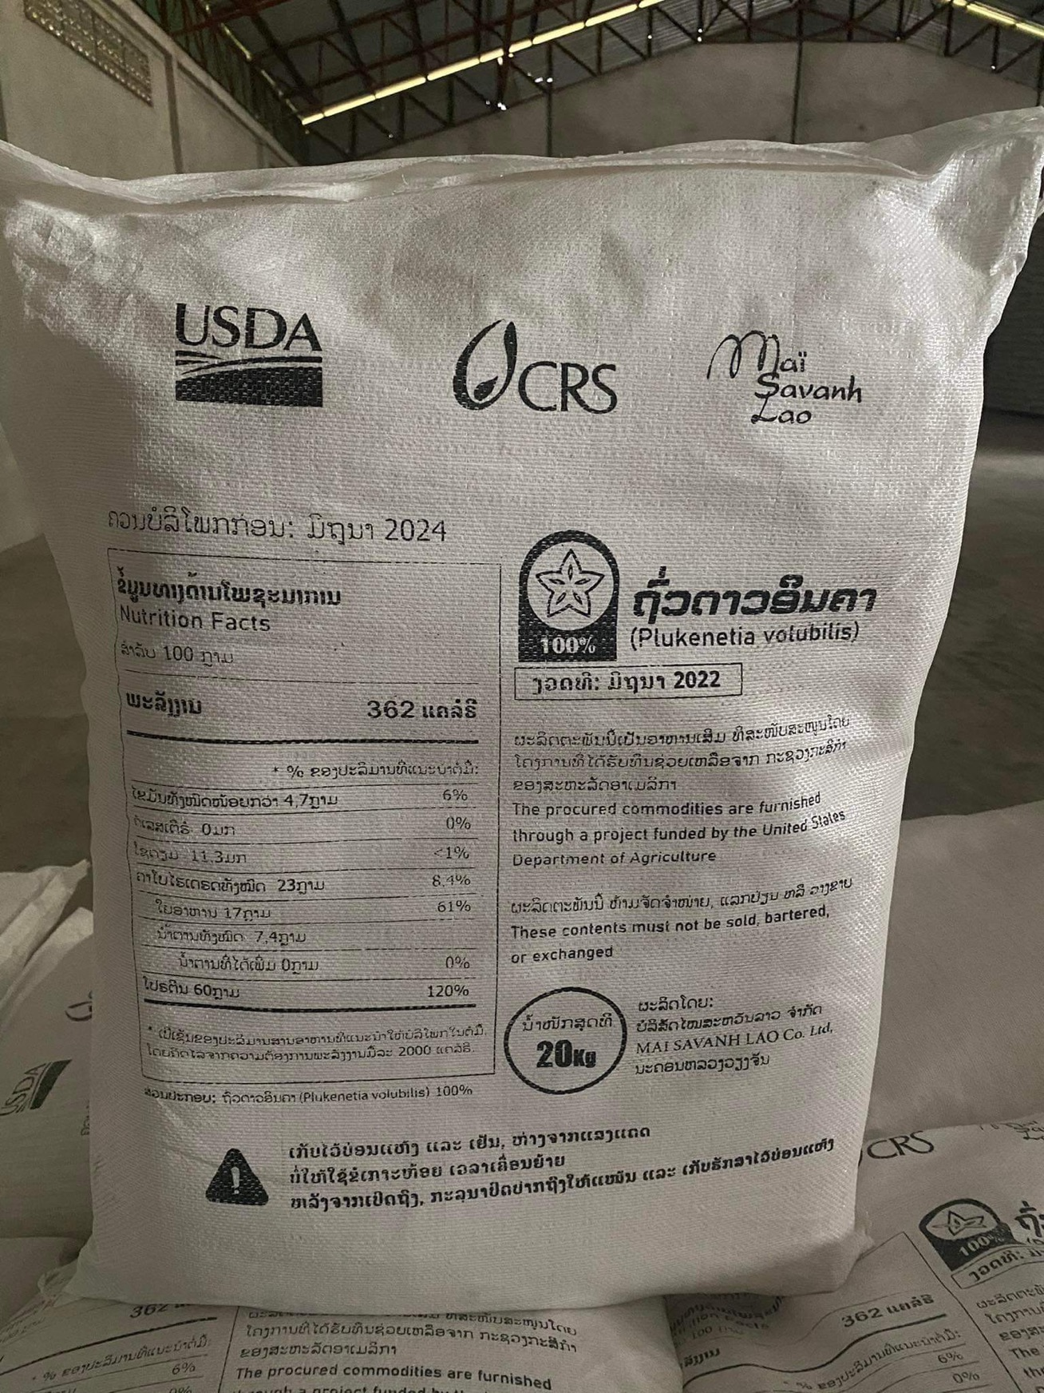

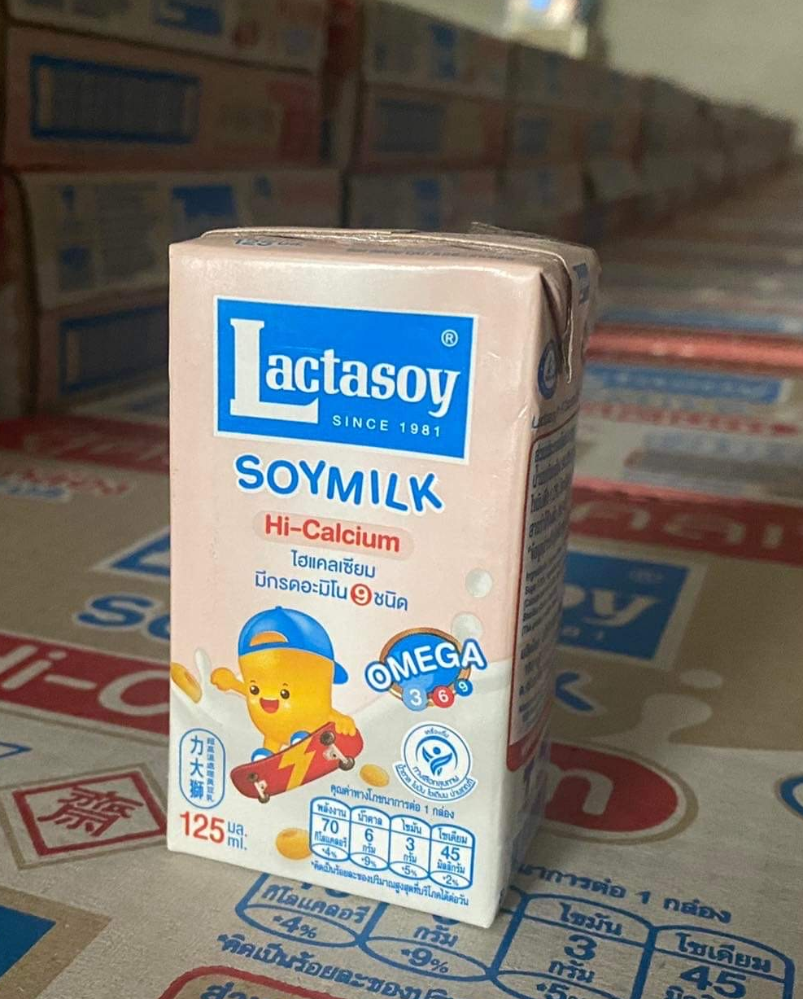
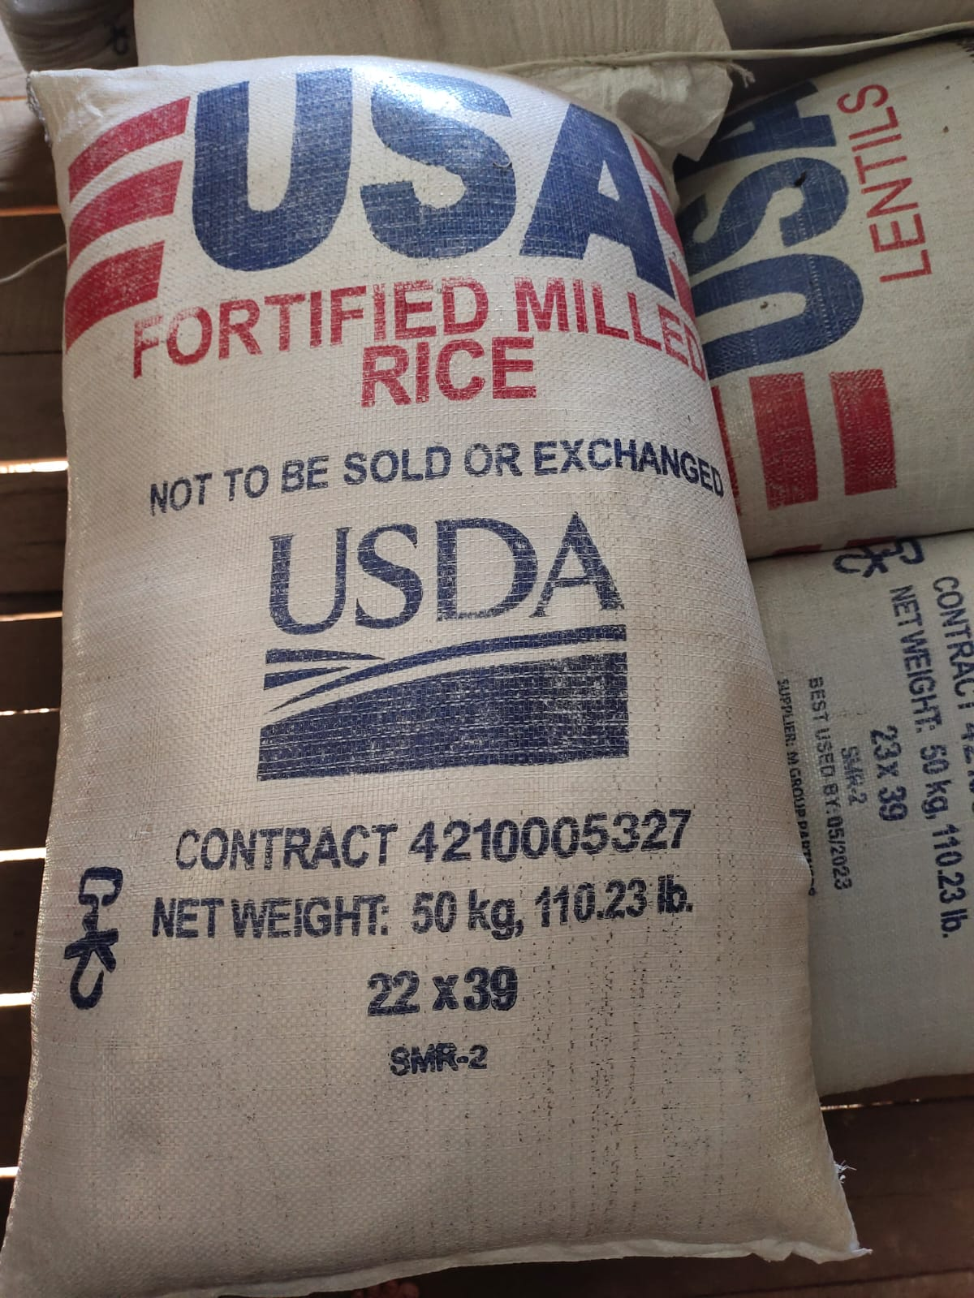
Main Activities
Provide School Meals
Nutrition Promotion in schools
Community Engagement and School Gardens
Develop Partnerships with farmer groups to supply food to schools
Advocacy for School Meals
Improve Early Childhood Education
Building and Rehabilitation of School Infrastructure
School Community Days
Capacity Building: Local, regional, and national level
Hygiene and Sanitation Promotion

Slide 4




Provide School Lunch
Local and Regional Procurement
1,000+
200+
150+
Rice (MT)
Lentils (MT)
Oil (MT)
1.3+ million
2.1+ million
17+
eggs
milk (carton)
Sacha inchi (MT)

Slide 5



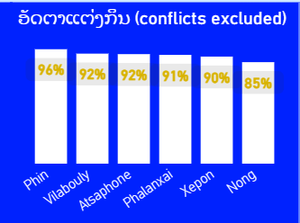
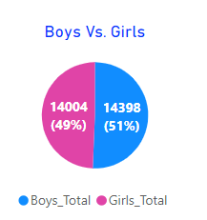


Provide School Lunch
5 million+
38,000+
2,500+
Meals served
Students
THR recipients
Cooking by district
Boy/Girl
302
87%
81%
Teachers/cooks/storekeepers
SCHOOL GARDENS
HARVESTING FROM GARDEN
COOKING RATE
(Sep’22-Jan’23)

Slide 6
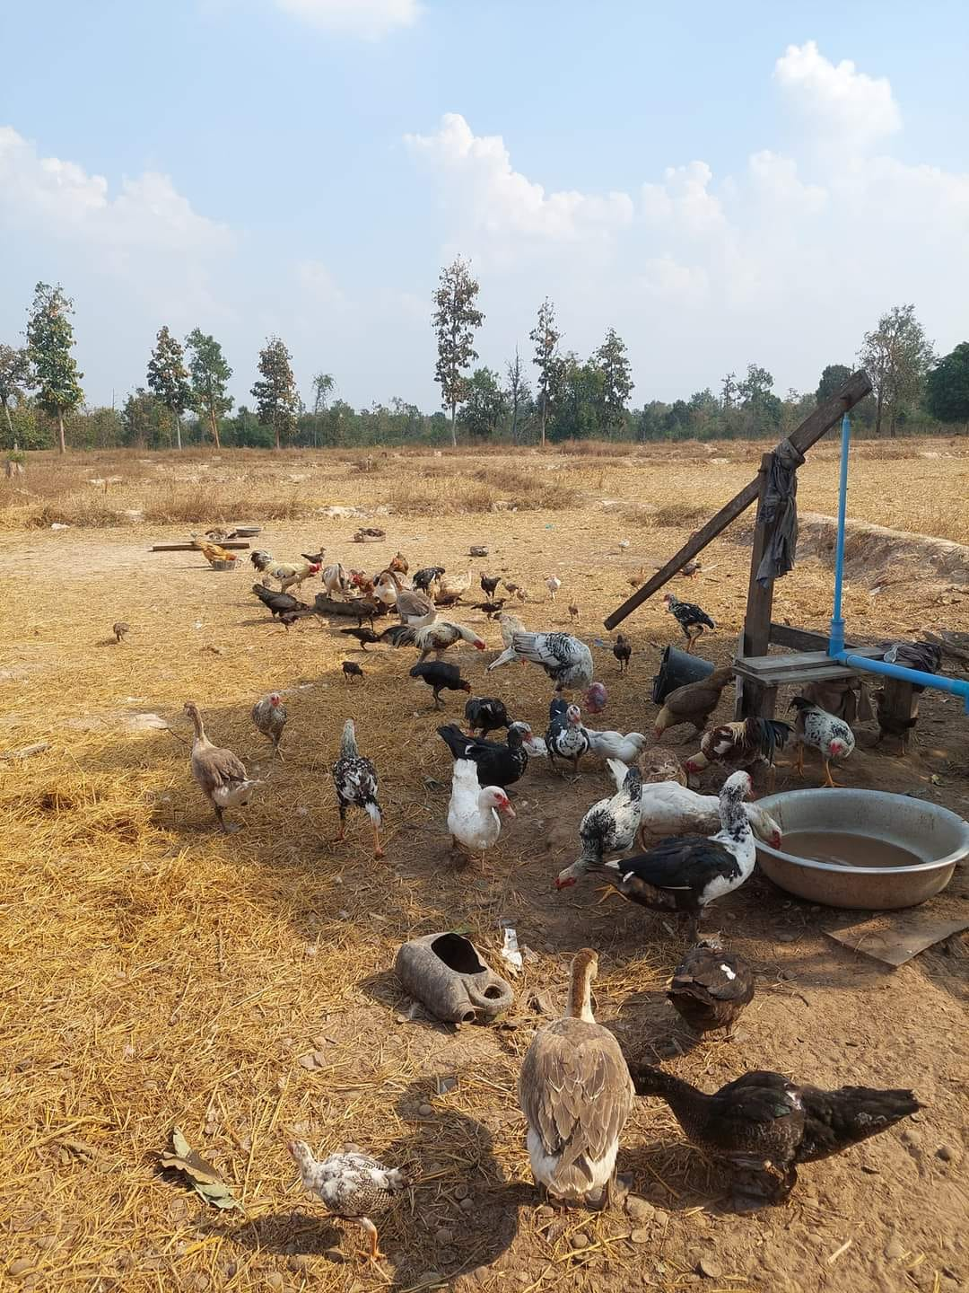
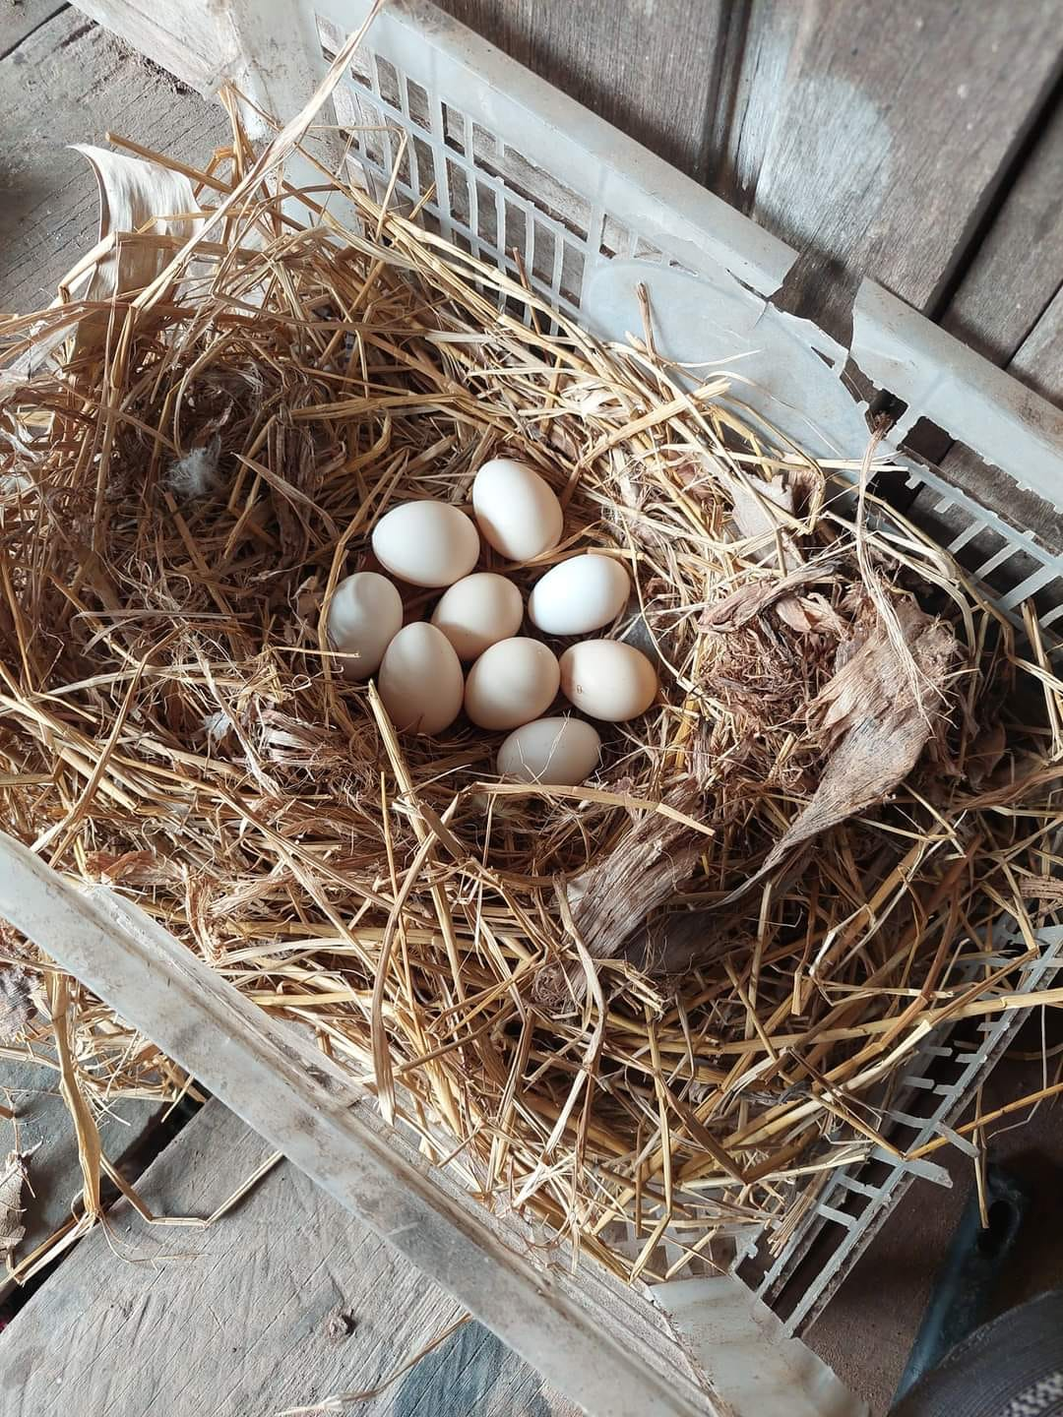
VEDC grants

Slide 7
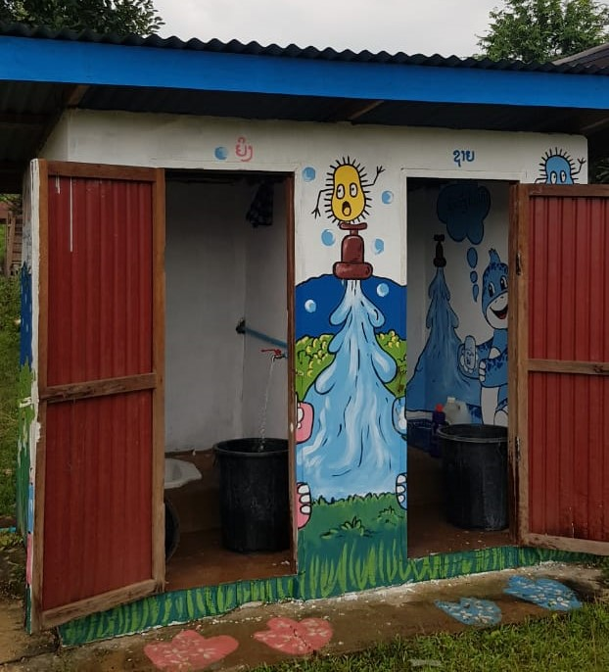
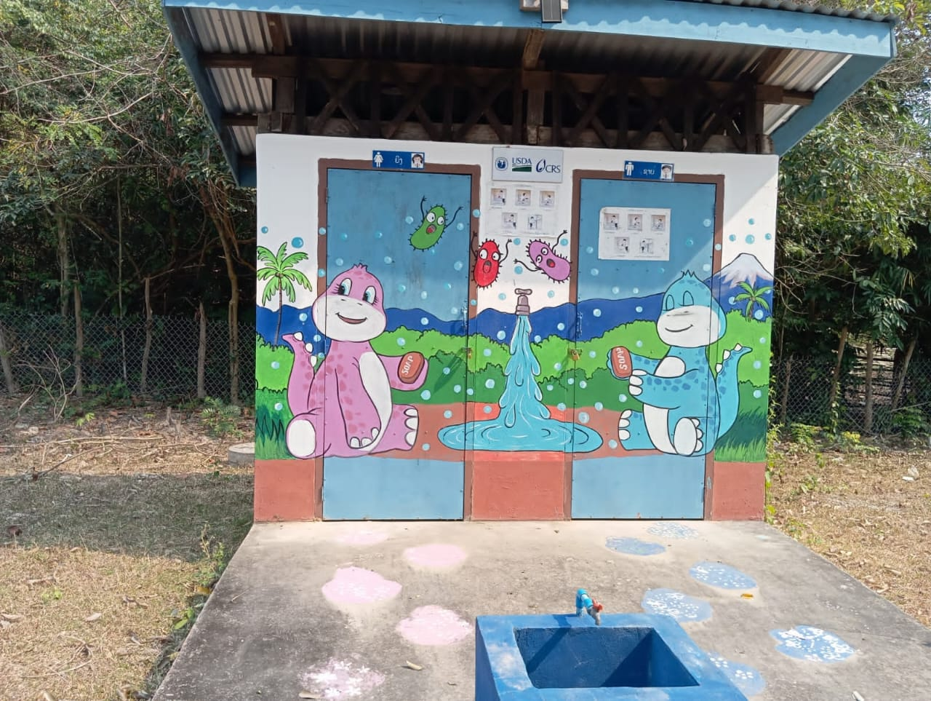
Latrines nudges (SBC)

Slide 8

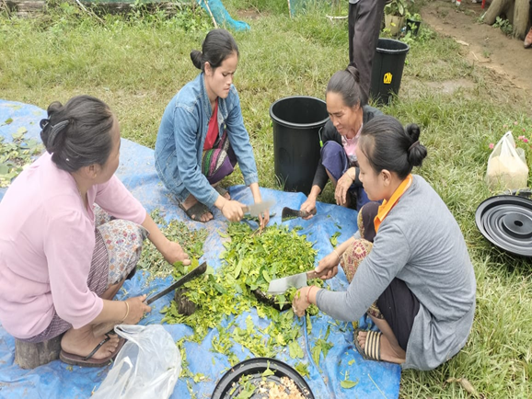
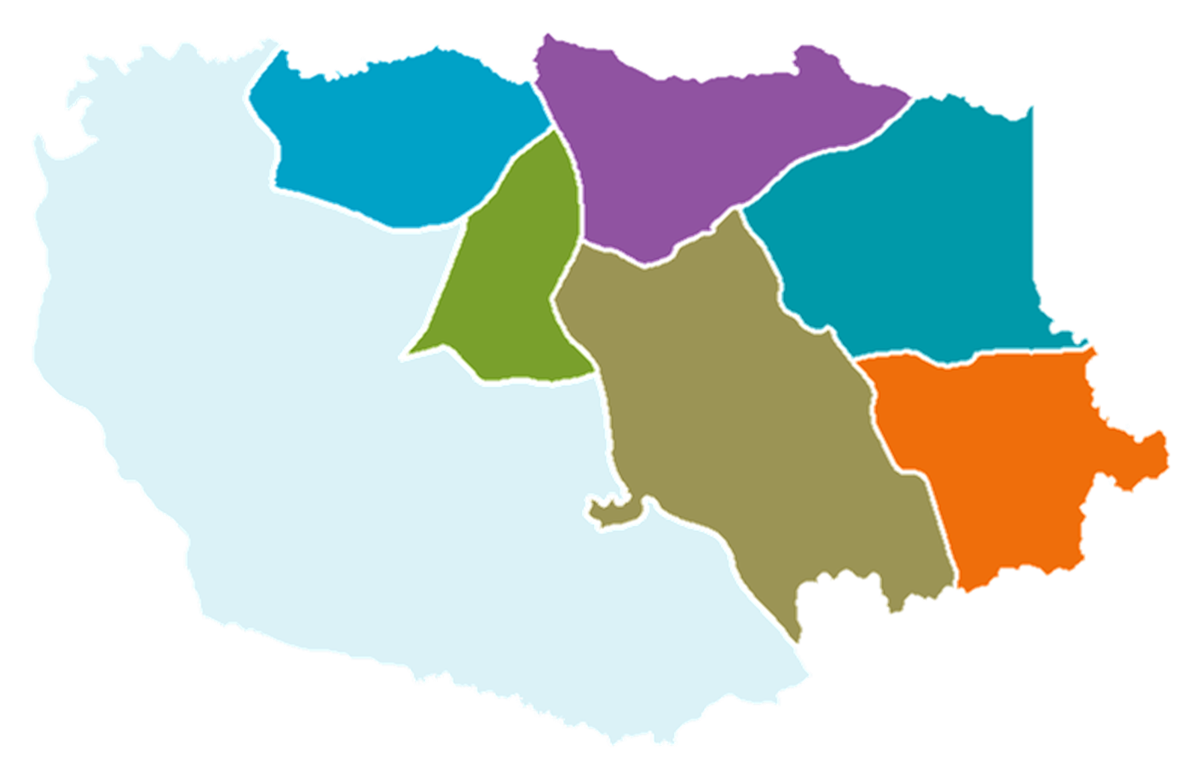


Farmer groups
Greenhouse farming set up
3 districts
16 families
Muengchanh Village, Sepon
PIN | Phin
XPN | Sepon
NON | Nong

Slide 9
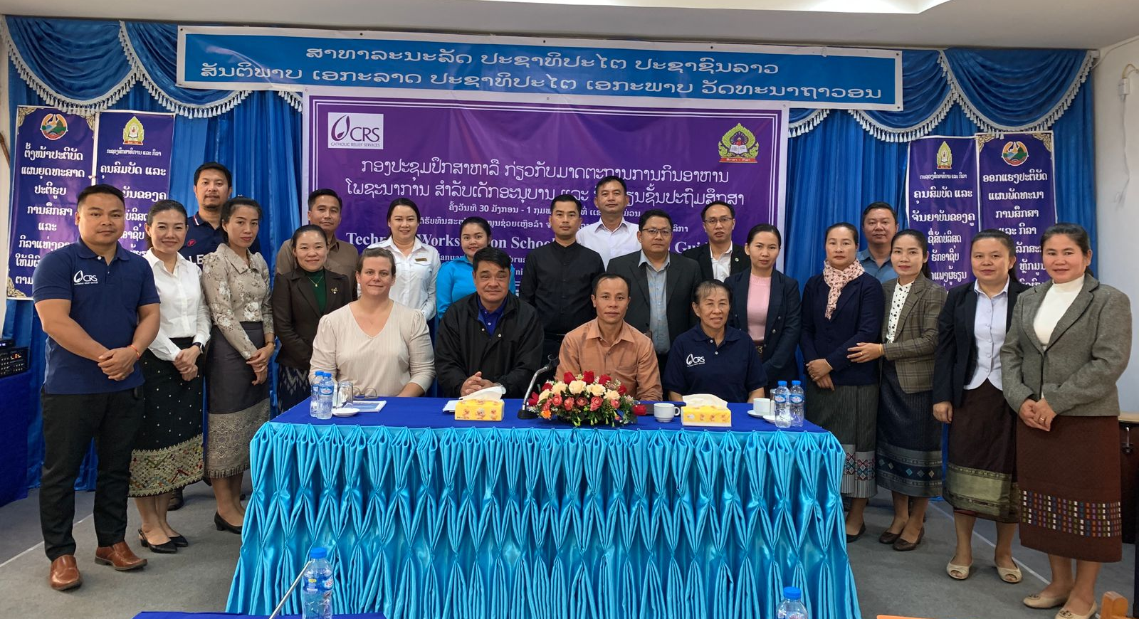
School Lunch Nutrition Guideline
Workshop in Khammuan during Jan 29-Feb 1
Multi-sectoral effort
User-friendly to cooks
40 pages max
Magazine style

Slide 10
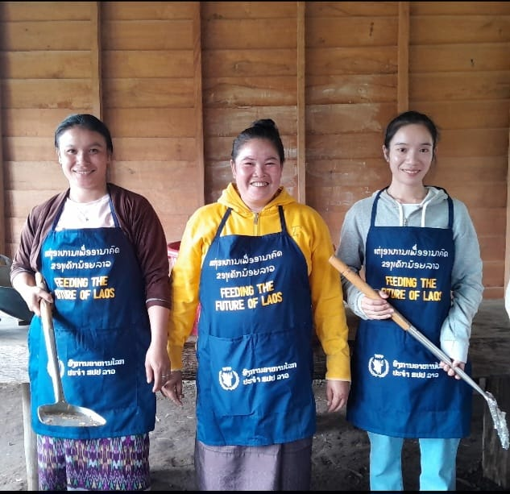
School Lunch Nutrition Guideline
Workshop in Khammuan during Jan 29-Feb 1
Multi-sectoral effort
User-friendly to cooks (moms)
40 pages max
Magazine style
Picture based

Slide 11
Planned Contents
Lao School Lunch Nutrition Guidelines
Child Nutrition Situation
Food needs of Lao children
  Nutritional needs of children
  Food groups
  Importance of diverse diets
Creating Meals
  Value of local foods
  Protein choices
  Multiple vegetables
  Cooking for taste
  Food safety
School Food Environment
  Cooking facilities
  WASH and School Meals
  School shops
  School gardens
Example Recipes
  Regional preference
  Porridge & Soup
  Steamed rice dishes
  Sticky rice dishes

Slide 12
