Slide 1
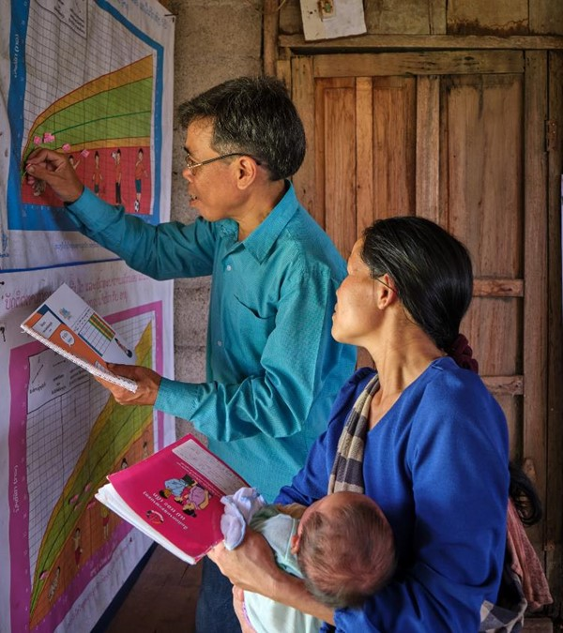











Consumption of Unhealthy Snack Foods and Beverages amongst children under 2 years in Oudomxay and Houaphan, Lao PDR
Notes:
The ENUFF project is a multisectoral nutrition project that aims to improve family and child nutrition in Houaphan and Oudomxay provinces through nutrition-sensitive agriculture production and SBCC for improved diets and hygiene behaviours.
Even with the project interventions we noticed the wide consumption of unhealthy snacks in the communities. To understand the situation a study was commissioned to assess the prevalence of unhealthy snack and beverage consumption amongst children and its determinants.

Slide 2
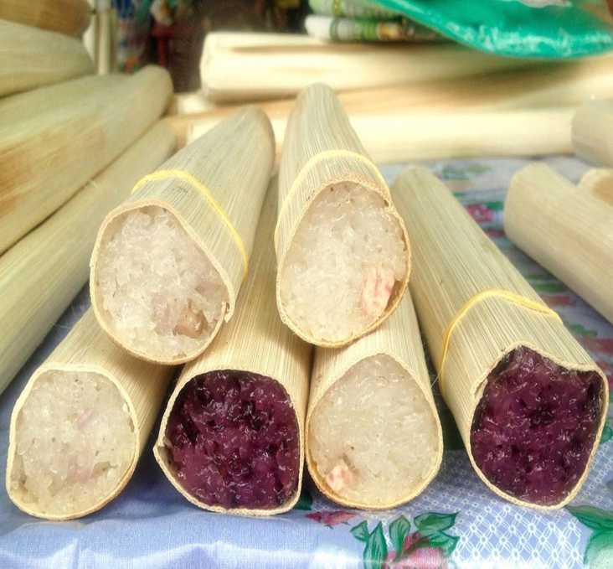
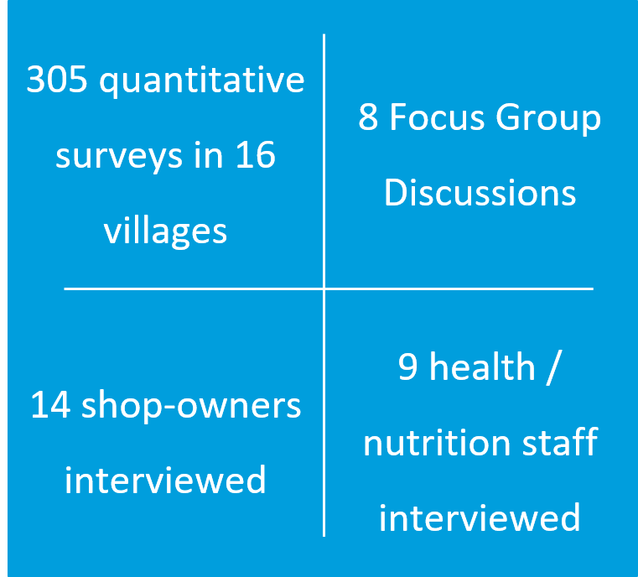
DATA COLLECTION
Notes:
The study consisted of

Slide 3
Unhealthy Snack Foods and Beverages
“food products that are often energy-dense, nutrient-poor and high in salt, sugar, saturated and/or trans fatty acids.”- WHO
Unhealthy food
Unhealthy Beverages
Frozen treats such as ice cream or similar confections
Candies, chocolate, and other sugar confections
Chips, crisps, cheese puffs, French fries, fried dough, instant noodles, and similar items
Cakes, pastries, sweet biscuits, and other baked or fried confections
Commercially produced and packaged, sweetened beverages (soda pop, fruit-flavoured drinks, sports drinks, chocolate and other flavoured milk drinks, malt drinks)
Sweet beverages including 100% fruit juice as well as fruit-flavoured drinks, whether made at home, by informal vendors or packaged in cans, bottles, boxes, sachets
Sweet beverages include home-made drinks of any kind to with sweeteners (sugar, honey, syrup, flavoured powders).
Notes:
For this study we used the WHO definition of unhealthy snack food and beverages. WHO defines unhealthy snack food and beverages as “food products that are often energy-dense, nutrient-poor and high in salt, sugar, saturated and/or trans fatty acids”
There is no acceptable amount of unhealthy foods and drinks for children. So children should not be consuming any of these snacks.

Slide 4
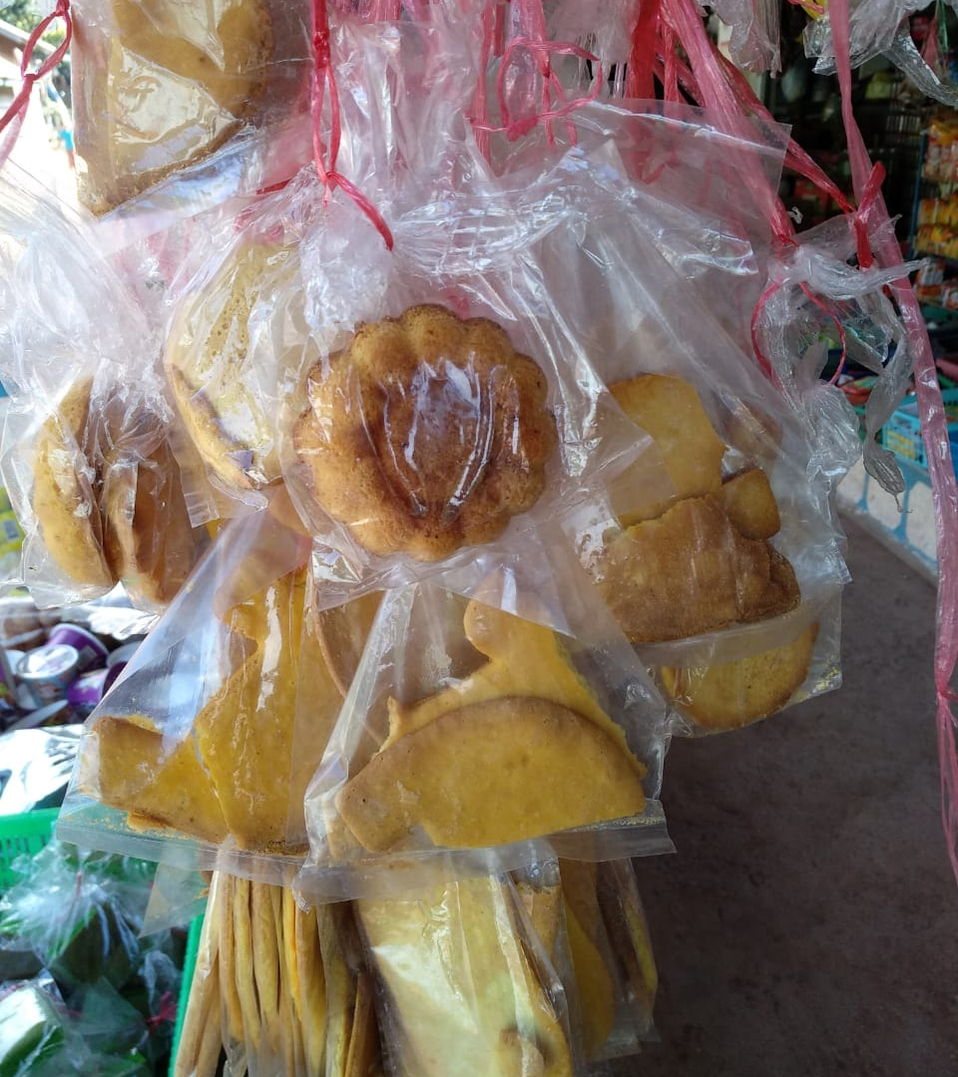
KEY
FINDINGS

Slide 5
Prevalence of Consumption
More than 70% of children between 6 and 23 months had consumed unhealthy snacks and unhealthy drinks in the previous 7 days.
Notes:
More than 70% of children between 6 and 23 months had consumed unhealthy snacks and unhealthy drinks in the previous 7 days.

Slide 6
Prevalence amongst children 0-5 months
The children who were not exclusively breastfed received mostly infant formula or water, and in some cases, thin porridge. They were not given unhealthy snacks.
Notes:
We were also interested to know if children under 6 months were being provided with unhealthy snacks. In our project areas the rate of breastfeeding is very high with more than 80% of children under 6 months receiving breastmilk the previous day.
The children who were not exclusively breastfed received mostly infant formula or water, and in some cases, thin porridge. They were not given unhealthy snacks.

Slide 7
Key Findings – Commercially packaged Snack consumption
Consumption of unhealthy snacks increases with age.
Notes:
The most popular snacks amongst children were sweet biscuit and cookies, savoury snacks like chips and commercially packaged traditional snacks.
We see here that the consumption of unhealthy snacks increases significantly after the age of 1.

Slide 8
Key Findings – Consumption of packaged beverages
Consumption of unhealthy beverages also increases with age.
Notes:
The most common drinks were sweetened milk and packaged juice (everyone would have heard of dido juice?).
We see here that the consumption of unhealthy drinks also increases significantly after the age of 1.

Slide 9
Key Findings – Frequency
More than 20% of children are consuming unhealthy snacks and beverages everyday.
 | Every day |  | At least 4 days a week |  | Between 1 and 3 days a week |  | Never
Sweet biscuit, cookies, crackers
Savoury snacks (chips, puffs, krupuk)
Sweetened Milk
Notes:
We can see here that more than 20% of children are consuming unhealthy snacks and beverages everyday.

Slide 10
Key Findings – Expenditures
50% of caregivers spend between 10,000-50,000 KIP per week on unhealthy snacks
Sweet and savoury snacks
Sweet Beverage
 | No expense
 | < 10,000 LAK
 | 10,000> x <49,999 LAK
 | 50,000> x <100,000 LAK
 | > 100,000 LAK
Notes:
In terms of money spent on these snacks, 50% of caregivers are spending between 10,000-50,000 kip per week on unhealthy snacks and beverages.

Slide 11
Key Findings – Perception
Happiness and convenience as main reasons to offer snacks or sweetened drinks to own child
They make him/her happy | 82%
They are convenient, easy to prepare or buy | 79%
They are cheap | 48%
Child’s happiness and convenience main reasons to offer unhealthy snacks and beverages
Notes:
The main reasons for providing unhealthy snakcs were to make the child happy and stopping them from crying, and convenience. The other reasons that were mentioned were …
With the increasing consumption of these unhealthy processed foods, these districts may see an increase in undernutrition rates as we know that these foods take the place of micronutrients that are required by the body.
Furthermore, introduction to these kinds of foods at such a young age can alter the dietary habits, as these foods are known to be addictive, and can put these children at a higher risk for diseases like high blood pressure and diabetes later on in life

Slide 12
Recommendations
National Level
  Integrate discouragement strategies targeting unhealthy snack foods and beverages in the national SBCC strategy
  Provide incentives to local enterprises with broader distribution capacities to produce healthier options
  Tax unhealthy foods and beverages
  Implement food labelling and marketing policies
Development partners
  Utilize existing village structures to promote healthy snacking (i.e. village volunteers, outreach programs)
  Introduce easy recipes for healthy snacking in cooking demonstration activities using available ingredients
  Work with local vendors (formal and informal) to supply convenient, healthy snacks year-round
  Build the capacity of Micro, Small and Medium Enterprises (MSME) to produce and market healthy snacks and beverages
  Invest in nutrition-sensitive value chain projects with a focus on local food environments
Notes:
Based on this study we make the following recommendations……
This study support the recent UNICEF commit study that found that 40% of Commercially Produced Complementary Food (CPCF) products sold in Laos include added sugars or sweeteners.
And that more than 50% of CPCF products exceed the recommended sodium thresholds.
Approximately 84% of CPCF were found to include non-permitted compositional claims on their labels such as high in vitamin and minerals.
A study conducted by WFP also showed high rates of consumption of these unhealthy foods by school children.
The vast consumption of these unhealthy foods and drinks needs to be taken seriously as it can hurt the country’s progress towards improved nutrition.

Slide 13
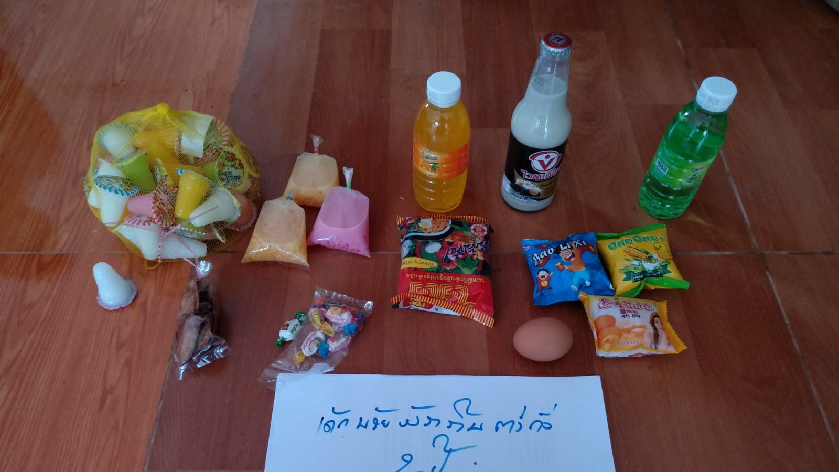
QUESTIONS?
Questions?

