Slide 1
Learning Exchange Workshop for LCSOs
29-30 Nov, 2023
Presented by World Vision International Lao PDR

Slide 2
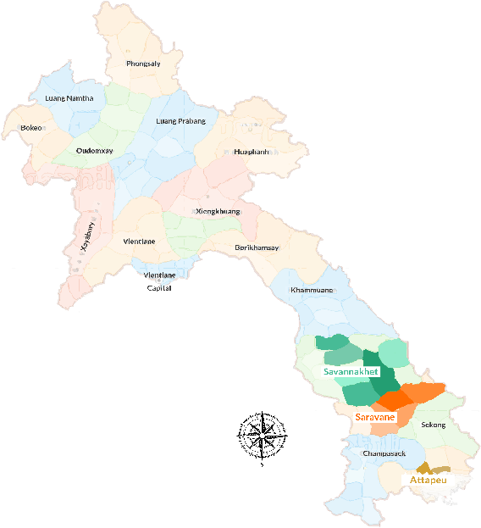
Area Program
Louanphabang - 2 districts Phonexay(12) & PakOu(13) AP
Khammouan- 4 districts AP
Mahaxay(17), Gnommalath(13), Xaybouathong(25) & Xebangfai(14)
Savannakhet - 1 district Nong(14) Grant Fund
Saravane – 1 district Samoui
(15). Grant Fund
Project period 5 province:
2022 - 2026 Laungphabang.
2022 - 2025 Khammoun
2022- 2024 Savannakhet
2020- 2024 - Saravan

Slide 3
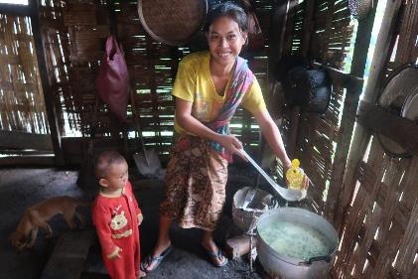
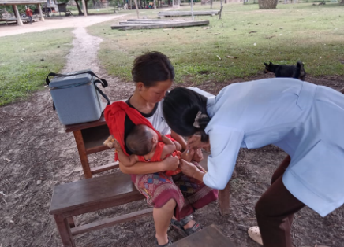
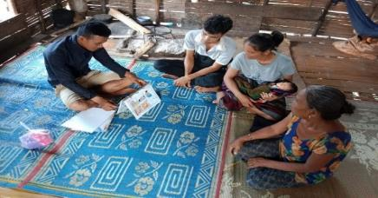
Main Activity:
Train master-trainers on TTC model methodology and monitoring.
Cooperate with PHD & DHO to conduct training/refresher training on ANC, PNC, IMNCI, MCH book, IYCF, IMAM, SAM to HC staffs.
Conduct training on C-IMNCI, CIMAM, IYCF, ANC, PNC, NNC(EENC) , birth spacing and safe delivery for VHV.
Support routine outreach activities (Grow Monitoring Promotion (GMP), Immunization including deworming and Vitamin A)
Support DHO/HC to conduct special events on World Breastfeeding week/food cooking demonstrate at community level

Slide 4

Major Progress
Outcome | Output | Indicator | Total target 2023 | Achieved | %
Improved access to health care services | Local partners are trained and supporting ttC implementation and management information system | # of children 0-59 months reached by a trained VHV | 1,906 | 2,488 | 130.54
 | Strengthened nutrition and health services (IMNCI, IMAM, Vaccination) and counselling for HCs | # of HC trained on CMAM protocol | 96 | 41 | 42.71
 |  | # and % of CU5 with diarrhea treated-ORS/Zinc referred and treated | 168 | 106 | 63.10
Improved dietary and care practices of carers of CU5 | Improved IYCF, maternal, Newborn and child care practices by caregivers | Number and percent of children 0-23 months served by ttC VHV | 1,672 | 1,955 | 116.93
 |  | # of children 0-59 months attending growth monitoring activities | 4,127 | 4,029 | 97.63
 | Caregivers & community leaders provide a healthy & nurturing environment for CU5 | Number of ttC registered newborns aged 0-23 month whose births were attended by a skilled birth attendant | 91 | 167 | 183.52
 |  | Number of active VHV for ttC/Home visit | 150 | 141 | 94.00

Slide 5
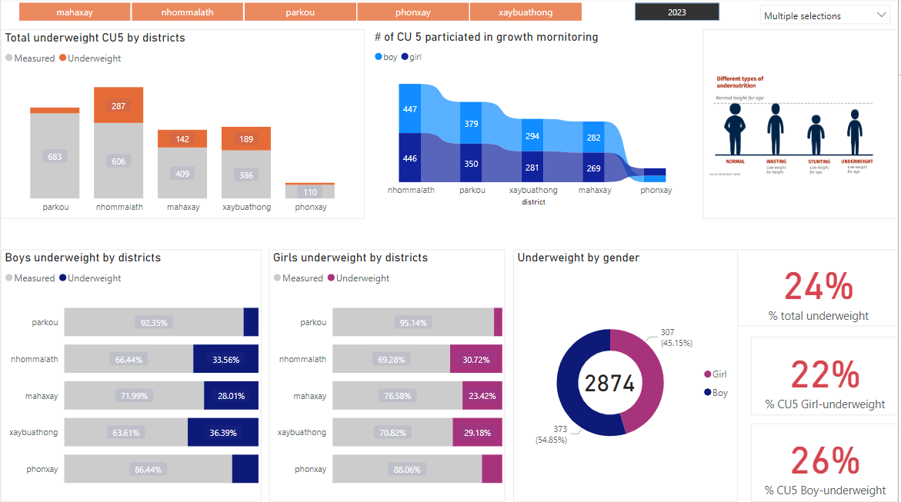

Slide 6
Samoui Nutrition Action Project (SNAP)
Midline Study Report(July 2023)
Objectives | Indicator | Baseline 2020 | Midline 2023 | Target 2025 | Remarks
Children and their caregiver improve dietary and care practices | % of caregivers that report doing a range of age-appropriate stimulating activities with their child U3 in the past three days) | 1.6% | 51.3% | 40% | .
 | % Infants (0-5 months) who are fed exclusively with breast milk | 18.8% | 58.5% | 48%
 | % women reporting satisfaction with their time spent on rest and leisure time | N/A | 84.4% | 49%
Households reduce incidence of selected water, sanitation and hygiene diseases/illnesses linked to undernutrition | Proportion of households using a basic drinking water facility | 54.6% | 73.6% | 80%
 | Proportion of households using a basic sanitation facility (improved sanitation facility) | 15.7% | 30.5% | 30%
 | Proportion of households practicing open defecation | 77.3% | 30.9% | 56%
Households have the knowledge and skills to practice improved safe water and hygiene | Proportion of households with basic hand washing facilities (including soap) | 18.4% | 39.4% | 35%
 | Prevalence of diarrhoea in children under 5 | 41.1% | 39.8% | 20%
Notes:
For the quantitative data collection in the midline survey, the sample size was determined based on an estimated total population of approximately 16,249 residing in the 15 target villages. sample size was 269 households (HH). Out of the 15 target villages, a total of 10 villages were selected for data collection.
The target households for the interview were those with a child under 5 years. Within this category, priority was given to households with children aged 0-5 months (1st priority), followed by households with children aged 6-23 months (2nd priority). Pregnant women were also included as part of the target households (3rd priority). Lastly, households with children 24-59 months were included (4th priority).
In addition to the selected households, 258 adolescents/youths aged 12-17 years old, who were residing in the same households, were also interviewed. This ensured a comprehensive assessment of the nutrition-related practices and behaviour within the household context, considering the perspectives of both caregivers and adolescents.

Slide 7
Samoui Nutrition Action Project (SNAP)
Midline Study Report(July 2023) Cont-
Summary of objectives | Indicator | Baseline 2020 | Midline 2023 | Target 2025 | Remarks
Parents and caregivers' practices support improved health, nutrition, hygiene and nurture | Proportion of children under 5 with diarrhoea who received correct management of diarrhoea | 82.9% | 91.6% | 90%
 | Proportion of parents or caregivers with appropriate hand-washing behaviour | 10.8% | 78.4% | 30%
CSO 4 - Children and their caregivers have improved access to timely and regular health and nutrition services | Proportion of children under 5 who receive regular growth monitoring | 29.7% | 93.3% | 55%
 | Proportion of Pregnant and Lactating Women who received at least 4 antenatal and 2 postnatal visits . | N/A | 32% | 85%
CSO 5 - Children and their caregiver improve access to nutritious food all year round | Proportion of parents or caregivers with the means to save money | 5.4% | 23.8% | 20%
 | Proportion of households with adequate food frequency | 94.0% | 74.3% | 96%
 | Proportion and number of parents and caregivers who prepare nutrient-dense meals at home. | N/A | 33.1% | 55%

Slide 8
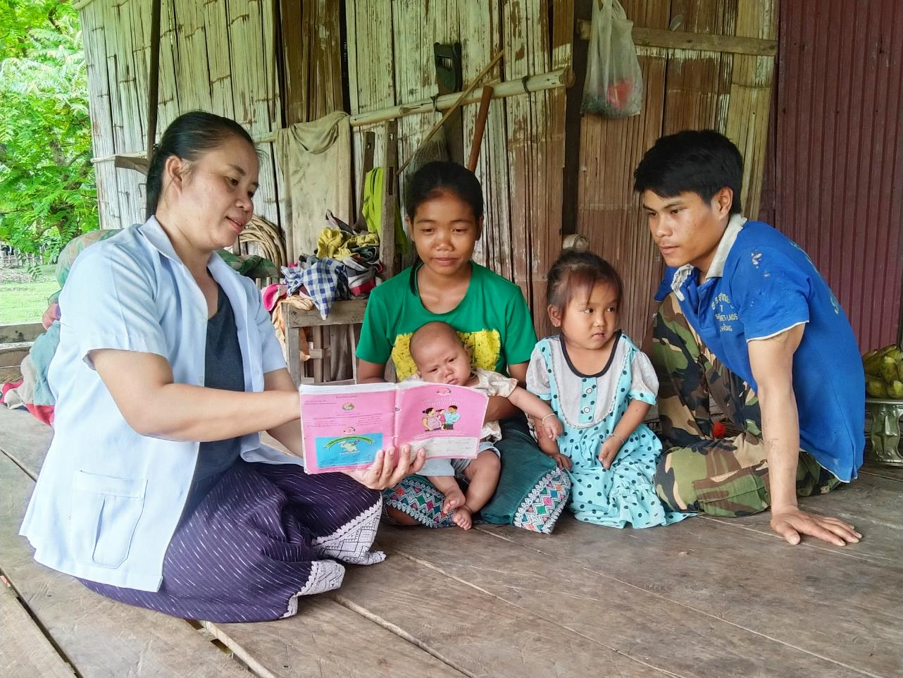



Community Health and Nutrition System Strengthening (CHNSS)

Slide 9

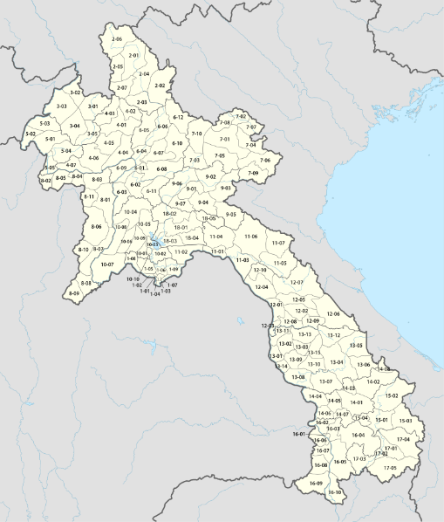
Geographical Coverage
Project Location:
Savannakhet: 4 districts,
Phine, Xonnabuly, Nong, Xepone.
Attapeu: 2 districts, Samakhixay, and Sanamxai.
Khammuane: 3 districts,
Mahaxay, Xaybouathong, Gnommalath
89 Health Centers

Slide 10
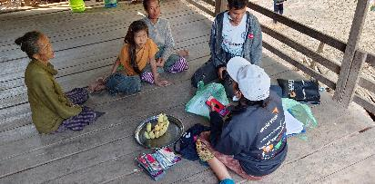
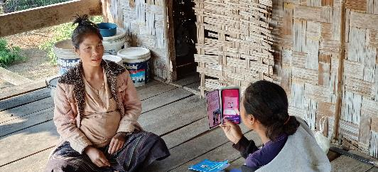
Main Activity:
Train master trainer (PHD & DHO staff) on using the standard VHV toolkit and other WV methodology for the RMNCAH visits and monitoring
Build VHVs list of the district and train VHVs on standard VHV toolkit for the RMNCH home visits.
Support VHVs to conduct home visits, including as per VHV toolkit, the registration of pregnant woman, children 0-59 months and adolescents in target villages and appropriate referral system
Cooperate with DHO/HC to conduct community sensitization on good nutrition and health special events (World Breastfeeding, cooking demonstration, toilet day, etc..) linked to health and nutrition community practices, including covid-19 messages.
Provide MCH books or other IEC material as necessary for health center for strengthening referral with VHVs on MCHN.
Conduct monitoring, mentoring and supportive supervision for VHVs in coordination with DHO & HC staffs

Slide 11
Water, sanitation and hygiene (WASH)

Slide 12
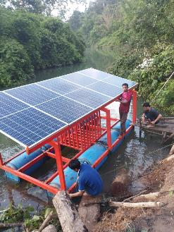
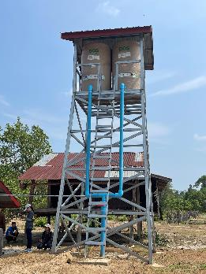
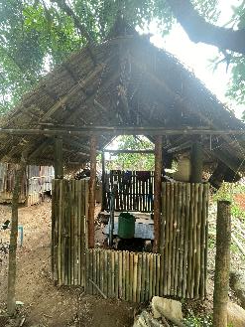
Main WASH activities under Integrated Health and Nutrition
Train VWSMCs, LWU and VHVs on personal and environmental hygiene and safe water and sanitation management
Community-wide WASH promotion events
Train and support VWSMC members and VHVs to conduct CLTS
Provide transportation support for HHs to access materials for latrines
Construct water supply systems.
Train VWSMCs on committee management and water infrastructure maintenance

Slide 13
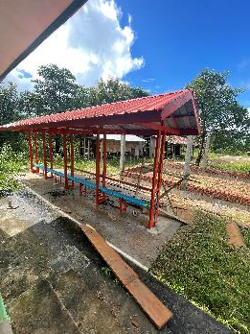
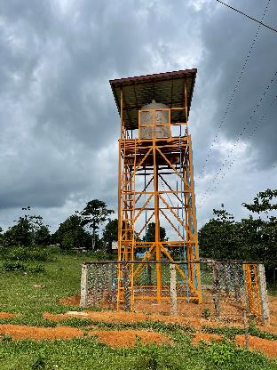
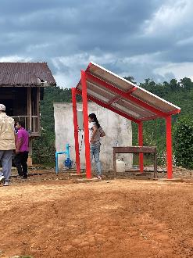
Main WASH activities Under Education
Train VEDC on operation and maintenance
Built hand washing stations
Build school latrine
Build water system for school
Hygiene education

Slide 14
Achievement:
Construction/Rehabilitation 9 districts | Total number
School latrine | 2
Hand washing station | 6
Borehole with solar pump | 7
Community Water system | 18
Indicator | Achieved
Number of people with access to a basic drinking water source in communities | 3,315
Number of successful boreholes completed and commissioned in communities | 13
Number of water points from non-functioning water sources rehabilitated in communities | 97
Number of people with access to household sanitation facilities | 6,680
Number of sensitized households that have handwashing facilities available | 4,947
Number of households with handwashing facilities | 4,117

Slide 15
WASH for ALL
Capacity building
WASH innovation
Developing the WASH guideline
Strengthening WASH relationship with other development partners
Support the National Central for Environmental Hygiene and Water Supply to ensure the country ODF goal achievement as plan 2025
Support and strengthening Provincial and District Namsaats on the water quality testing mechanism

Slide 16
Challenge
Caregivers missed out of outreach activity especially June and December due to seasonal harvesting. The malnutrition in CU5 may take time to reduce due to the increase of food insecurity in the community affecting by economic down turn and most communities changed to plant cassava. Infants in the six month and under age group, are still fed supplementary food such as cereals, milk powder or rice soup. It is a positive sign for mothers who received postnatal care visits, but the women will have postnatal care only when they feel sick. VHV have left their village to work in other provinces due to economic issues. Material for building toilet from supplier too high . CLTS activity is challenged in some target villages, because of financial or material aid and road condition for transportation. Staff turnover and transitioning of project team increased gaps and a shortage of staff to support the implementation of project activities in the communities.

Slide 17
Lesson learned
Working in good coordination with government partners in both planning and implementing activities is the key to complete and achieve the project plan.
In rainy season the team learnt how to make and adapt the activity plan which was appropriate to the situation.
Working with ethnic groups is very challenge as language, culture, and beliefs. So combining different approaches to work with community is more effective. Ex. engaging elders and traditional leaders is more champion than heads of village.
Involving communities in constructing water system(cooperation, compromise, or group participation leads to all participants benefiting) is the way to build relationships and to strengthen their engineering technical capacity and skills for promoting sustainability of project activities as the more to get communities engaged the more ownership is gained and the maintenance responsibility is high.
Integrated Nutrition program is effective on improvements of child nutrition:
  Building Secure Livelihoods: Provide small animal, home garden,
  Integrated WASH.
  Saving group for Nutrition.
  Gender and women’s labour-saving technologies

Slide 18
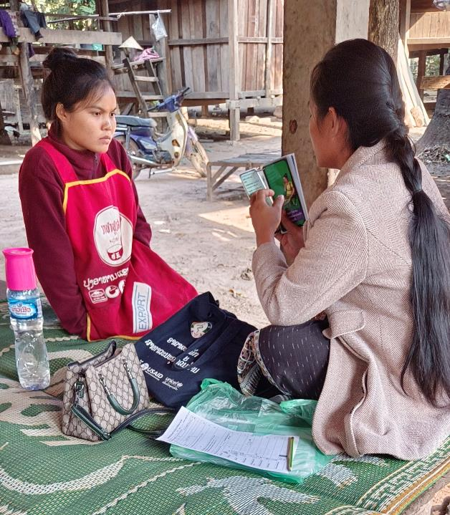

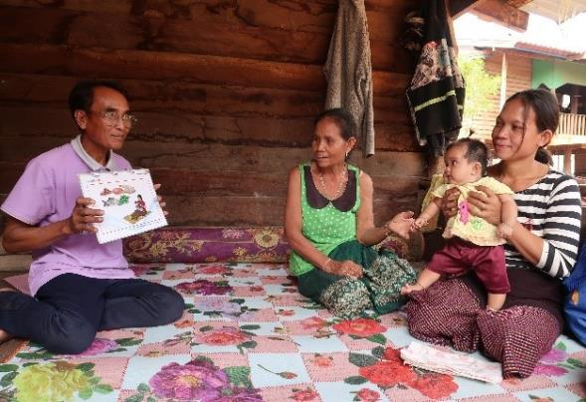
Thank you

