Slide 1
Overview of Wasting Prevention and Management Program in Lao PDR
UNICEF- Vientiane Lao PDR

Slide 2
Outline of Presentation
Prevalence and Situation of Wasted Children in Lao.
Strategic Approach to address the problem of Wasting.
Progress made so far on IMAM Program.
Challenges
Scale up Plan of IMAM – 2023-2024

Slide 3
Situation of Infant and Child Mortality Rate

Slide 4
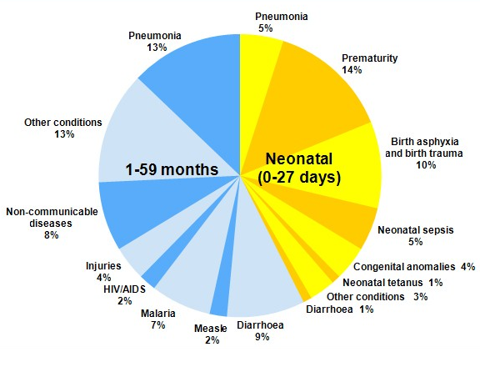
Undernutrition and Child Mortality
Source: The Lancet Maternal and Child Nutrition Series 2013
About 45% of Child
Mortality is associated
with undernutrition

Slide 5
Why these children needs immediate attention
Children suffering from wasting are up to twelve times more likely to die than well-nourished children.
This makes wasting one of the most significant contributors to child mortality.
Globally, 1 in 5 deaths among children under the age of 5 is attributed to severe wasting – also known as severe acute malnutrition.

Slide 6
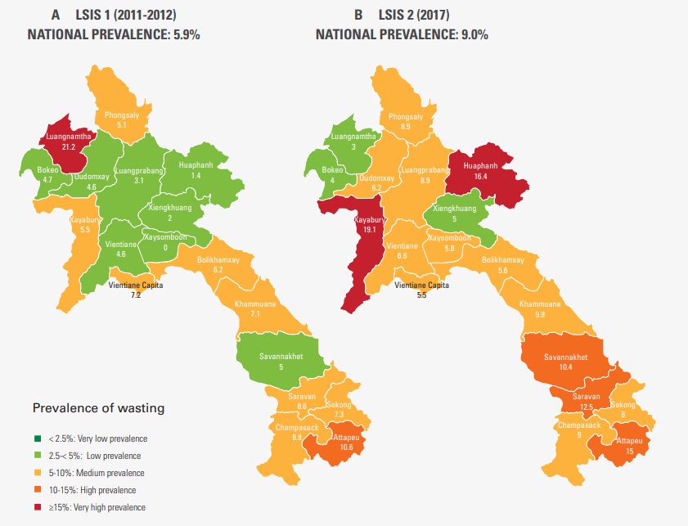
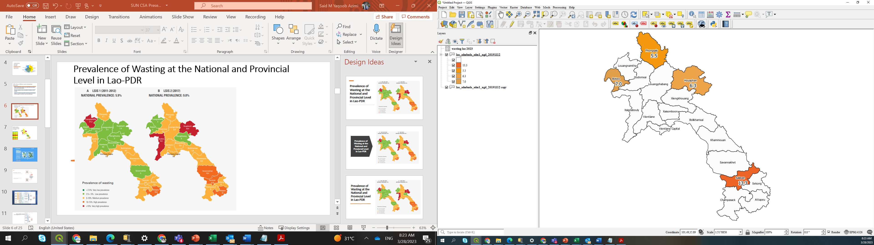
Prevalence of Wasting at the National and Provincial Level in Lao-PDR
C PHHS (2022)
National PREVALENCE: NA
Notes:
6

Slide 7
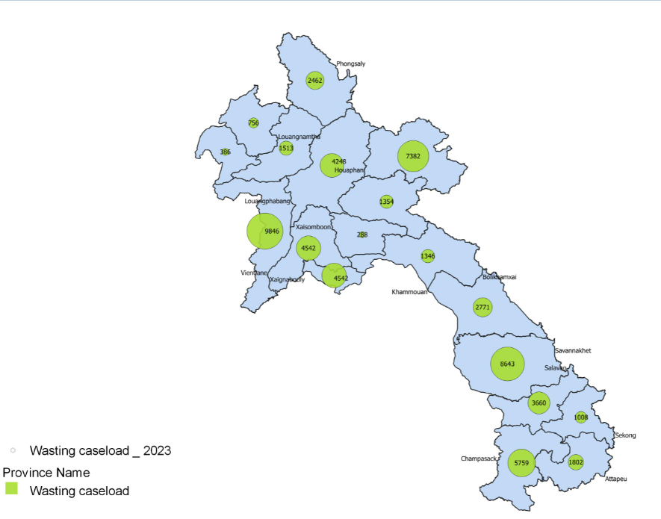
Burden of Severe Wasting at National and Provincial Level in Lao-PDR
National | 60728 | Prevalance
Vientiane Capital | 4542 | 1.8%
Phongsaly | 2462 | 4.5%
Luangnamtha | 756 | 1.4%
Oudomxay | 1513 | 1.6%
Bokeo | 386 | 0.7%
Luangprabang | 4248 | 3.2%
Huaphanh | 7382 | 8.3%
Xayabury | 9846 | 8.4%
Xiengkhuang | 1354 | 1.8%
Vientiane Prov. | 2963 | 2.3%
Bolikhamxay | 1346 | 1.6%
Khammuane | 2771 | 2.3%
Savannakhet | 8643 | 2.9%
Saravane | 3660 | 3.0%
Sekong | 1008 | 2.9%
Champasak | 5759 | 2.7%
Attopeu | 1802 | 4.2%
Xaysomboun | 288 | 1.1%
Notes:
7

Slide 8
Equity analysis of Wasting Prevalence
Source: Nutrition Provincial Household Survey 2022
 |  | Wasting (- 2 SD⁵⁾ |  |  |  | Severe Wasting (3 SD⁶ )
 |  | Saravanne | Phongsaly | Huaphan | Bekeo | Saravanne | Phongsaly | Huaphan | Bekeo
 | Province | 13.3 | 5.5 | 6.3 | 7.0 | 2.7 | 1.6 | 1.8 | 1.8
Sex | Male | 14.2 | 5.9 | 7.0 | 7.7 | 2.7 | 2.0 | 1.9 | 1.9
 | Female | 12.3 | 5.1 | 5.6 | 6.4 | 2.8 | 1.0 | 1.8 | 1.8
Area | Urban | 9.7 | 4.7 | 5.3 | 5.6 | 1.9 | 1.6 | 0.9 | 0.8
 | Rural | 13.6 | 5.6 | 6.4 | 7.4 | 2.8 | 1.6 | 1.9 | 2.1
Education | Pre-primary or none | 15.9 | 5.2 | 6.1 | 8.8 | 2.7 | 1.7 | 1.9 | 1.9
 | Primary | 13.8 | 6.2 | 6.2 | 6.6 | 3.0 | 1.5 | 1.9 | 1.8
 | Secondary | 10.7 | 4.2 | 6.5 | 7.8 | 2.3 | 1.3 | 2.0 | 1.6
 | Post-secondary+ | 8.8 | 7.3 | 5.9 | 4.2 | 2.4 | 2.0 | 0.9 | 2.1

Slide 9

Our Challenge
We need a new paradigm, new approach to prevent, protect and treat life-threatening forms of undernutrition
We know what it takes to achieve reductions in child wasting and other forms of undernutrition.
Much of what we need to do is already being done, but the way we are doing it means that vulnerable households and children do not systematically and periodically access available support. Some of the children access some of the services some of the time.
To reduce wasting, that has to change.
From This
To This
Vulnerable Household
Child-centered essential nutrition actions

Slide 10
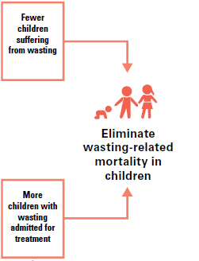
The Strategic approach
UNICEF primary goal is to ensure that no child dies from wasting

Slide 11
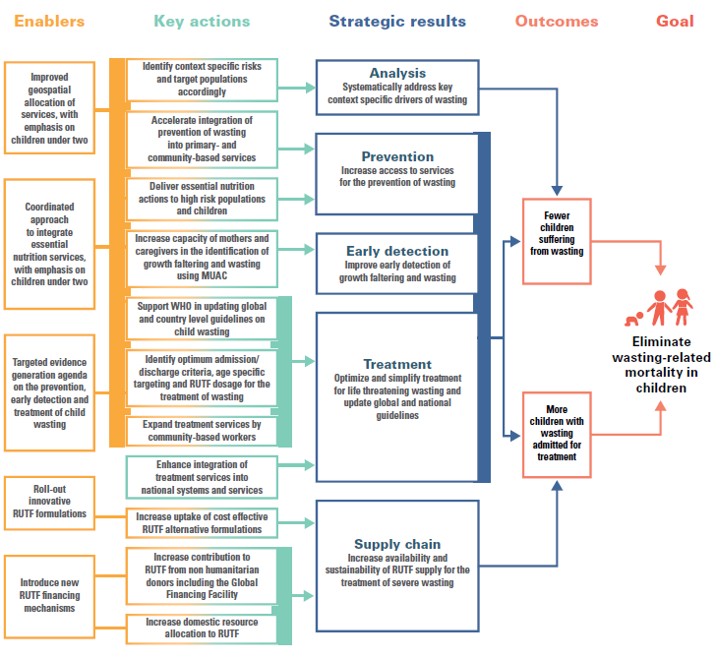

Slide 12
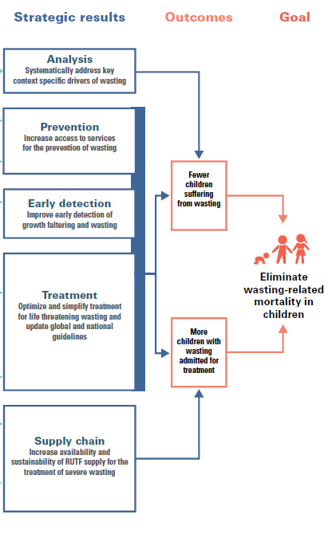
What are we finding?
How is it changing what we do?

Slide 13
What are we finding?
How is it changing what we do?
What does it mean, concretely, to put prevention first?

Slide 14

What are we finding?
How is it changing what we do?
What does it mean, concretely, to put prevention first?
How can we simplify and optimize the early detection and treatment of child wasting?

Slide 15
Early detection and Treatment of Child Wasting
In context of limited resources, we must prioritize the most vulnerable
Prioritize the financial resources available for treating wasting and protect children at highest risk of death
Scale up early detection and access to treatment
Increase the availability of commodities for the early detection and treatment of children with wasting.
Notes:
When prevention fails, treatment is a must

Slide 16

Progress made so far……..

Slide 17




National Guidelines on IMAM program
National Guidelines developed with Job Aids for IPD, OPD & Community Component
Training package developed for different levels of services providers.
National ToTs and roll out of IMAM trainings done in targeted provinces.
Provincial and District level staffs of PHO, DHO and Hospitals trained on IMAM

Slide 18
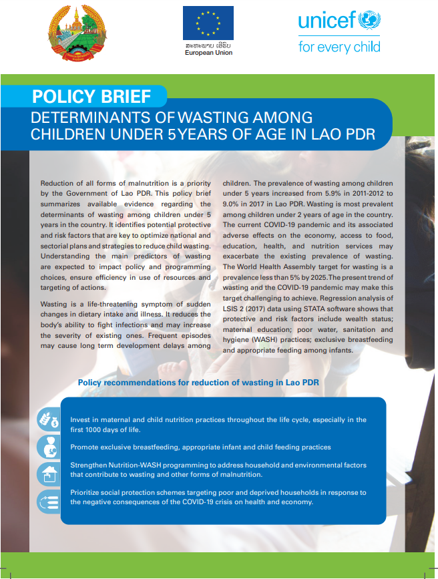
Policy Brief- WASTING
Policy brief was developed to understand the determinants of wasting among children under the age of five in Lao PDR, as well as to identify potential protective and risk factors that can be used to improve national and sectorial plans and strategies to reduce child wasting.
Key Policy Recommendations :-
Invest in maternal and child nutrition practices throughout the life cycle. Especially in the first 1000 days of life.
Promotion of exclusive breastfeeding and appropriate infant feeding.
Strengthen Nutrition-WASH programming to address household and environmental factors that contribute to wasting.
Prioritize social protection schemes targeting poor and deprived households and control of the negative consequences of the COVID-19 crisis on health and economics.

Slide 19

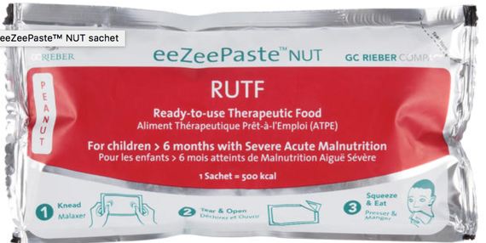
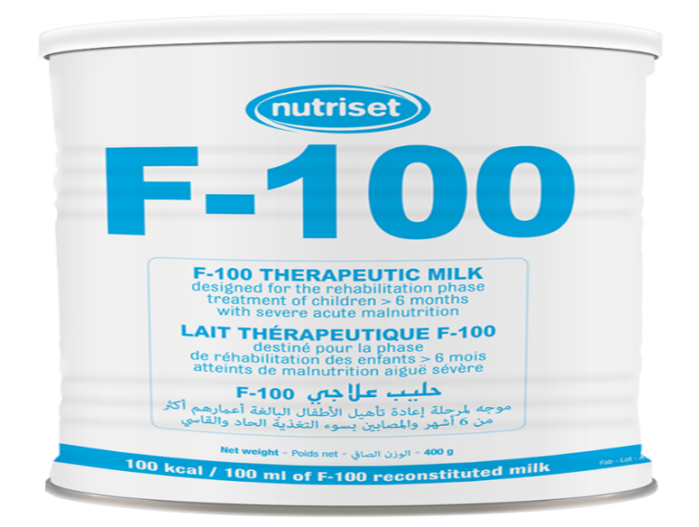

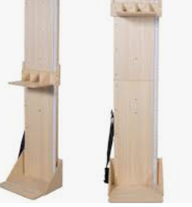
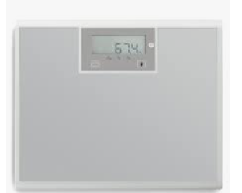
Procurement & transportation of Anthropometric Equipment and therapeutic nutrition supplies
Year- 2021
Weighing Scales = 771 +1112= 1,883
Height Boards- 1026 +22= 1048
MUAC tapes= 2256 PACs
Nutrition Kits ( Inpatient – Med Supplies -2) – 14
Nutrition Kits ( Inpatient- Mod Equipment ) -18
RUTF, 92g/CAR-150= 4073 Cartons
F-100 Therap milk CAN 400g/CAR-24 = 56 Cartons
F-75 Therap milk CAN 400g/CAR-24 = 169 Cartons
Year- 2022
MUAC tapes= 8,000 PACs
Nutrition Kits ( Inpatient- Mod Equipment ) -25
RUTF, 92g/CAR-150= 6,100 Cartons
F-100 Therap milk CAN 400g/CAR-24 = 31 Cartons
F-75 Therap milk CAN 400g/CAR-24 = 85 Cartons
NB: Targeted Hospitals and Health Centers have anthropometric equipment & supplies for the management of acute malnutrition.

Slide 20
Nutrition Supply Chain Management
Nutrition commodities included in the routine monitoring of supply using mSupply (an international electronic Logistics Management Information System).
Supply chain assessment was undertaken in Luangprabhang and Huaphan province with technical support of CHAI .
Support in development of tool to improve planning, forecasting, distribution, utilization and reporting of nutrition commodities as well as increase the control and improve stock management practices of RUTF at subnational level.

Slide 21
Development of e- learning videos and course to improve skills and knowledge on IMAM
In Joint partnership with MoH, UNICEF and Lao Friendship Hospital, Luangprabang (LFHC), e- videos were developed in the amidst of COVID-19 for continuation of learning of Health Workers in improving skills and knowledge on management and treatment of acute malnutrition.
UNICEF has also collaborated with its Regional Office to develop an online/ blended course which will help frontline workers to access course at their convenience and enhance their knowledge on SAM Management. The work in near completion and would be first online training course in the region.

Slide 22

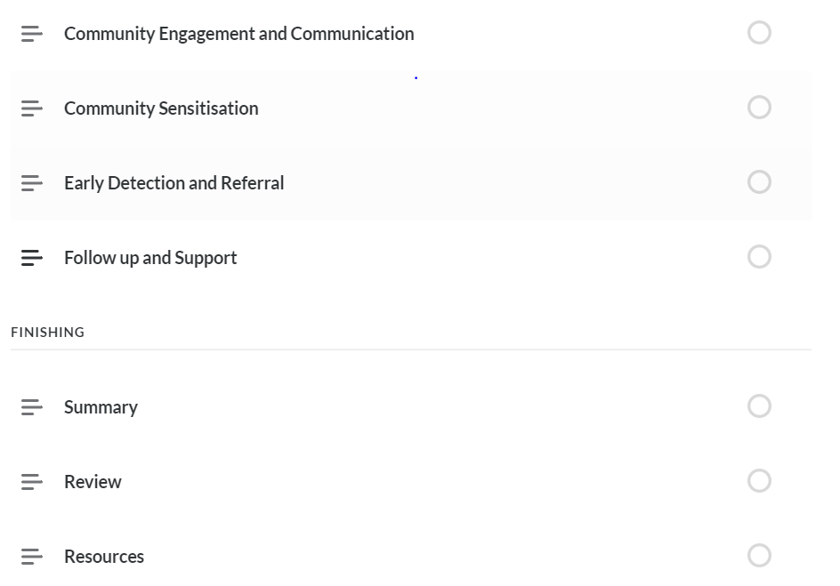
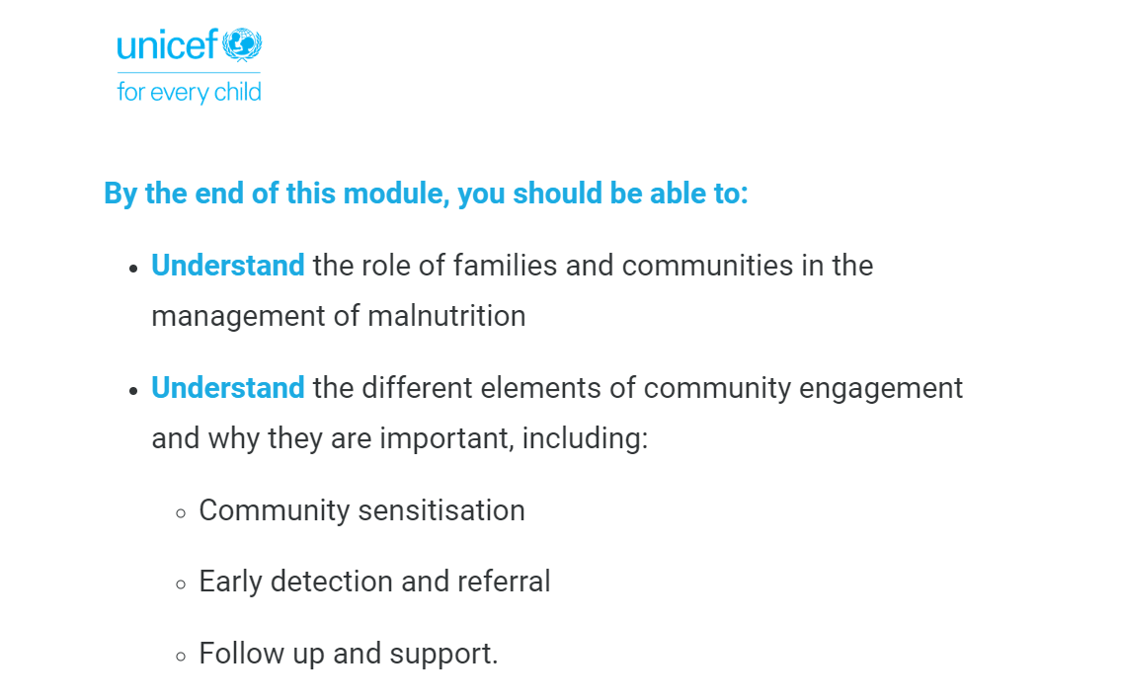
Modules of e- Learning Wasting Course
M1 ( Introduction to Management of Severe Acute Malnutrition ) https://360.articulate.com/review/content/1f2c112d-4507-4412-94c5-1c0b7f13ab83/review
M2 (Community Management and Communication)
https://360.articulate.com/review/content/cdeaf758-1d62-4700-95d5-ca9b46297e31/review
M3 ( Assessment and Triage of Malnutrition)
https://360.articulate.com/review/content/6eec5305-f8dd-4f19-a5d8-cb6e6371fcfd/review
M4 ( Management of Moderate Acute Malnutrition )
https://360.articulate.com/review/content/23ceac19-8026-4835-8248-8f1f71912b4d/review
M5 (Management of SAM without Complication – Outpatient Therapeutic Care)
https://360.articulate.com/review/content/89789abc-7283-4c19-b6e3-df8f29de0e9b/review
M7 ( Managing Infants les than 6 months)
https://360.articulate.com/review/content/17bfd8fb-02eb-48bf-8bd3-28a757e4d232/review
M8 (Monitoring, Reporting and Supply Management)
https://360.articulate.com/review/content/ebb5b419-f505-422a-b666-2d6d0b3aaf1c/review
M9 (Supporting Carers)
https://360.articulate.com/review/content/9a78bc92-5d4a-4b4d-975c-198f4ad8acf3/review
M10 ( Recent Development)
https://360.articulate.com/review/content/cf82dc8c-bfee-44ea-9a44-18bd24807804/review

Slide 23
Training Support & Anthropometric Videos
Appetite Test:
https://vimeo.com/693154170/017dfd94e6
Assessing Nutrition
https://vimeo.com/693158898/fac3aa2271
Checking for Complications:
https://vimeo.com/manage/videos/693162454/e14fb010a6
Community Engagement
https://vimeo.com/693163916/0868d6dbab
Emergency Kangaroo Care:
https://vimeo.com/693168076/52d5ab8e55
Failure to Respond:
https://vimeo.com/693170443/5283fbfc9d
Management and Follow Up
https://vimeo.com/693173601/45e1db5f28
Case Study 2; Failure of OP therapy https://vimeo.com/693645998/f272737dbc
Case Study 1: Nutrition Rehabilitation https://vimeo.com/693799911/135ab8b2a7
Anthropometry Videos: Height Standing:
https://vimeo.com/693806923/b1ef31bc05
Height Lying Down:
https://vimeo.com/693807692/582b6bdd59
Weight Balance Beam Scale:
https://vimeo.com/693808789/1e31ea2290
Weight Salter Scale:
https://vimeo.com/693809792/ee1804bce4
Electronic Scale:
https://vimeo.com/693811770/5545a1b3d0
Measure MUAC:
https://vimeo.com/693815359/dcbf3dc38a
Check for Oedema:
https://vimeo.com/693815786/d8f29ce9c7

Slide 24
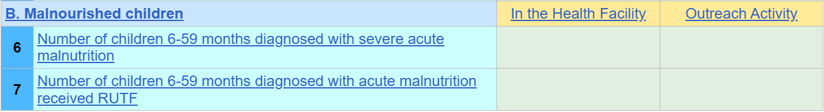
Inclusion of IMAM Indicators in DHIS-2
IMAM indicators were included in the DHIS-2 which includes of both coverage and outcome indicators.
SO4- Indicator-
Proportion of children 6- 59 months who have been screened with MUAC / and or looking for pitting Oedema on both feet's (%)
SO5 – Indicators-
Proportion of children 6- 59 months with SAM who are admitted for treatment at health facilities.
Proportion of children 6- 59 months with SAM who are admitted for treatment at health facilities and discharged as Cure.
Proportion of children 6- 59 months with SAM who are admitted for treatment at health facilities and discharged as dead.
Proportion of children 6- 59 months with SAM who are admitted for treatment at health facilities and discharged as defaulted.

Slide 25
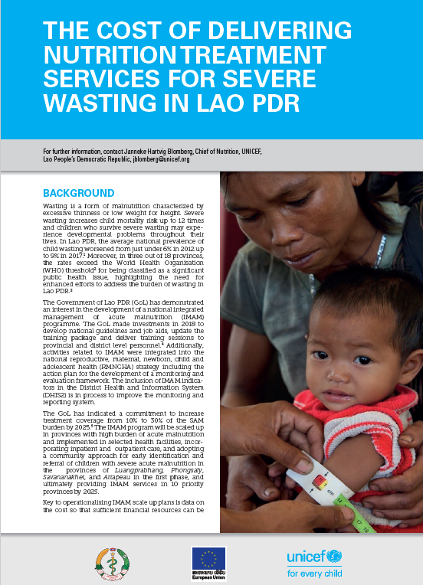
Cost of Treatment of SAM Child-
Pilot Study
A Pilot Study was undertaken to understand Cost of treatment of SAM child based on data collected from existing IMAM services in Khamoune and Attapeu provinces.
Objective was to estimate cost per child treated for wasting according to the National IMAM protocol and to estimate total resource envelope required to progressively scale up service delivery.
At present cost of treatment of child is coming around $ 400/ child ( which includes of costs pertaining to supplies , training , human resources, monitoring and supervision and management). This is very high compared to global average.
Efforts of scaling up should focus on increase treatment coverage in the high burden of acute malnutrition. This will maximize cost-efficiency and increase the number of children that can be treated within the fiscal space available
RMNCAH- Result & Evaluation Framework propose to screen children of age 6-59 month by 35% and reach for admission and treatment of SAM children by 20% in Year- 2023.

Slide 26
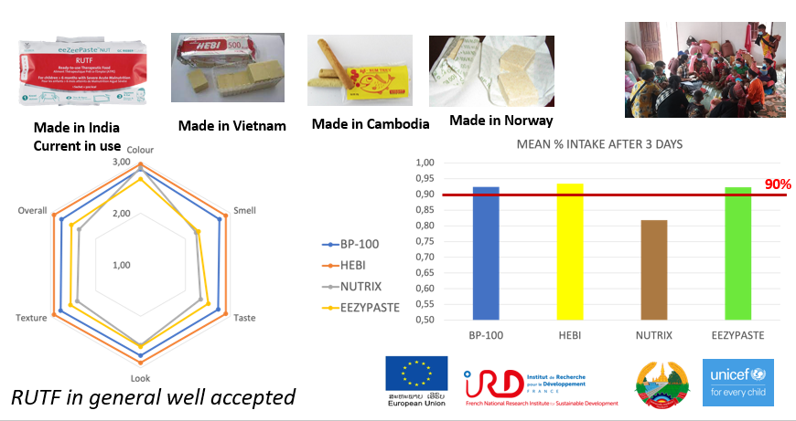
RUTF Acceptability Study
Centre of Nutrition and UNICEF in partnership with LTPHI and IRD conducted a RUTF acceptability study in two provinces Phongsaly and Atatepau to better understand the likeability of the product to inform the type of product utilized in Lao PDR in the future in terms of organoleptic features such as taste, structure, color, and smell, as well as other cultural factors.

Slide 27
Challenges

Slide 28
Key challenges of IMAM Program
Poor Coverage and access
Limited Coverage
Less Admission
Timeliness
Poor Community Mobilization
Timely Identification and Referral
Continuity of treatment
Defaulter & relapse cases
Skilled and Trained Human Resources
Distance to access services
Availability of treatment services
Non availability of supplies and drugs

Slide 29
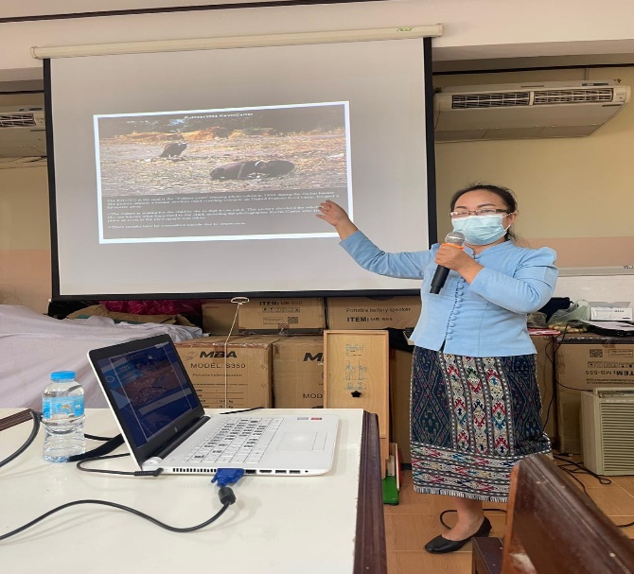
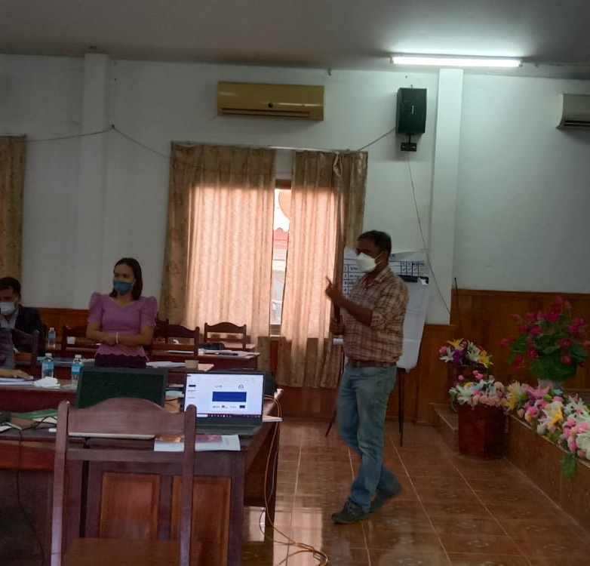
Capacity Issues to deliver IMAM Program
Trainings of Health & Community workers was less prioritized in previous investments, resulting in limited early detection and referral mechanism of children with Severe Acute Malnutrition.
Limited focus on community sensitization and mobilization activities to create awareness on malnutrition in the community.
Turn over of staffs and transfers is high and require more refresher trainings.
Limited number of Pool of trainers at Provincial & District Level.

Slide 30

Poor Outcome Indicators
Very limited information available of children admitted with defined admission and discharge criteria.
Limited children reach with CURED criteria as many of them often get defaulted.
For children enrolled in the program, there is weak follow-up mechanism for continuity of treatment.
Distance of caretaker to access services from long distance is also a challenge in some locations.
Due to lack of early detection and referral mechanisms of severe acute malnutrition children, their health conditions deteriorate and needs hospitalizations services for treatment.

Slide 31
Limited Prevention Activities to address Wasting
Weak implementation of health specific interventions related to Maternal Nutrition, IYCF Counselling, Micronutrient supplementation in hard-to-reach locations.
Growth Monitoring and faltering is not uniformly implemented and monitored.
MUAC screening for early identification and referral mechanism is not rolled out and reported.
Social safety schemes to support household with SAM children are limited.
Limited accessibility of safe drinking water and sanitation facilities in pockets with high malnutrition rates.

Slide 32

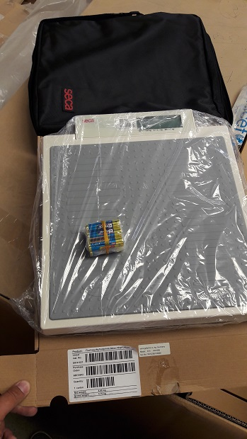
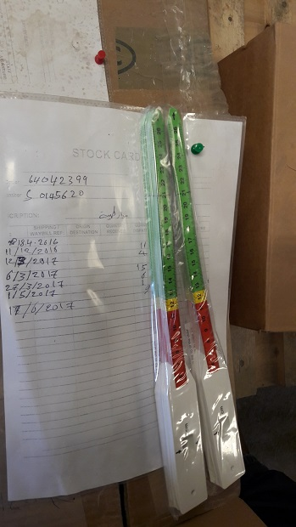
Nutrition Supply Chain Management
Limited therapeutic supplies is procured for the initial treatment and management of children with severe acute malnutrition.
More resources require to procure additional quantity of supplies for continuity of treatment.
Nutrition Supplies are not prioritized for provinces/ districts with high malnutrition prevalence.
Stock out of essential nutrition commodities in health facilities.
Poor planning, forecasting, procurement and distribution of therapeutic supplies resulting in under utilization of nutrition commodities and sometime expiry of supplies.

Slide 33
Scale up Plan of IMAM- 2023-2024

Slide 34
Scale up Plan-2023-2024
Provinces | PH ( IPD) | DH ( OPDs) | Districts for (Community Program) * | # of Health Centers | Target 30% of Health Centers | Annual Burden of SAM | Target- 50% | Funding Source
Phongsali | 1 | 7 | Nhot ou | 7 | 2 | 443 | 222
 |  |  | Phongsaly | 7 | 2 | 332 | 166
Loungprabhang | 1 | 12 | Narn | 8 | 2 | 285 | 143
 |  |  | Phonexay | 10 | 3 | 330 | 165
Houaphan | 1 | 10 | Xon | 5 | 2 | 418 | 209
Xainyabouli | 1 | 11 | Xainyabouli | 10 | 3 | 2012 | 1006
Khammouan | 1 | 10 | Mahaxay | 11 | 3 | 267 | 134
 |  |  | Xaybouathong | 6 | 2 | 190 | 95
 |  |  | Yommalath | 8 | 2 | 240 | 120
Savannakhet | 1 | 15 | Phine | 12 | 4 | 597 | 299
 |  |  | Atsaphangthong | 9 | 3 | 422 | 211
 |  |  | Xonnabuly | 13 | 4 | 554 | 277
 |  |  | Nong | 9 | 3 | 272 | 136
 |  |  | Xepone | 15 | 5 | 516 | 258
Salavan | 1 | 8 | Vapi | 7 | 2 | 356 | 178
Xekong | 1 | 4 | Thateng | 8 | 2 | 354 | 177
Champasak | 1 | 10 | Phonthong | 11 | 3 | 805 | 403
Attapeau | 1 | 5 | Samakhixay | 5 | 2 | 484 | 242
 |  |  | Sanxai | 10 | 3 | 286 | 143
 |  |  | Sanamxai | 10 | 3 | 449 | 225
Total | 10 | 92 | 20 | 181 | 54 | 9612 | 4806
Number of IPD program to established :- 10
Number of OPD program at District Hospitals :- 92
Number of OPD program at Health Center :-54

