Slide 1




Nutrition Governance Index

Slide 2

Overview
Although Laos has demonstrated strong multisectoral political commitment, there is a lack of evidence-based guidance on its implementation
ENUFF is collaborating with Tufts University to conduct research using the Nutrition Governance Index to analyse how the NPAN in Laos gets translated from paper to practice
The NGI research has been conducted in Nepal. It is currently being replicated in Laos, Jordan and Ethiopia

Slide 3
Nutrition Governance Index
set of 24 questions on self-perceived governing practices ​
The questions are grouped into 6 different themes
Roles
Colleagues
Coordination
Finance
Capacity
Support
e.g. Was there a demand/suggestion from other departments for you/your department to collaborate with them on nutrition related issues?
2 rounds of survey conducted
Round 1 (July-Aug 2021) 315 respondents
Round 2 (Aug 2022) 322 respondents
PNC members, DNC members, technical staff, Village authorities interviewed
Notes:
The Nutrition Governance Index measures the ‘quality of governance’ and allows to make an assessment of what people responsible in implementation of nutrition policies know, think and do in relation to their defined areas of responsibility at all levels of administration, and across all sectors.
We have been collaborating with Tufts University to conduct this research on Nutrition Governance.
Since round 1 we have disseminated NPAN, budget training

Slide 4
During Round 1: Only 67% of the NC members were aware of the NNS and NPAN
Activities conducted after Round 1 results:
  NPAN Dissemination at the Province
  NPAN Dissemination at the District
  Nutrition Basics Training
  Regular DNC meetings lead by DNC-S

Slide 5
+
-
SUPPORT
ROLES
CAPACITY
%
FINANCE
COLLEAGUES
COORDINATION
Notes:
Overall more increased agreement than hpn

Slide 6
86% agree that their own personal responsibilities in relation to action on nutrition are clearly defined compared to 72% (NUTRIFICIAL)

Slide 7
39% agreed they personally have sufficient financial support to be effective in nutrition related activities and responsibilities compared to 19% in 2021 (respbudresnut)

Slide 8
80% felt that other departments were sharing information about nutrition plans and activities compared to 64% in 2021 (NFNUTACT)

Slide 9
93% felt there was effective collaboration across departments in addressing nutrition issues compared to 78% (Collefect)

Slide 10
Are you aware of the National Nutrition Strategy and National Nutrition Plan of Action???

Slide 11
Challenge
Only 45% of the respondents were interviewed in both rounds
Share of PNC, PNC-S, DNC and DNC-S respondents who were interviewed in both round 1 and round 2
PNC member | 23.7%
PNC secretariat member | 27.3%
DNC member | 70.2%
DNC secretariat member | 66.7%
High staff turnover is a risk to the successful implementation of the NPAN

Slide 12
Recommendations
NPAN dissemination needs to be done down to the district level and include technical staff and not only DNC members
Basic nutrition training for staff from relevant sectors at all levels
Management courses for nutrition committee and secretariats
MEAL training for technical staff so hard data can be used to track progress and assess gaps
Handover process should be in place for nutrition committee members

Slide 13
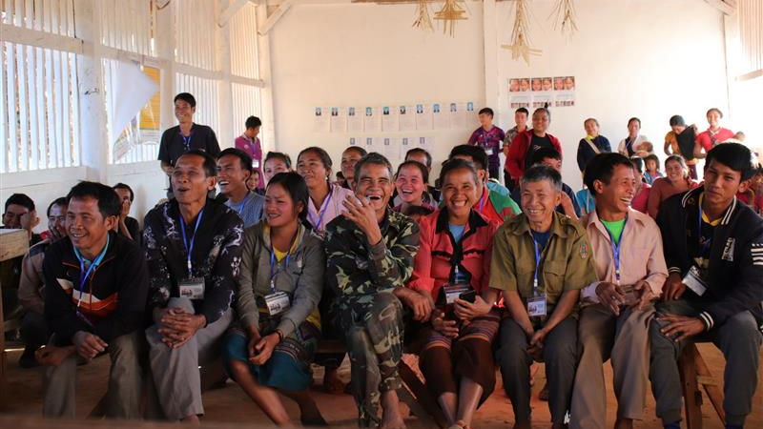
Thank you!

