Slide 1
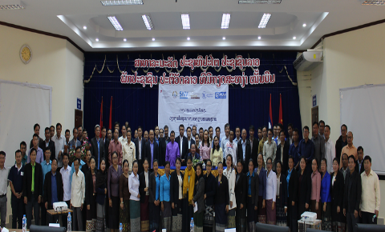
ກອງປະຊຸມແລກປ່ຽນບົດຮຽນດ້ານໂພຊະນາການຂອງຫຼາຍຂະແໜງການໃນຂັ້ນແຂວງ
ແຂວງຫົວພັນ ແລະ ອຸດົມໄຊ

Slide 2
ຜູ້ເຂົ້າຮ່ວມ
ຜູ້ເຂົ້າຮ່ວມແມ່ນຈະຖືກເຊີນມາຈາກພາກລັດຖະບານ ແລະ ອົງການຈັດຕັ້ງທາງສັງຄົມ, ຊຶ່ງລວມມີບັນດາອົງກອນສະມາຊິກຂອງ SUN CSA. ຖ້າຫາກມີອົງກອນຂອງ ສະຫະປະຊາຊາດ ແລະ ຄູ່ຮ່ວມພັດທະນາອື່ນໆທີ່ເຮັດວຽດ້ານໂພຊະນາການຢູ່ພາຍໃນແຂວງ, ເຂົາເຈົ້າເຫຼົ່ານີ້ກໍ່ຈະຖືກເຊີນເຂົ້າຮ່ວມ.
Notes:
Participants are invited from government and civil society organisations, including SUN CSA organisations. If there are UN or other development partners working on nutrition in the province, they should be invited too.
Normally key government participants include the PNC, the District Nutrition Committee (DNC) members. Other Provincial/district-based staff can attend if invited. Limits are usually based on the funding available. National Nutrition Centre (NNC) should also be invited, along with any other national level ministries as prioritised by the funders of the event.
Normally any SUN CSA organisation working in the province is invited to attend, again focusing on key nutrition staff. Limits are usually based on the funding and space available
Generally, each workshop will contain presentations from different stakeholders about what they have learnt when implementing nutrition projects. What worked for them? What didn’t work? How can the successes be repeated by others? How can the challenges be avoided by others. As the workshop will provide approaches from different sectors, there may be tools or ideas from one sector that could be replicated or repeated in a different sector or project.
The workshops aim to inspire us to do nutrition activities better and more often.

Slide 3
“ບົດຮຽນສຳລັບການແລກປ່ຽນ” ທີ່ຈະເອົາມານໍາສະເໜີໃນກອງປະຊຸມແມ່ນຫັຍງ?
ປະເດັນນີ້ຖືວ່າສຳຄັນຫຼາຍ. ກອງປະຊຸມຈະໜ້າເບື່ອ ແລະ ບໍ່ໜ້າຕິດຕາມ ຖ້າພວກເຮົາພຽງແຕ່ລາຍງານໃນສິ່ງທີ່ພວກເຮົາໄດ້ຈັດຕັ້ງປະຕິບັດຜ່ານມາ ໂດຍບໍ່ໄດ້ຍົກໃຫ້ເຫັນບົດຮຽນກ່ຽວກັບສິ່ງທີ່ເຮັດແລ້ວໄດ້ຜົນ ແລະ ສາມາດນຳໄປປັບໃຊ້ກັບຜູ້ອື່ນໄດ້.
ແມ່ນຫັຍງທີ່ເຮັດແລ້ວໄດ້ຜົນສໍາລັບໂຄງການເຮົາ?
ເປັນຫຍັງມັນຈຶ່ງໄດ້ຜົນ? ຜູ້ອື່ນຈະສາມາດນຳໄປຈັດຕັ້ງປະຕິບັດເພື່ອໃຫ້ໄດ້ຮັບຜົນເຊັ່ນດຽວກັນໄດ້ຄືແນວໃດ?
ແມ່ນຫັຍງທີ່ເຮັດແລ້ວບໍ່ໄດ້ຜົນສຳລັບໂຄງການເຮົາ? ເປັນຫຍັງມັນຈຶ່ງບໍ່ໄດ້ຜົນ? ມີຫຍັງແດ່ທີ່ຜູ້ອື່ນຄວນຈະເຮັດເພື່ອບໍ່ໃຫ້ພົບບັນຫາຄືກັບເຮົາ?
ອຸປະກອນ/ຊັບພະຍາກອນ ທີ່ເປັນປະໂຫຍດແມ່ນຫຍັງ? ນຳສະເໜີວ່າມີຫຍັງແດ່. ອະທິບາຍວ່າເປັນຫຍັງສິ່ງເຫຼົ່ານັ້ນຈຶ່ງສຳຄັນ.
Notes:
What are examples of ‘lessons learned’ that could be good to present at the Workshop?
This is important to consider. These workshops can easily become boring if we only report on what we did, rather than what worked and can be replicated.
Presentations could include powerpoint, posters, videos, photos, diagrams, demonstrations (like cooking demonstrations) or materials.
Presentations should focus on:
1. What worked in the project? Why did it work? How can others repeat this for success?
2. What didn’t work? Why did it not work? What can others do to avoid repeating this?
3. What materials/resources were useful? Show these. Explain why they are important.

Slide 4
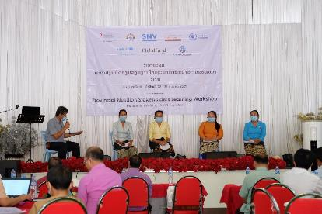
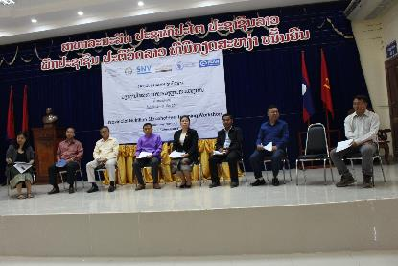
ເວທີສົນທະນາ

Slide 5
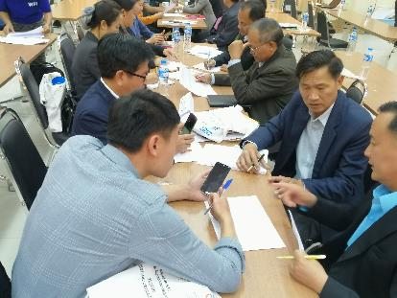
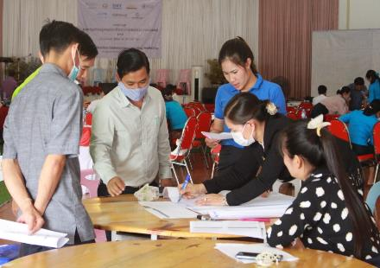
ສົນທະນາກຸ່ມກ່ຽວກັບແຜນວຽກໂພຊະນາການຂອງເມືອງ

Slide 6
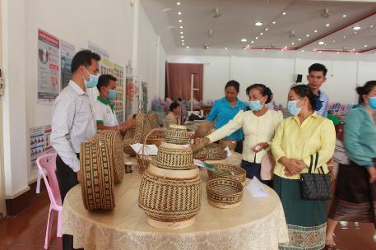
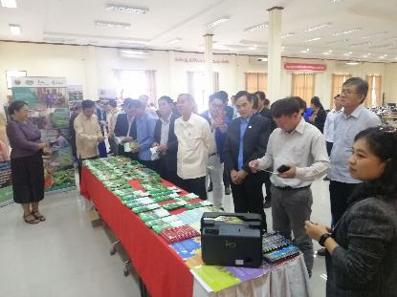
ວາງສະແດງ

