Slide 1

National Information Platforms for Nutrition (NIPN)
in Lao PDR

Slide 2
What is NIPN?
The National Information Platforms for Nutrition (NIPN) is an international initiative of the European Union
It is implemented in 10 countries globally
Lao PDR is the only country in South East Asia.

Slide 3
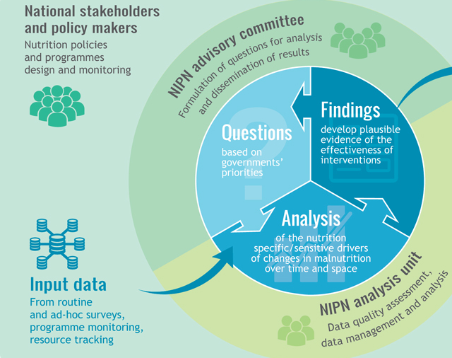
Objectives
Overall Objective: To contribute to the global reduction of stunting (chronic undernutrition) in alignment with the World Health Assembly 2025 targets.
Specific Objective: To strengthen capacities in Lao PDR to monitor progress towards undernutrition reduction, and implement more cost-effective and evidence based policies.

Slide 4
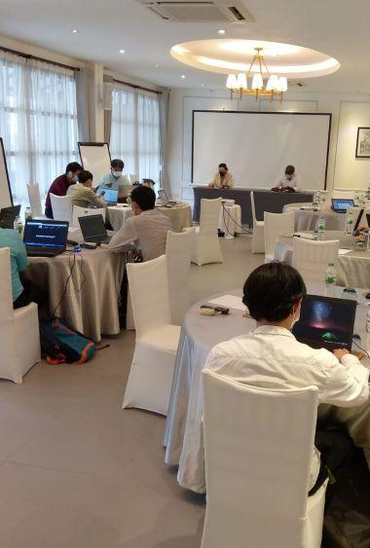
Key Expected Results
Result Area 1: Improved capacity within national institutions to operate and maintain a functional NIPN.
Result Area 2: Strengthened capacity to track progress in meeting national objectives to prevent under-nutrition and monitor nutrition investments.
Result Area 3: Strengthened capacity of government staff to make better use of evidence and data to design and implement nutrition-related policies and programmes

Slide 5
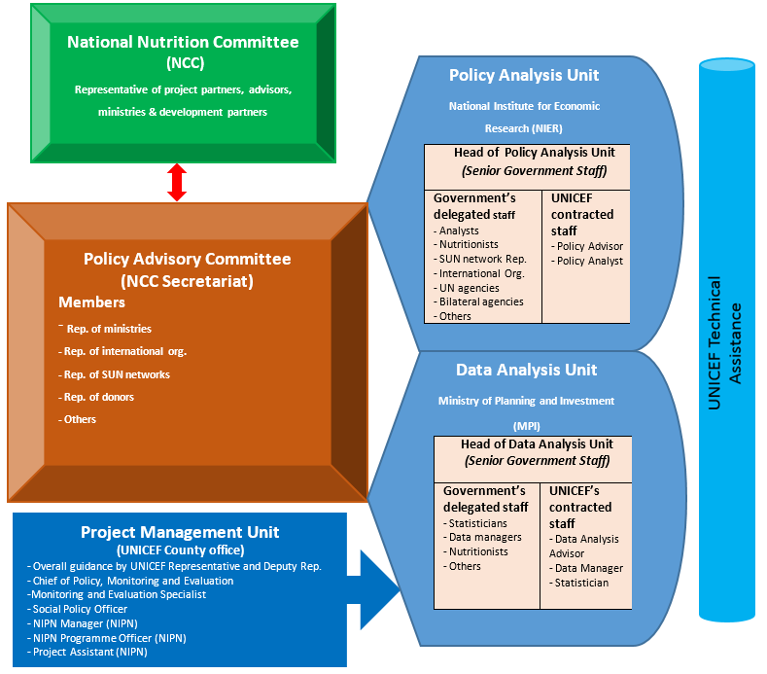
NIPN Structure
Notes:
NIPN Advisory Task force
Coordinate line ministries, NNC-Sec, Nutrition Centre, SUN Networks and NNC members
Convene meetings of the key stakeholders in nutrition
Line Ministries
National Nutrition Committee Secretariat members
SUN Networks (includes Development partners)
The NIPN Data Analysis Unit is responsible for;
Coordinate across different information systems
Map sources of data of interest to the NIPN and define the principles for sharing and using data
The NIPN Policy Unit is responsible for;
Coordinating and convening the NIPN Policy Advisory Committee
Preparing key findings from data analysis

Slide 6
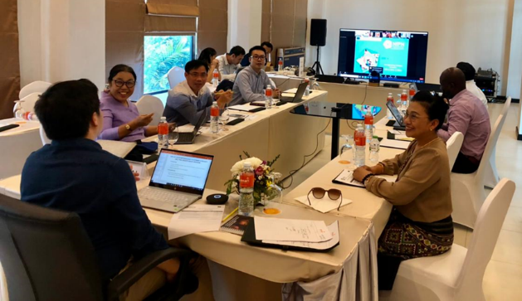
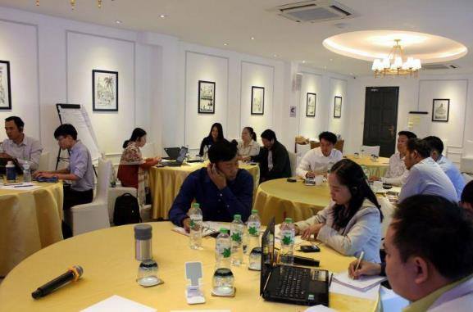

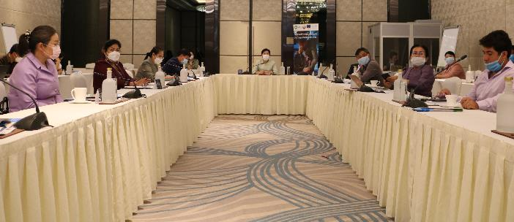



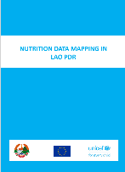

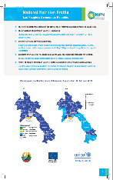
Achievements so far…
6
Participated in 3rd NIPN Global Gathering (Virtual)
Governance & South-South learning
System strengthening through capacity building of government staff
Data and Evidence generation
Engagement with academia and researchers

Slide 7
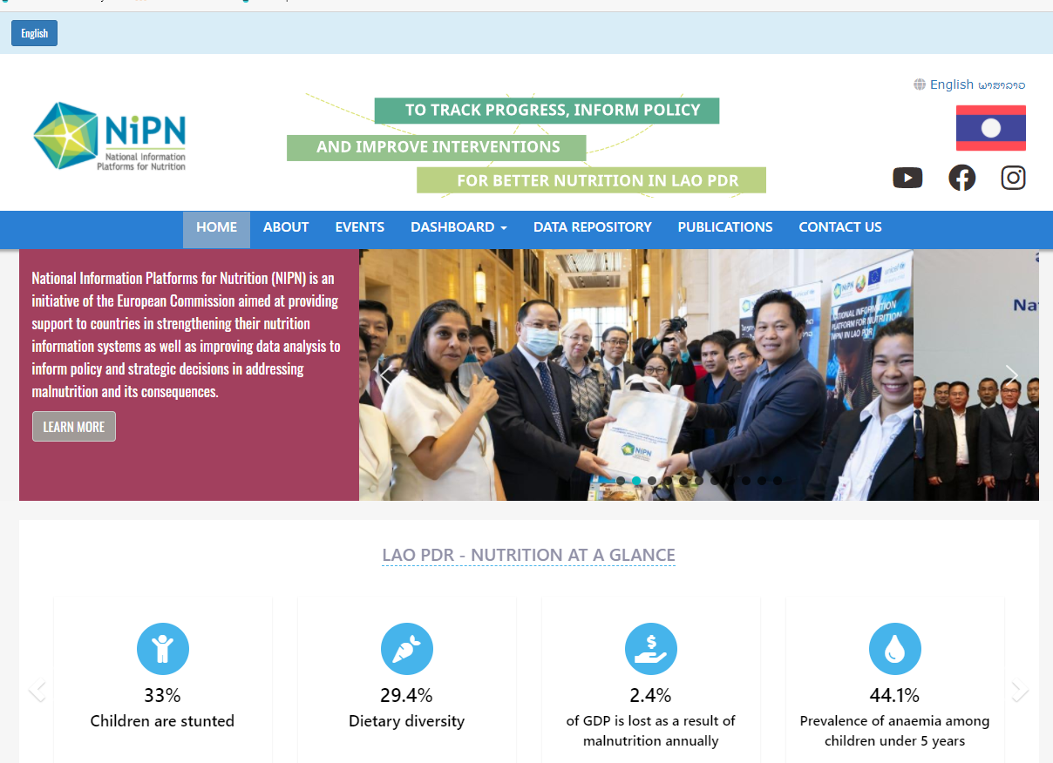

Achievements so far…
SNNIS
https://nipn.lsb.gov.la/
Notes:
System established for NSS
Manuals
Training package
Online Capi-ONA
BUT ownership and consistency issues
NIPN
Dashboard and repository established
Access through link
Publications based on analyzed data
Various reports
SNNIS– Elementary stages
Kick off meeting done
Selection of indicators ongoing
Used opportunity of RMNCAH review to improve nutrition data

Slide 8
NIPN Phase 2: July 2022 – Dec. 2025
To contribute to delivering the commitments and strategic priorities of the European Union on the 2030 Agenda to end all forms of malnutrition in Lao PDR by 2030 (in particular SDG 2.2)
Overall Objective
To consolidate and institutionalize NIPN in Lao PDR, by strengthening its strategic and analytical capacity to produce disaggregated information for more effective decision-making on nutrition
ER 1: Strengthened capacity within national institutions to generate quality nutrition data for knowledge & evidence for policy decisions
ER 2: Strengthened capacity of government staff to make better use of data and evidence to design and implement nutrition-related policies and programmes
ER 3: Strengthened capacity for improved nutrition governance and accountability through tracking of progress in meeting national targets and monitoring nutrition investments.
Specific Objective
Notes:
NIPN 2 shall focus on;
Consolidation of gains of phase 1
Institutionalization for government take over/sustainability
System strengthening on data analysis and use at both central and sub national level
Contributing to nutrition governance

Slide 9
Guiding principles
The following shall underpin the NIPN process in Lao PDR.
  Participation and Government-ownership
  Data equity and context appropriateness
  Partnership and value addition
  System strengthening
  Multi-sectorality

Slide 10
Leverage effect and contribution of SUN CSA and DPs
Data analysis and information sharing
Strengthening data repository – sharing data on project assessments/research
Evidence based advocacy
Boosting NIPN website and vice versa

Slide 11

END
NIPN Team, Lao PDR

